Slide 2
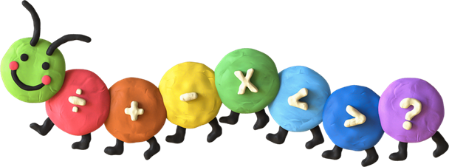

04
Fun corner
Word Game

Slide 3




Slide 4


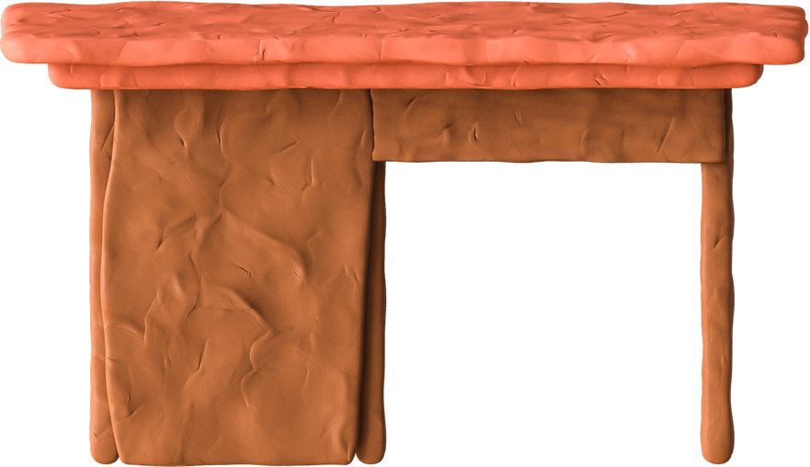
Goodbye
See you later

