Slide 2







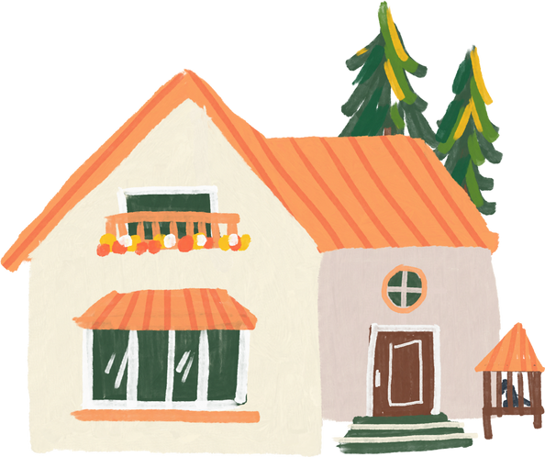
01
Warm-up and review

Slide 3
05
Fun corner and wrap-up

Slide 4
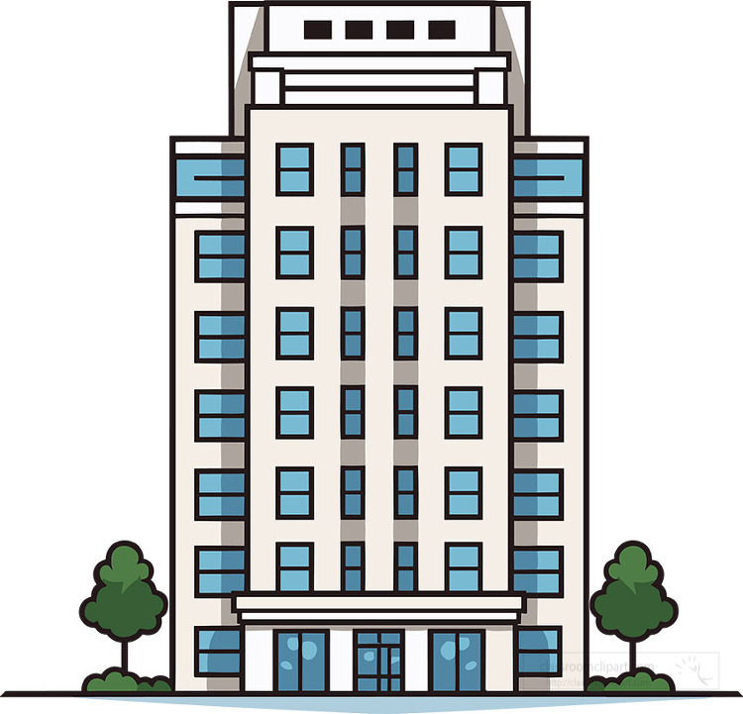
live / Do / this / you / builing / in / ?
Do you live in this building?

Slide 5


Complete:
you / live / this / tower?
Do you live in this tower?

Slide 6

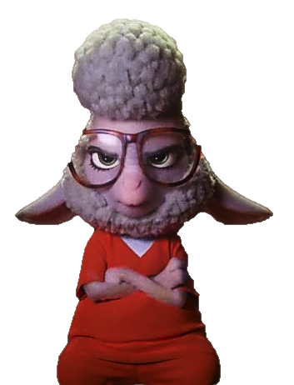



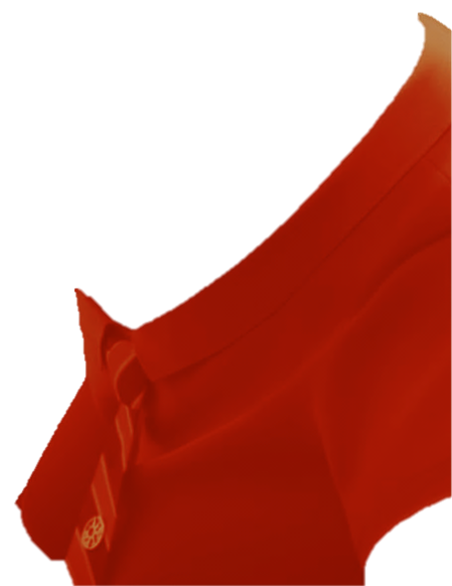



Good job!
Bellwether
Flash
Finnick

Slide 7
Website: hoclieu.vn
Fanpage: facebook.com/www.tienganhglobalsuccess.vn

