Slide 2







Unit 2:In the backyard
Lesson 2 – Period 2

Slide 3


Slide 4










Class Rules

Slide 5



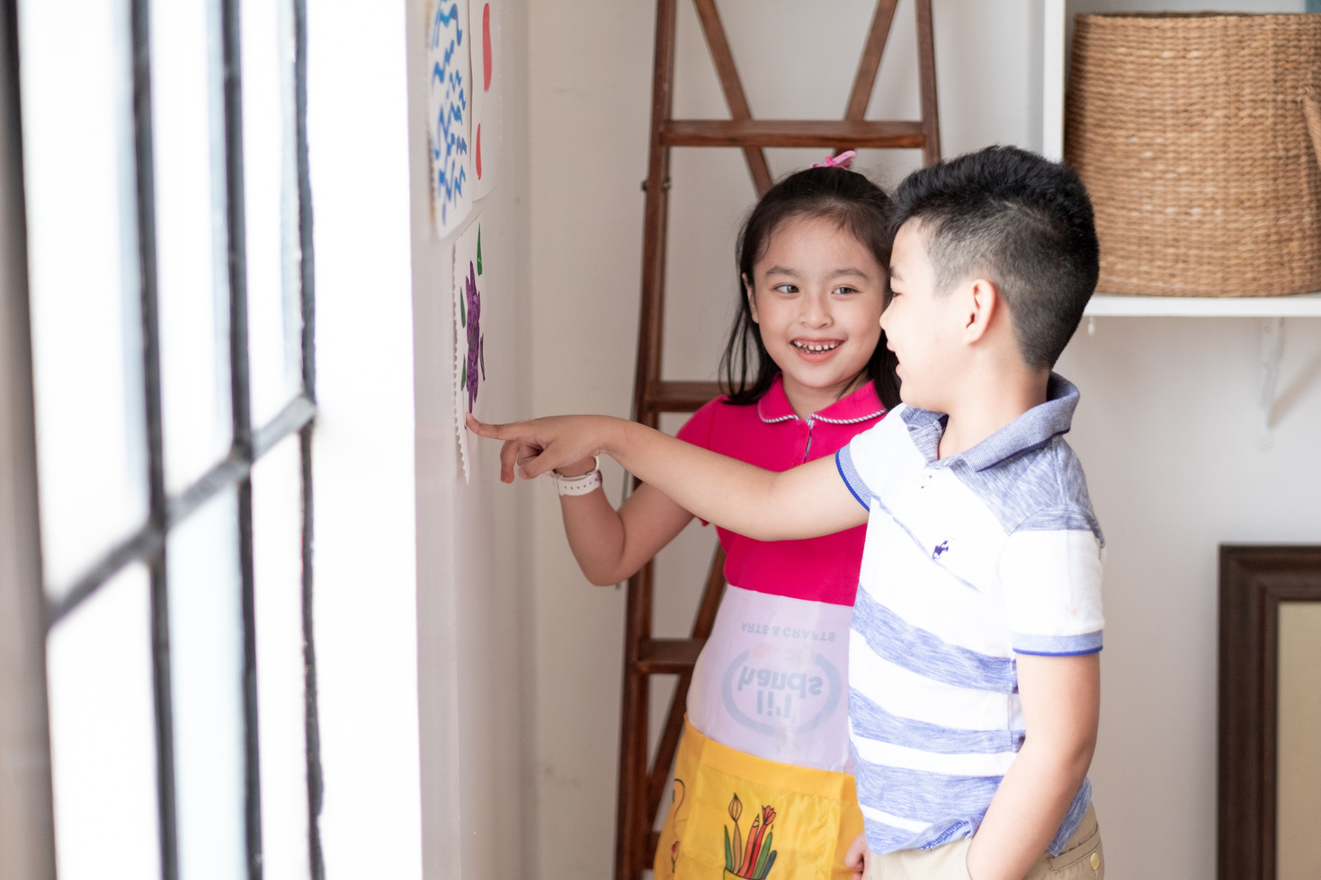



Rule 1
Listen to
your friend
talking in front.

Slide 6


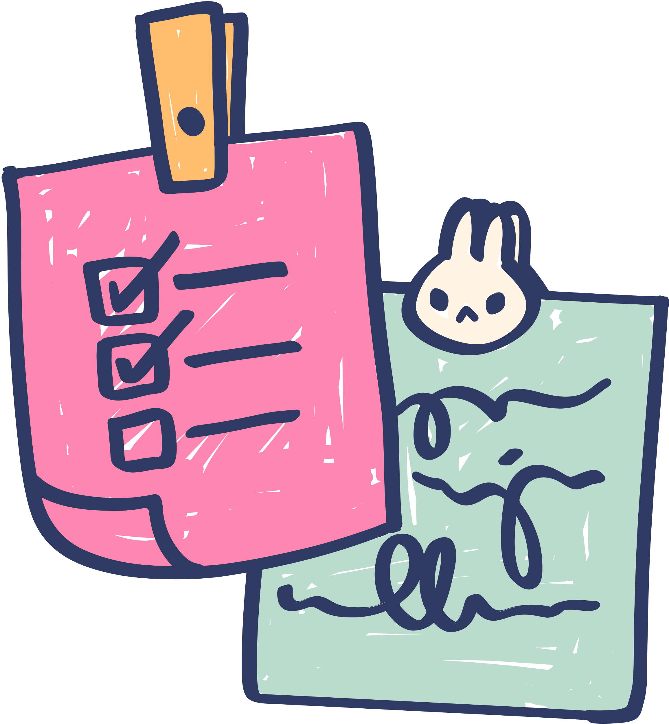





Rule 2
Raise your hand
if you have a question.

Slide 7




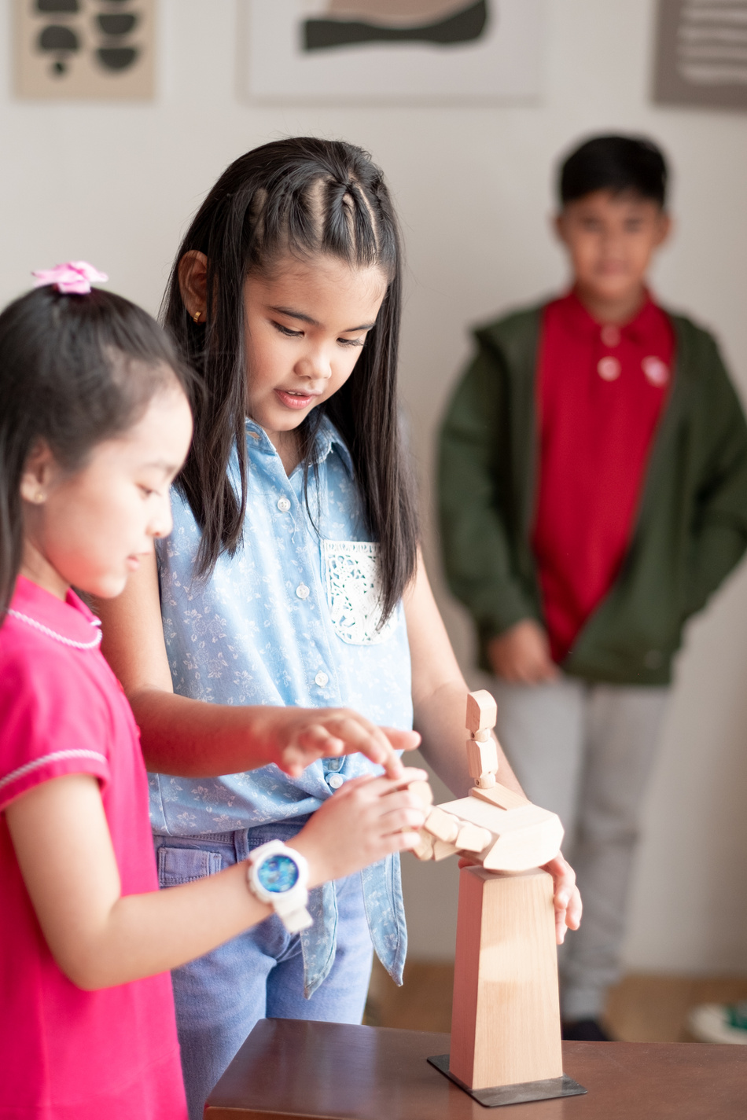


Rule 3
Wait for
your turn.

Slide 8
TABLE OF CONTENT
1. Warm-up & review
2. Activity 3: Listen and chant
3. Activity 4: Listen and circle
4. Activity 5:Look and write
5. Fun corner & wrap-up

Slide 9
01
Warm-up and review
Game: “Odd one out”

Slide 10


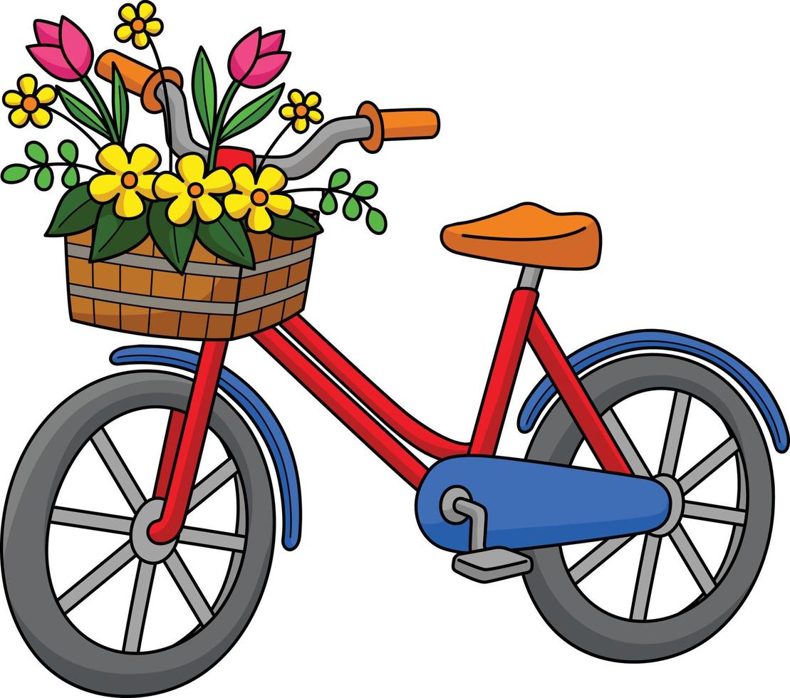
Game: “Odd one out”

Slide 11






02
Activity 3
Listen and chant

Slide 12




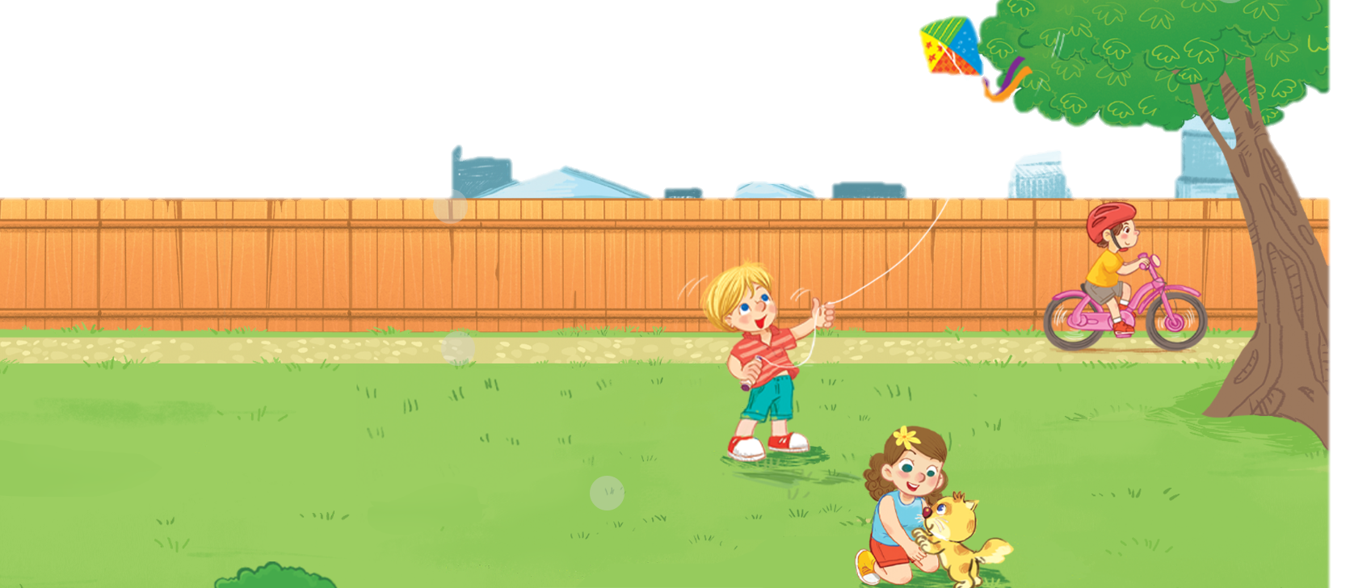
Unit
3. Listen and chant.

Slide 13
03
Activity 4
Listen and circle

Slide 14
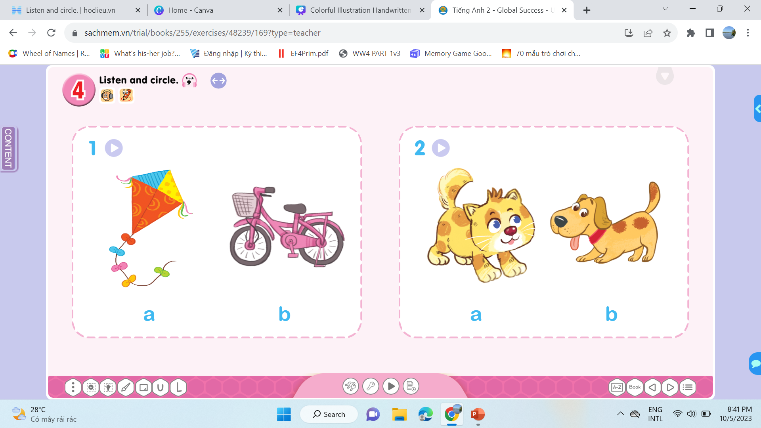
Unit
I have a ….

Slide 15
04
Activity 5
Look and write

