Slide 2









Our Home
Lesson 2 - Period 3

Slide 3








01
Warm-up and review
SLAP THE BOARD
SLAP THE BOARD
Notes:
- T numbers SS in each team
- T call out a number, ss with that number stand up and say the answee
- SS who have the fastest and correct answer will get 2 points, the slower correct answer will get 1 point

Slide 4
Review
Numbers 1 - 100

Slide 5
02
Look, listen and repeat.
Notes:
- T numbers SS in each team
- T call out a number, ss with that number stand up and say the answee
- SS who have the fastest and correct answer will get 2 points, the slower correct answer will get 1 point

Slide 6
What's your address?
It's 45 Ba Trieu Street.

Slide 7
03
Listen, point and say.
Notes:
- T numbers SS in each team
- T call out a number, ss with that number stand up and say the answee
- SS who have the fastest and correct answer will get 2 points, the slower correct answer will get 1 point

Slide 8
What's your address?
It's _______ street.

Slide 9
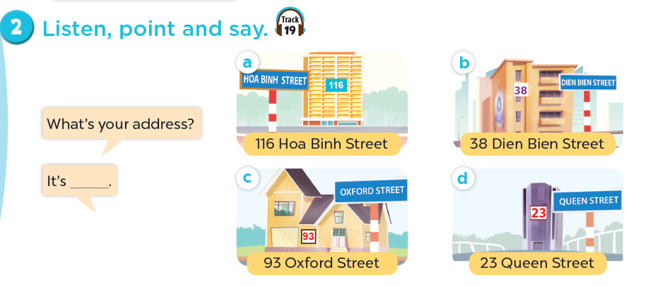
Work in pairs. Practise.
What’s your address ?
116 Hoa Binh Street
38 Dien Bien Street
It’s ______ .
93 Oxford Street
23 Queen Street

Slide 10
04
Let's talk.
Notes:
- T numbers SS in each team
- T call out a number, ss with that number stand up and say the answee
- SS who have the fastest and correct answer will get 2 points, the slower correct answer will get 1 point

Slide 11
05
Fun corner and wrap-up
Notes:
- T numbers SS in each team
- T call out a number, ss with that number stand up and say the answee
- SS who have the fastest and correct answer will get 2 points, the slower correct answer will get 1 point

Slide 12




…but, don’t have
bad luck like Billy.

Slide 13
Website: hoclieu.vn
Fanpage: facebook.com/www.tienganhglobalsuccess.vn

