Slide 2









Our Home
Lesson 2 - Period 4

Slide 3

Table of contents
01
02
03
Listen and circle.
Read and complete.
Warm-up and review
04
05
Listen, complete and sing.
Fun corner and wrap-up

Slide 4







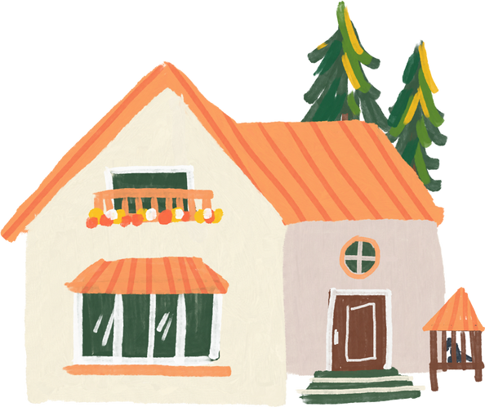
01
Warm-up and review

Slide 5
02
Listen and circle.

Slide 6
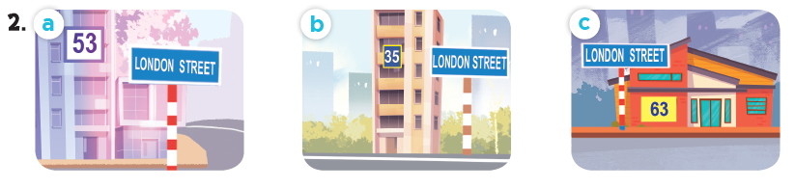
Look and say the number.
fifty-three
thirty-five
sixty-three

Slide 7

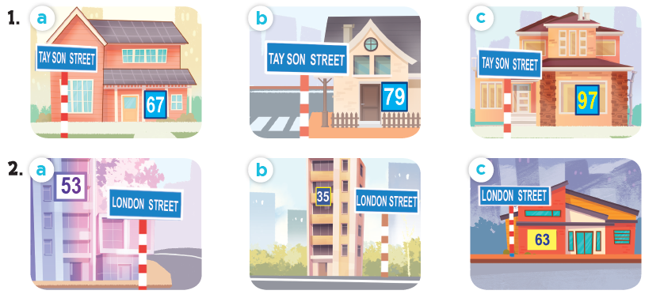
Listen and circle.

Slide 8
03
Read and complete.

Slide 9
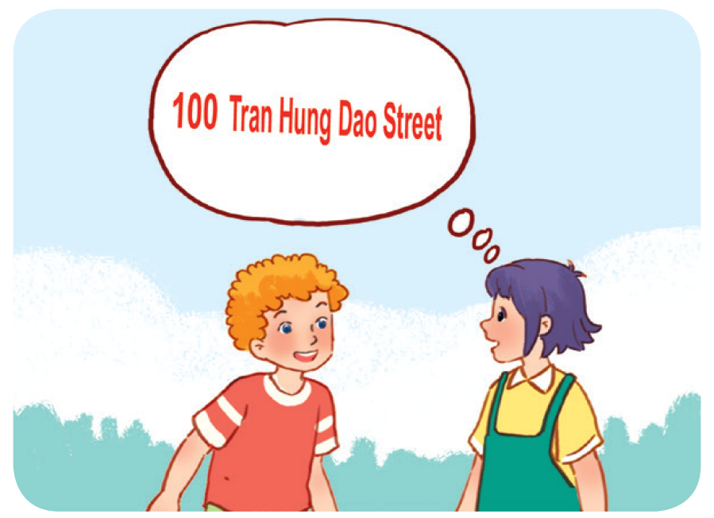
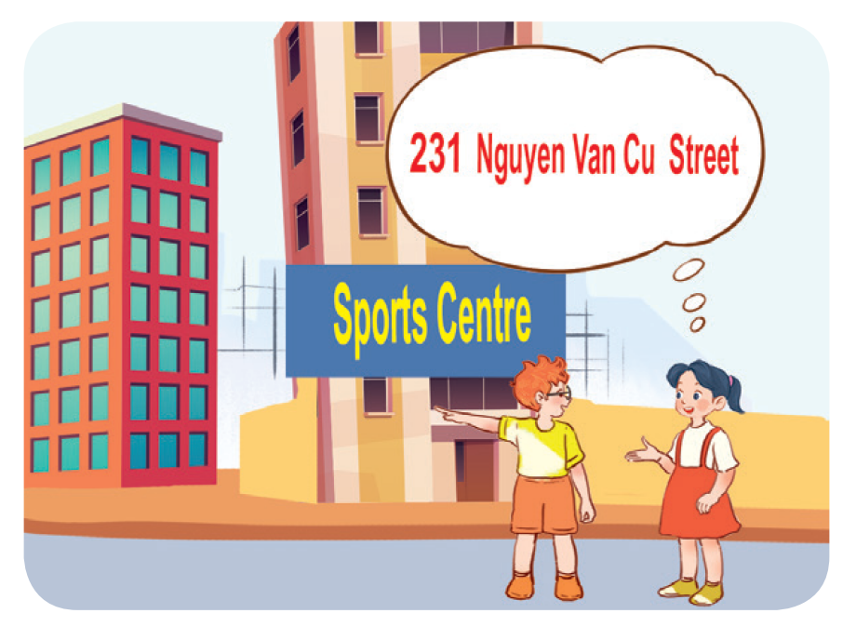
Work in pairs. Read and complete.
1. A: What’s your address?
B: It’s ________________.
A: Is it far ________________ here?
B: Yes, it is. It’s about ten kilometres from here.
2. A: I live in ________________ building over there.
B: Oh, it’s near the sports centre.
A: ________________ do you live?
B: I live far from here, in District 5.
A: ________________ your address?
B: It’s ________________.

Slide 10
Work in pairs. Read and complete.
1. A: What’s your address?
B: It’s ________________________.
A: Is it far ______ here?
B: Yes, it is. It’s about ten kilometres from here.
100 Tran Hung Dao Street
from

Slide 11
04
Listen, complete and sing.

Slide 12
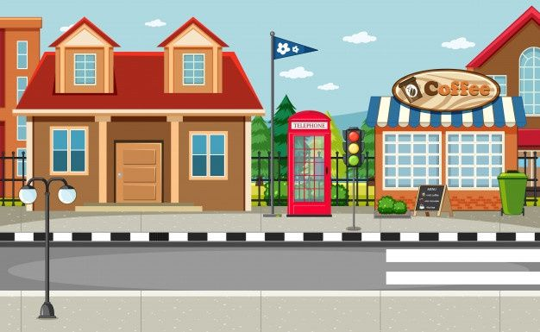



What’s your address?
32
Oxford
It’s _________________.
32 Oxford Street

Slide 13
Website: hoclieu.vn
Fanpage: facebook.com/www.tienganhglobalsuccess.vn

