Slide 2









Our Home
Lesson 3 - Period 6

Slide 3

Table of contents
01
02
03
Read and tick True or False.
Let’s write.
Warm-up and review
04
05
Project
Fun corner and wrap-up

Slide 4








01
Warm-up and review

Slide 5
02
Read and tick True or False.

Slide 6
03
Let’s write.

Slide 7
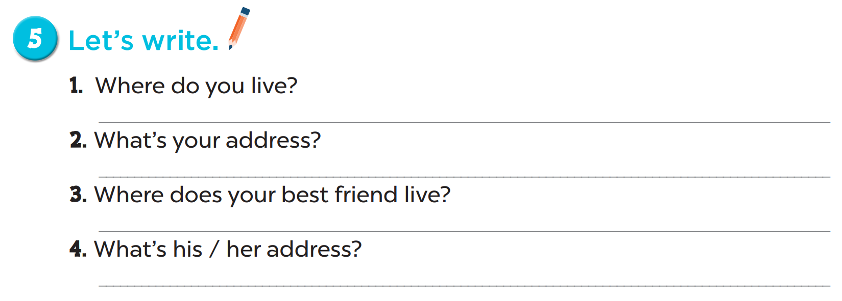

Slide 8
1. Where do you live?
2. What’s your address?
3. Where does your best friend live?
4. What’s his / her address?
I live in …
My address is …
He / She lives in …
Her / His address is …

Slide 9
04
Project

Slide 10
05
Fun corner and wrap-up

Slide 11
Website: hoclieu.vn
Fanpage: facebook.com/www.tienganhglobalsuccess.vn

