Slide 1


Time and daily routines
2
Lesson 1 - Period 1

Slide 2
01
Warm-up & Review

Slide 3
02
Look, listen and repeat.

Slide 4
03
Listen, point and say.

Slide 5
Vocabulary

Slide 6
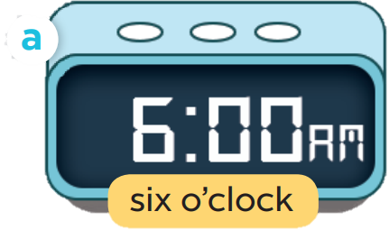
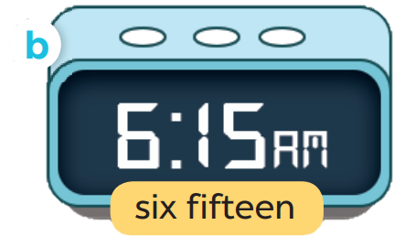
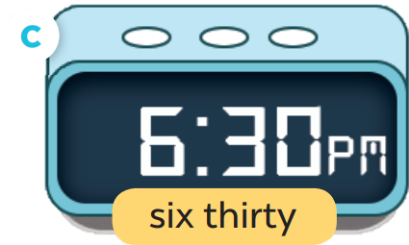
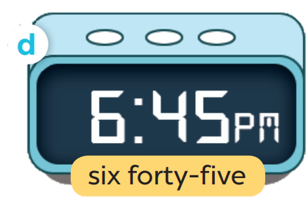

Slide 7
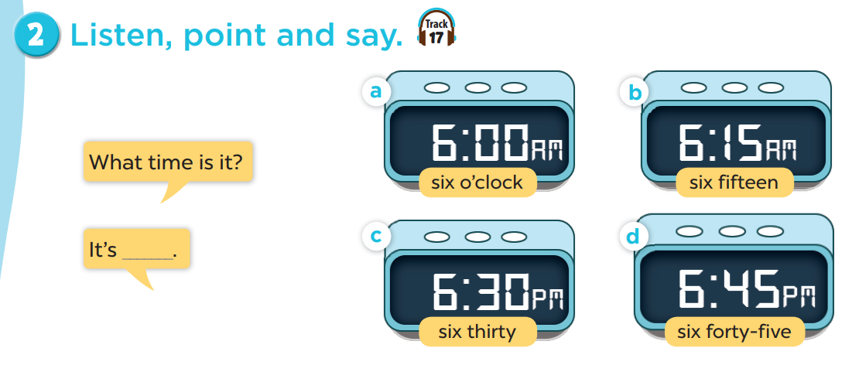


Slide 8

What time is it?
I six o’clock.

Slide 9
04
Let’s talk.

Slide 10
