Slide 1


Time and daily routines
2
Lesson 1 - Period 2

Slide 2
Table of contents
01
Warm-up and review
04
02
03
Let’s play.
05
Fun corner & wrap-up
Listen and tick.
Look, complete and read.

Slide 3
01
Warm-up & review

Slide 4
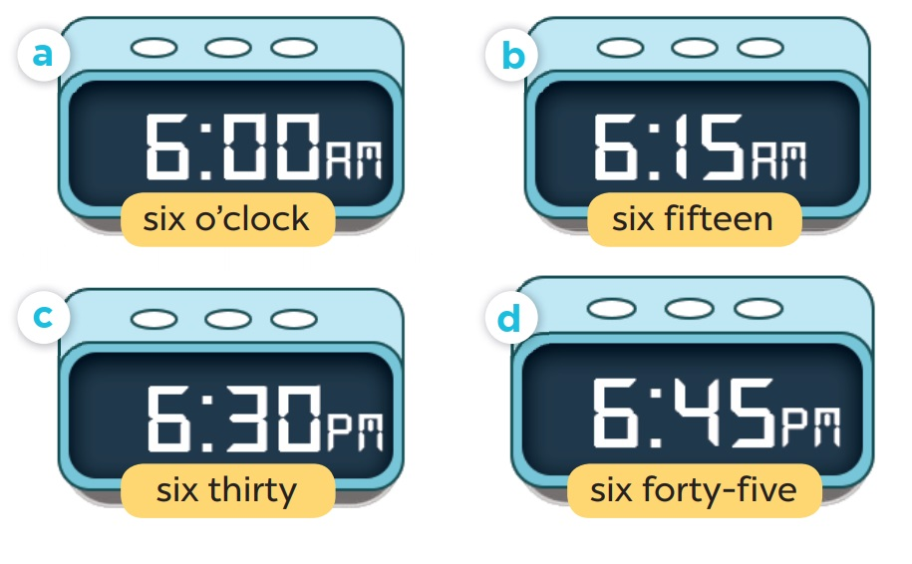
Slap the board

Slide 5
02
Listen and tick.

Slide 6
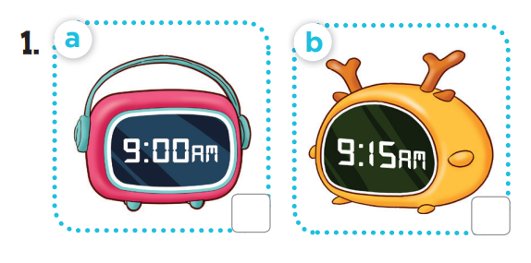
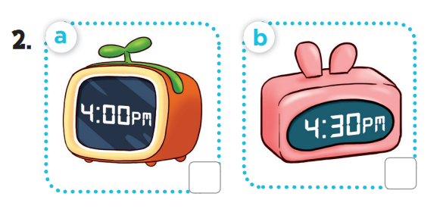

Slide 7
03
Look, complete and read.

Slide 8
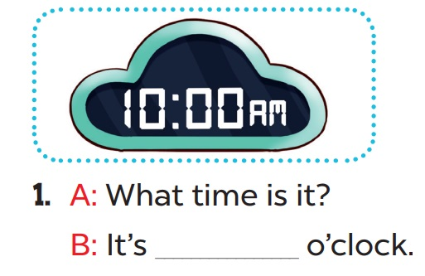
ten

Slide 9
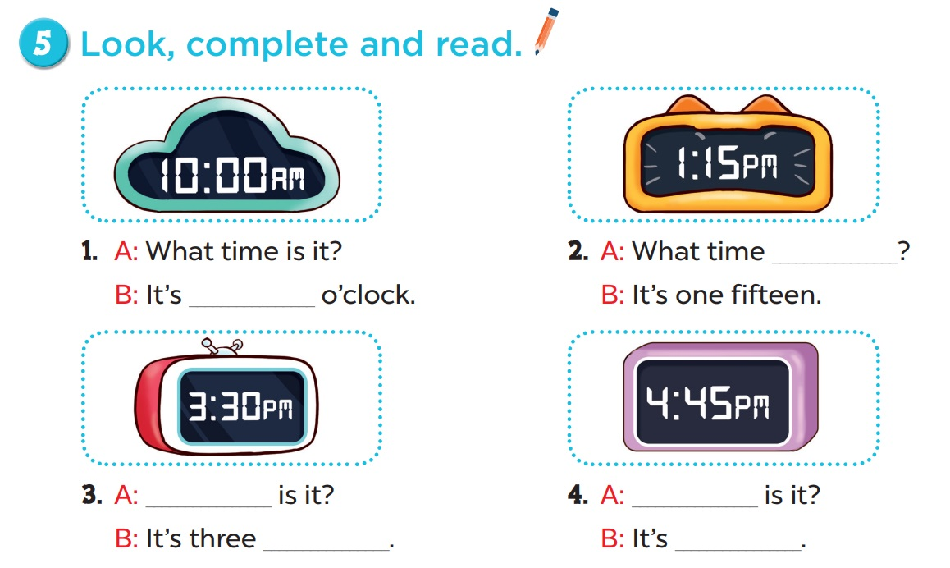
is it
ten
What time
What time
thirty
four forty-five

Slide 10
04
Let’s play.

Slide 11
