Slide 1

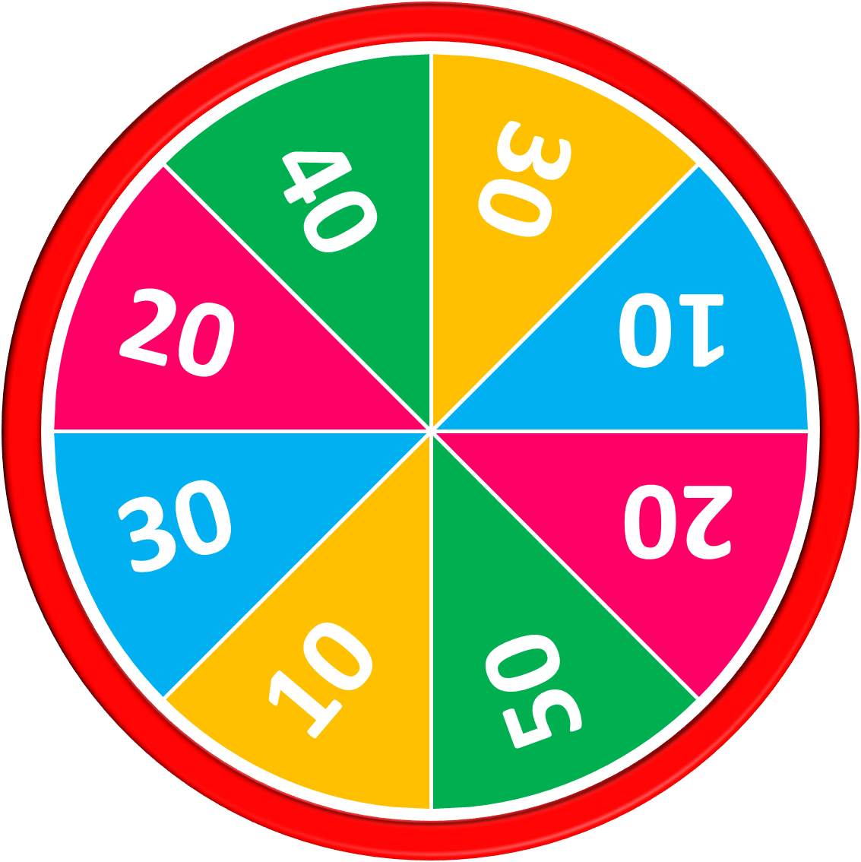
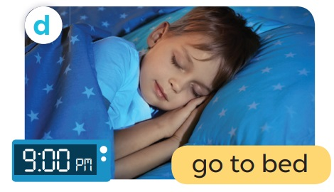
50
10
20
30
10
20
Answer
30
40
A: What time do you go to bed?
B: I go to bed at nine o’clock.
Stop
Spin

Slide 2

50
10
20
30
10
20
30
40
Exit

