Slide 1


Time and daily routines
2
Lesson 2 - Period 4

Slide 2
01
Warm-up & review

Slide 3

Slap the board!
Notes:
Teacher can read the action or time

Slide 4
02
Listen and number.

Slide 5
03
Look, complete and read.

Slide 6
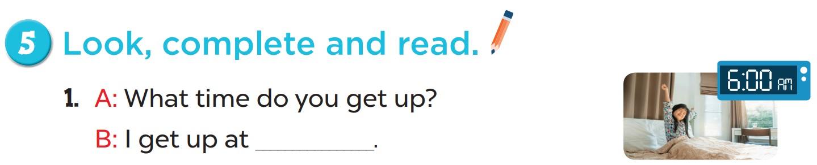
6 o’clock

Slide 7
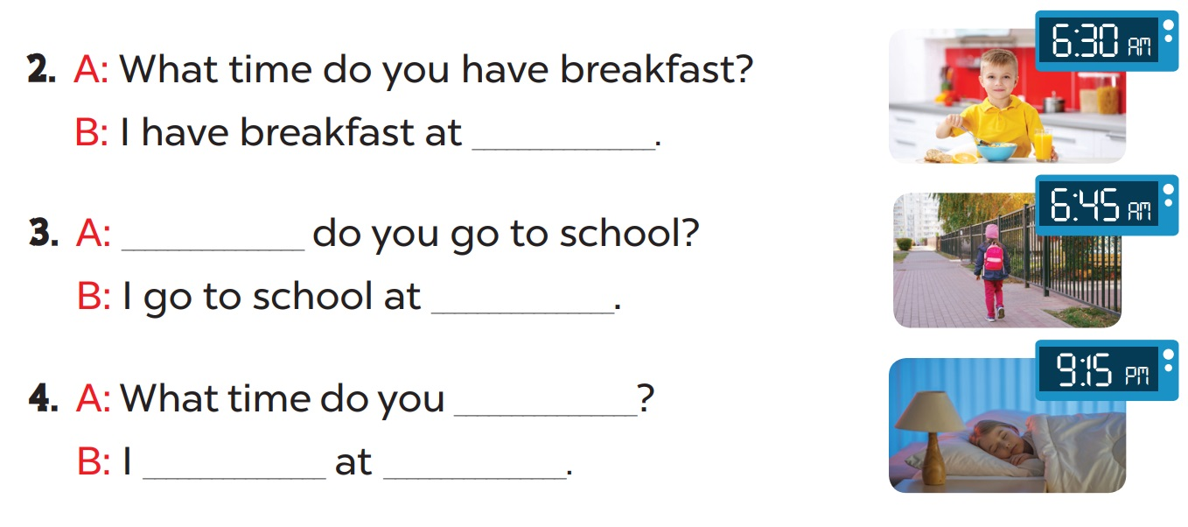
six thirty
What time
six forty-five
go to bed
go to bed
nine fifteen

Slide 8
04
Let’s sing.

