Slide 1


Time and daily routines
2
Lesson 3 - Period 6

Slide 2
01
Warm-up & review

Slide 3
02
Read and match.

Slide 4
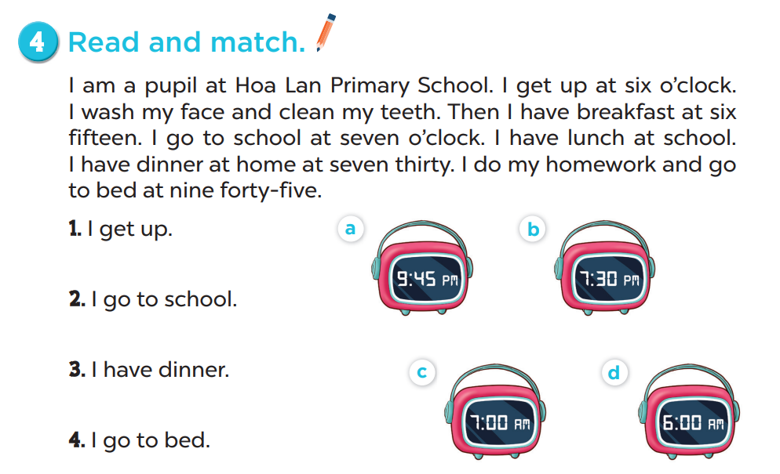

Slide 5
03
Let’s write.

Slide 6
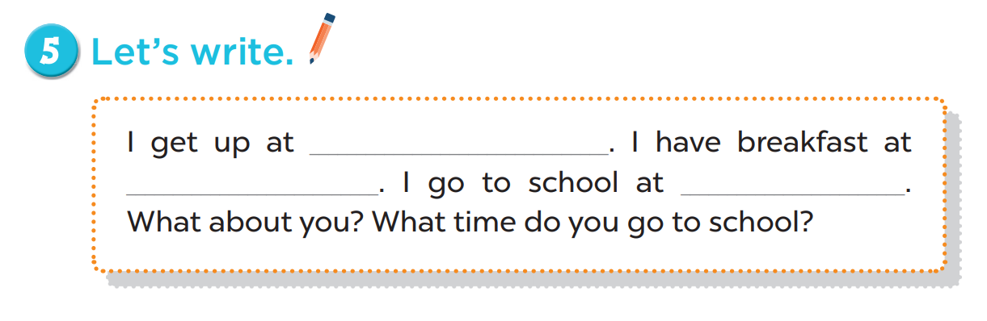
six o’clock
six thirty
seven o’clock

Slide 7
04
Project

Slide 8
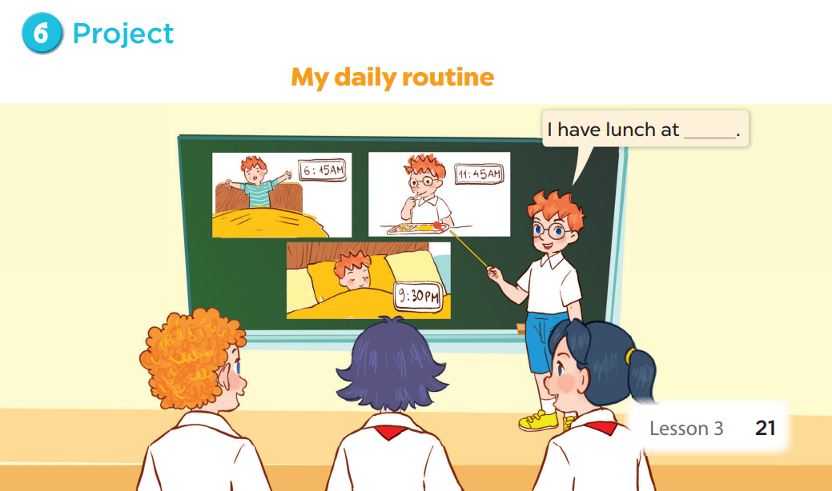

Slide 9
05
Fun corner & wrap-up

