Slide 1
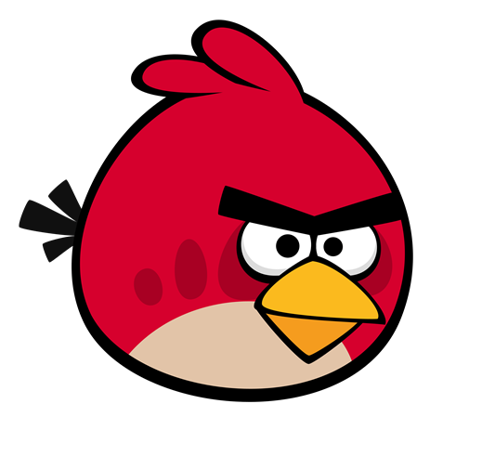
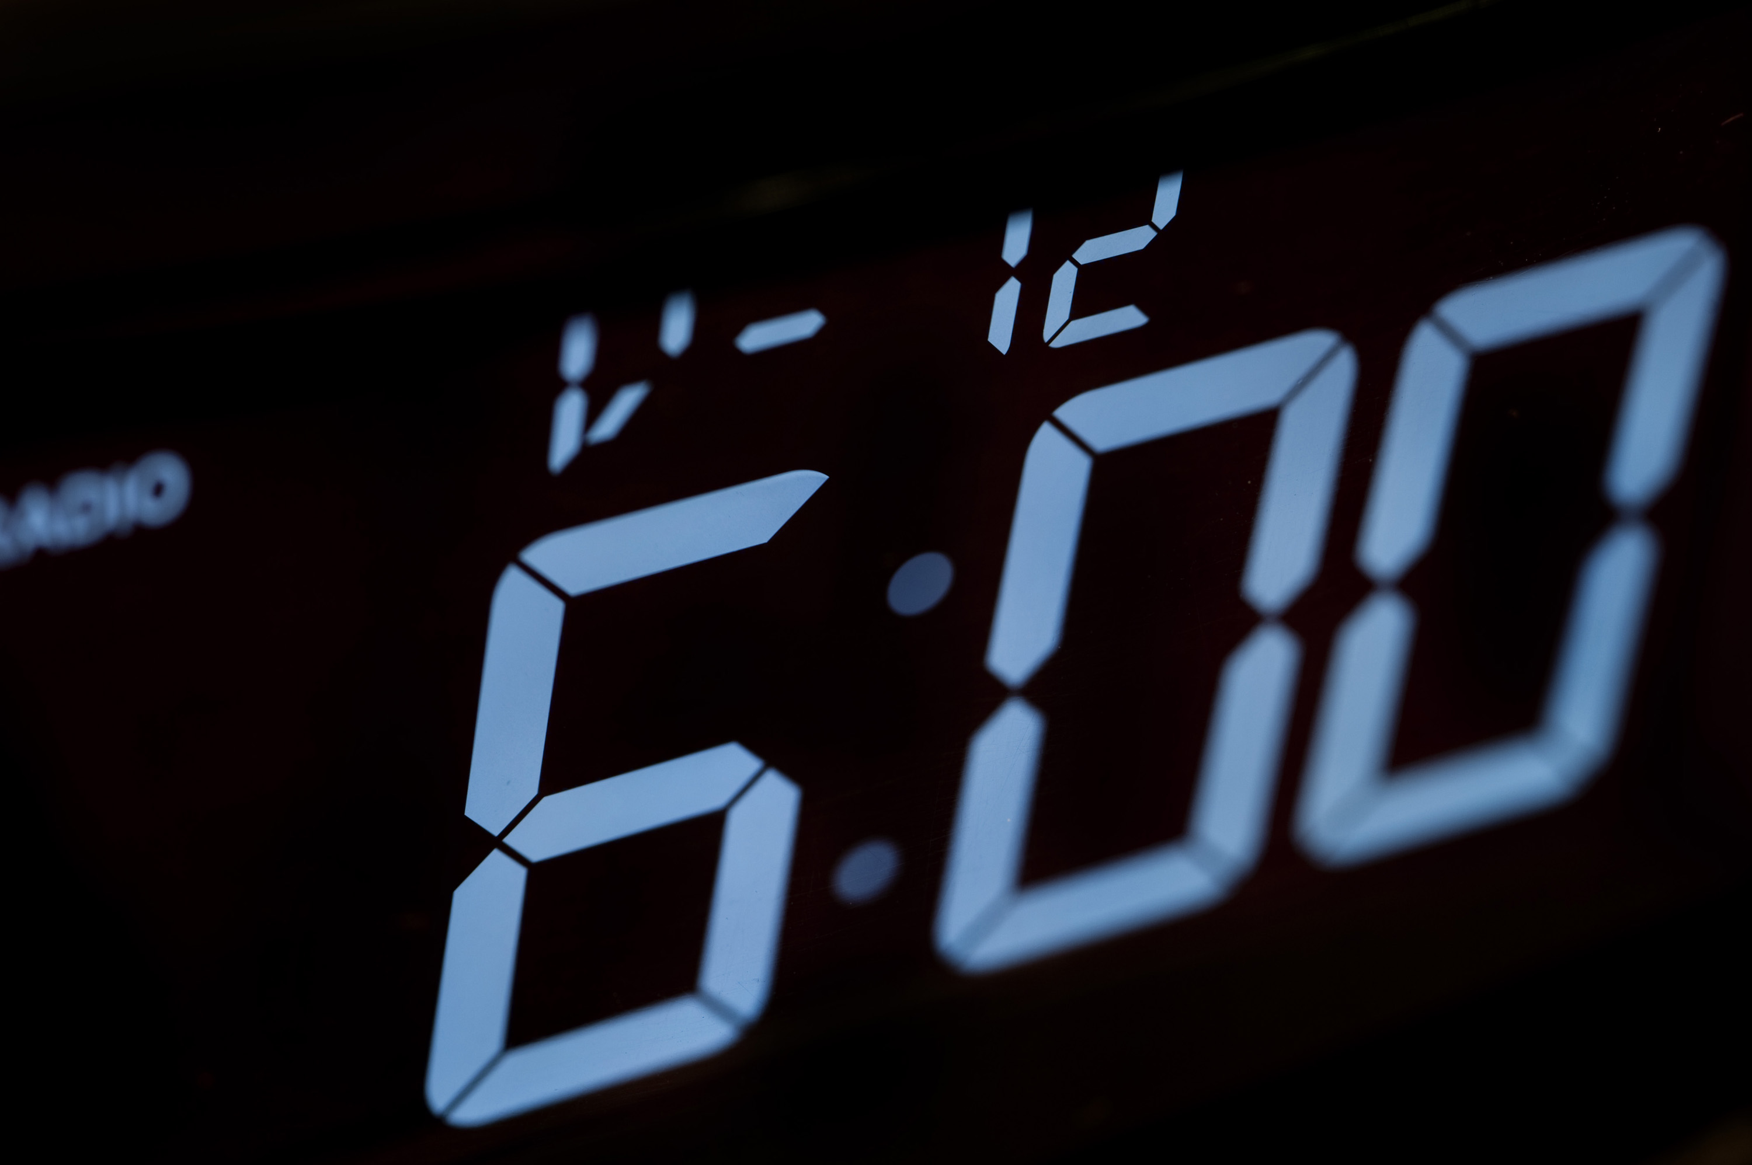




Câu hỏi 2
A. I get up at six fifteen.
B. I get up at six
forty-five.
+5
-1
-1
-1
C. I get up at six o’clock.
D. I get up at six thirty.

Slide 2




Great job!
Exit

