Slide 2


Unit 3: At the seaside
Lesson 1 – Period 1

Slide 3
TABLE OF CONTENTS
  Warm-up & Review
  Activity 1: Listen and repeat.
  Activity 2: Point and say.
  Fun corner & Wrap-up

Slide 4
01
Warm-up & Review
Game: Sing and complete

Slide 5





Unit
03
Activity 2
Point and say.

Slide 6



Unit
Point and say.
GROUP WORK

Slide 7

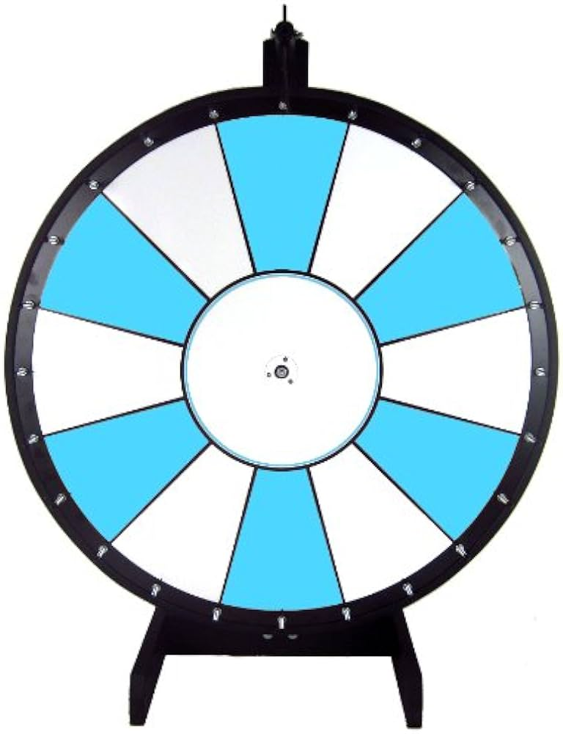





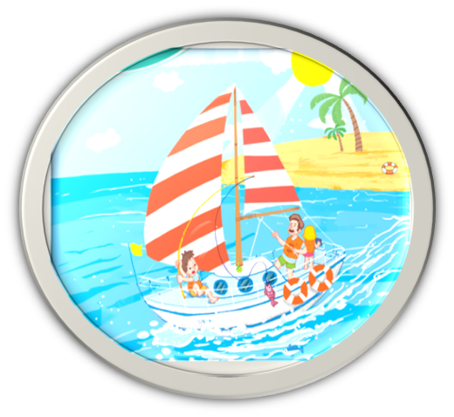
Unit
Point and say.
Notes:
Click the hand to spin and stop the wheel

