Slide 2

TEAM WORK
Team 1
Team 3
Team 5
Team 2
Team 4
Team 6
Notes:
Click to choose the Team
Click the word Team to congratulate

Slide 3

TEAM WORK
Chant

Slide 4





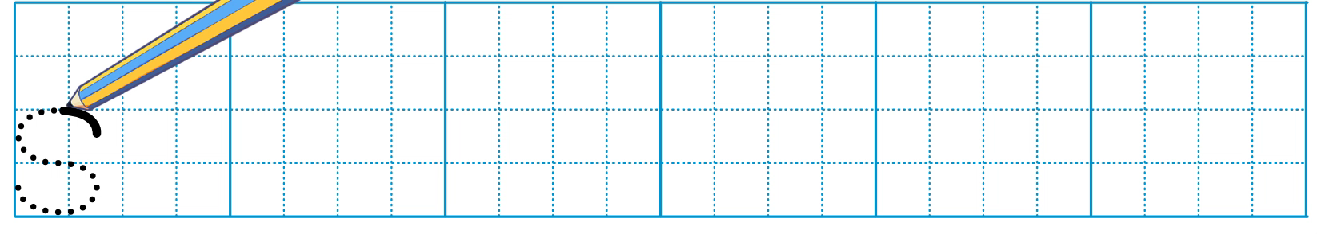
Unit
Look and write.

Slide 5
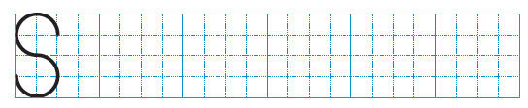
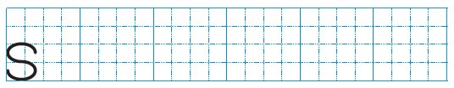


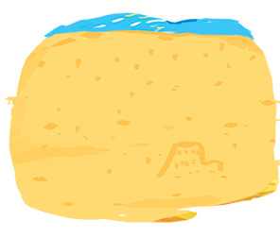
Unit
Look and write
s
ea
s
ail
s
and

Slide 6

05
Fun corner & Wrap-up
Option 1
Game: Vocabulary review

