Slide 2


Unit 3: At the seaside
Lesson 3 – Period 3

Slide 3








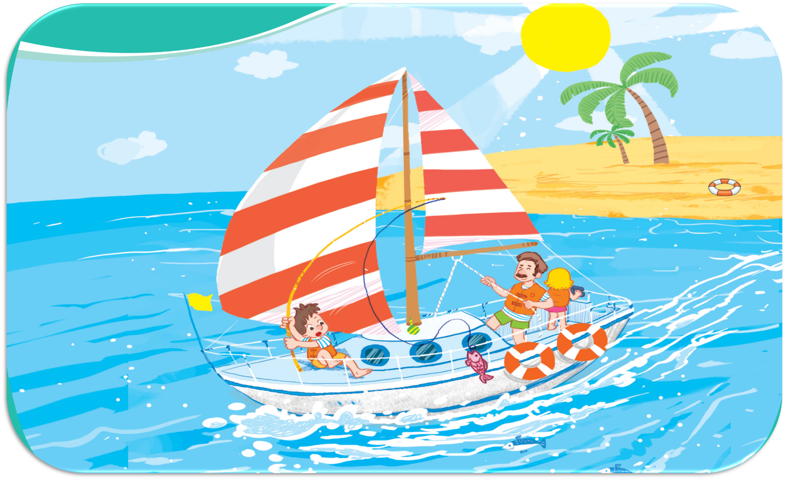



Oops, Try again!
3
2
5
4
6
1
Let’s look at the sail!
Let’s look at the seaside!
Let’s look at the sun!
7
Let’s look at the sand!
Let’s look at the sea!
TEAM 1
TEAM 2
Notes:
Click the apple to see the picture then say the sentences
Click the pictures to see the right sentences
Click the pictures again to clear them
Click the Team 1/ 2 to get points/ presents

Slide 4






Unit
Let’s sing!
Saturday

Slide 5
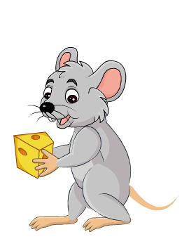




Game: Lucky numbers
1
2
3
4
You get points
5
6
7
8

Slide 6


