Slide 1



My week
3
LESSON 1 - PERIOD 1
SUNDAY
SUNDAY
MONDAY
TUESDAY
WEDNESDAY
THURSDAY
FRIDAY
SATURDAY

Slide 2
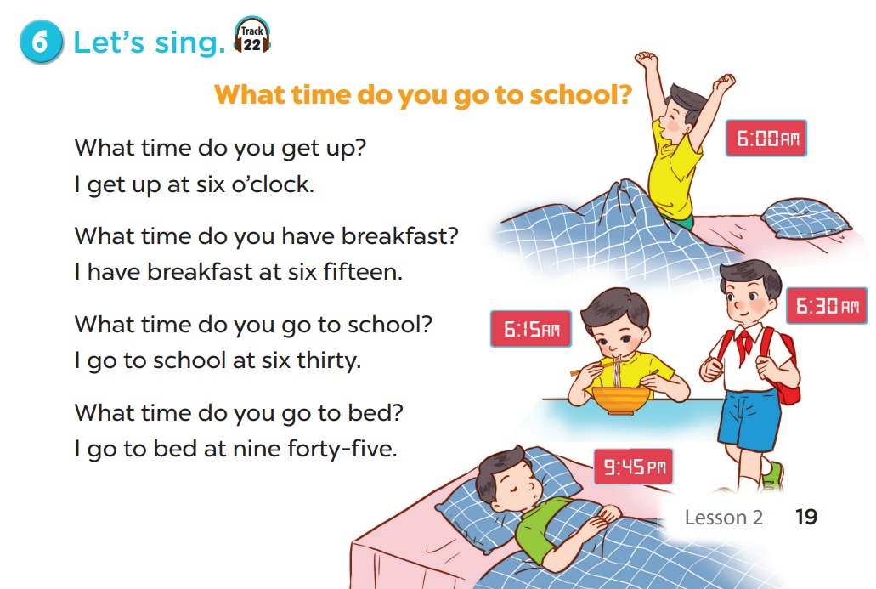
LET’S SING TOGETHER.

Slide 3
02
Activity 1
Look, listen and repeat.

Slide 4
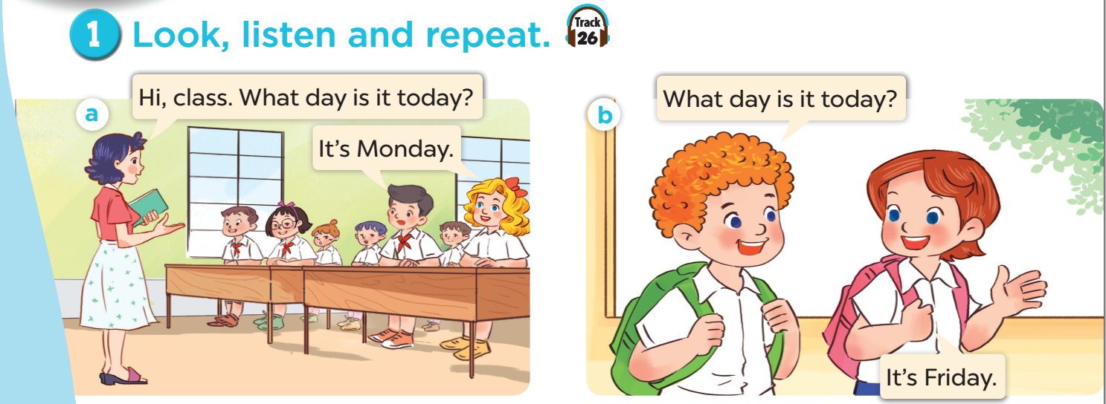

Slide 5
03
Activity 2
Listen, point and say.

Slide 6
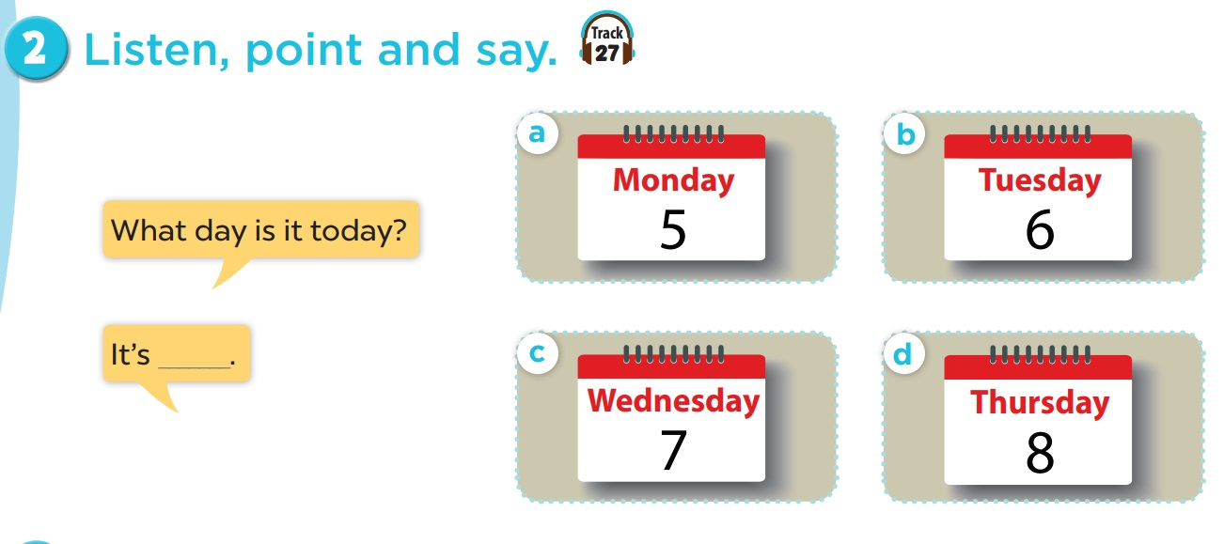

Slide 7
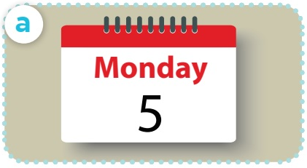
What day is it today?
It’s Monday.

Slide 8
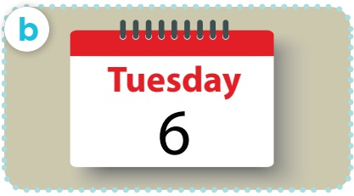
What day is it today?
It’s Tuesday.

Slide 9
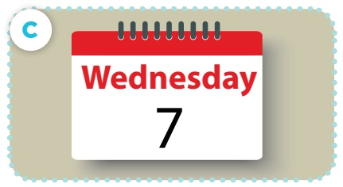
What day is it today?
It’s Wednesday.

Slide 10
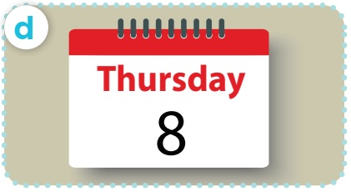
What day is it today?
It’s Thursday.

Slide 11
04
Activity 3
Let’s talk.

Slide 12
