Slide 1



My week
3
LESSON 1 - PERIOD 2
SUNDAY
SUNDAY
MONDAY
TUESDAY
WEDNESDAY
THURSDAY
FRIDAY
SATURDAY

Slide 2
01
Warm-up Look and guess.

Slide 3


What day is it today?

Slide 4


What day is it today?

Slide 5

What day is it today?

Slide 6


What day is it today?

Slide 7
02
Activity 4 Listen and tick.

Slide 8
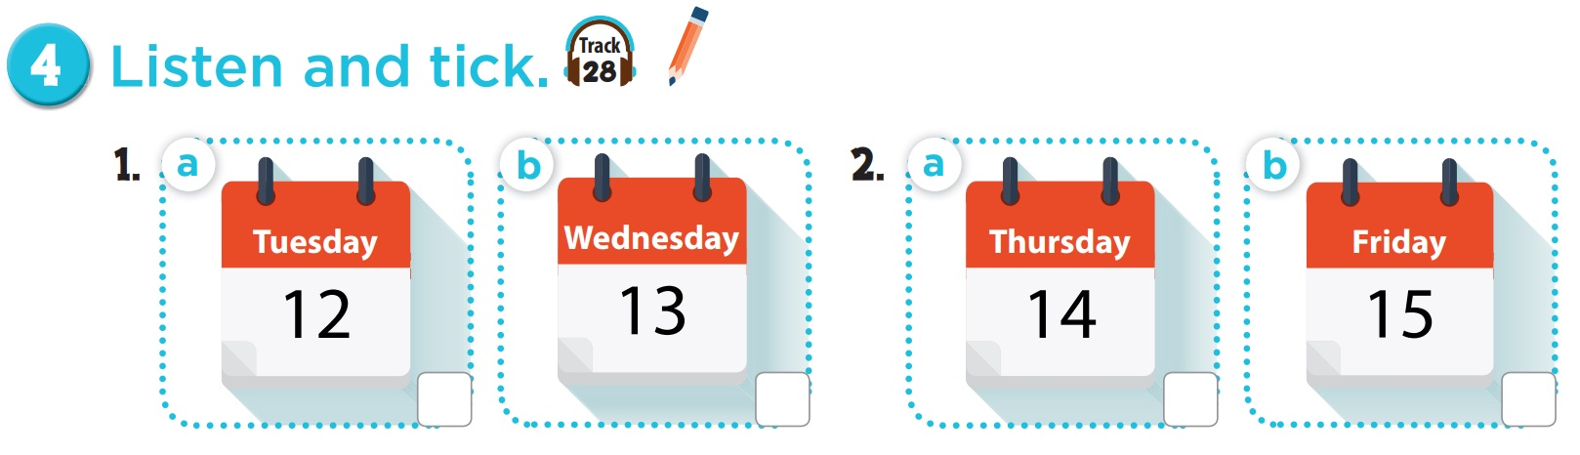
1. Ms Hoa: Hello, Nam.
Nam: Hello, Ms Hoa. Ms Hoa: What day is it today? Nam: It’s Wednesday. Ms Hoa: OK.
2. Mr Long: Hello, Mai. Mai: Hello, Mr Long. Mr Long: What day is it today?
Mai: It’s Thursday. Mr Long: Good.

Slide 9
03
Activity 5 Look, complete and read.

Slide 10
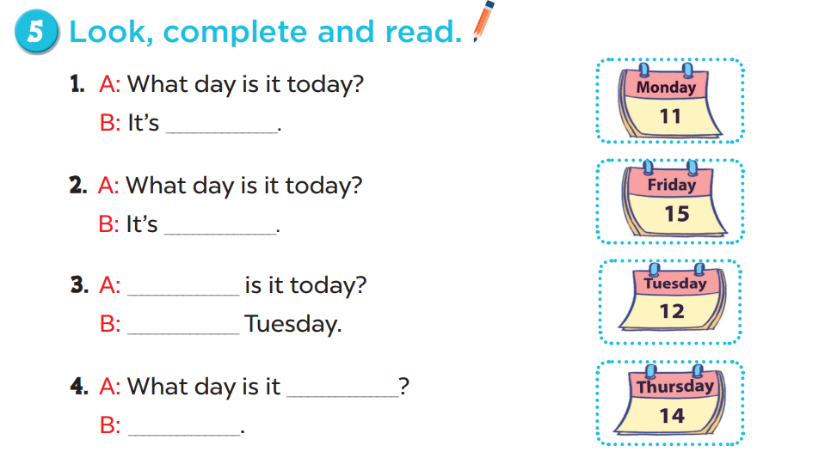
Monday
Friday
What day
It’s
today
It’s Thursday

Slide 11
04
Activity 6 Let’s play.

Slide 12
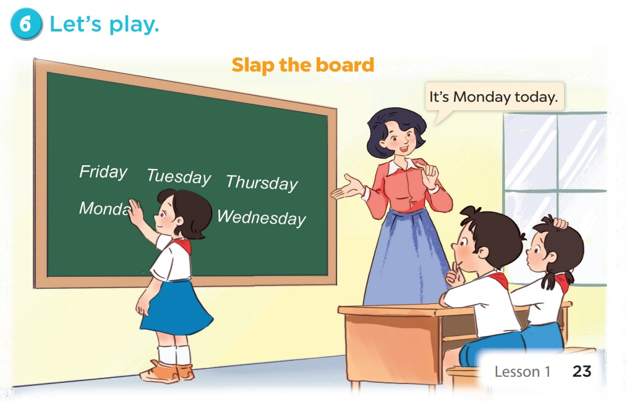

Slide 13
05
Fun corner & wrap-up

