Slide 1



My week
3
LESSON 2 PERIOD 4
SUNDAY
SUNDAY
MONDAY
TUESDAY
WEDNESDAY
THURSDAY
FRIDAY
SATURDAY

Slide 2
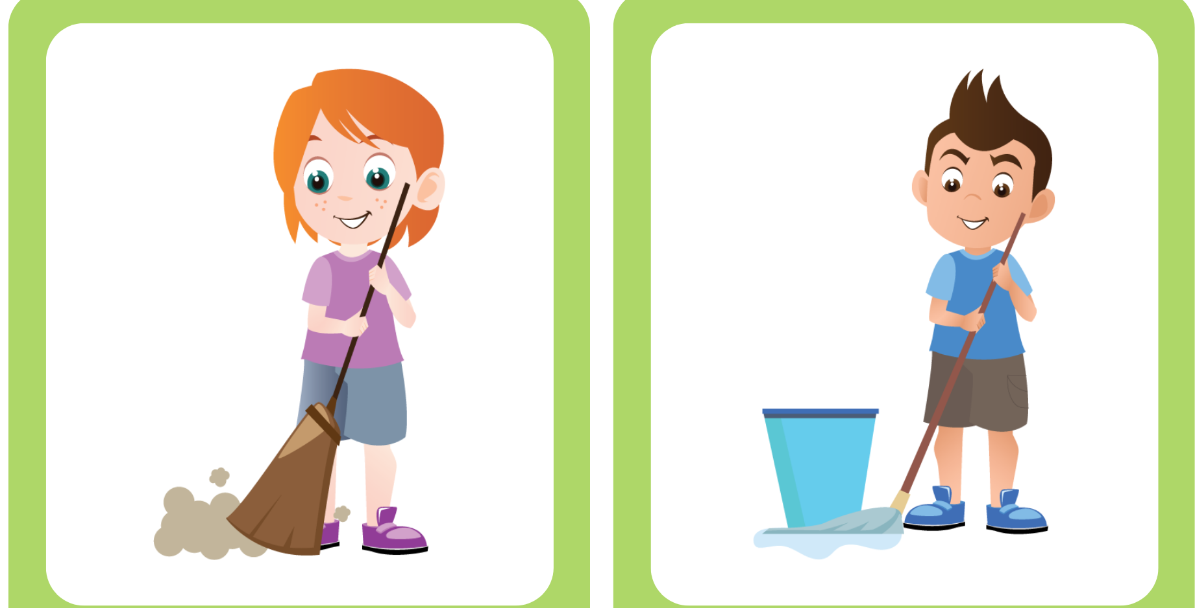
MIMING GAME

Slide 3
02
Activity 4 Listen and number.

Slide 4
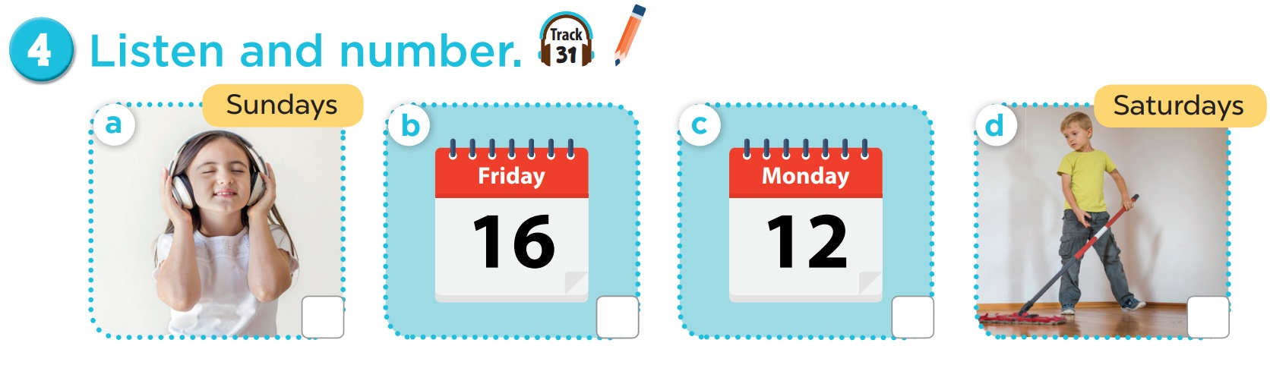
4
3
1
2

Slide 5
03
Activity 5 Look, complete and read.

Slide 6
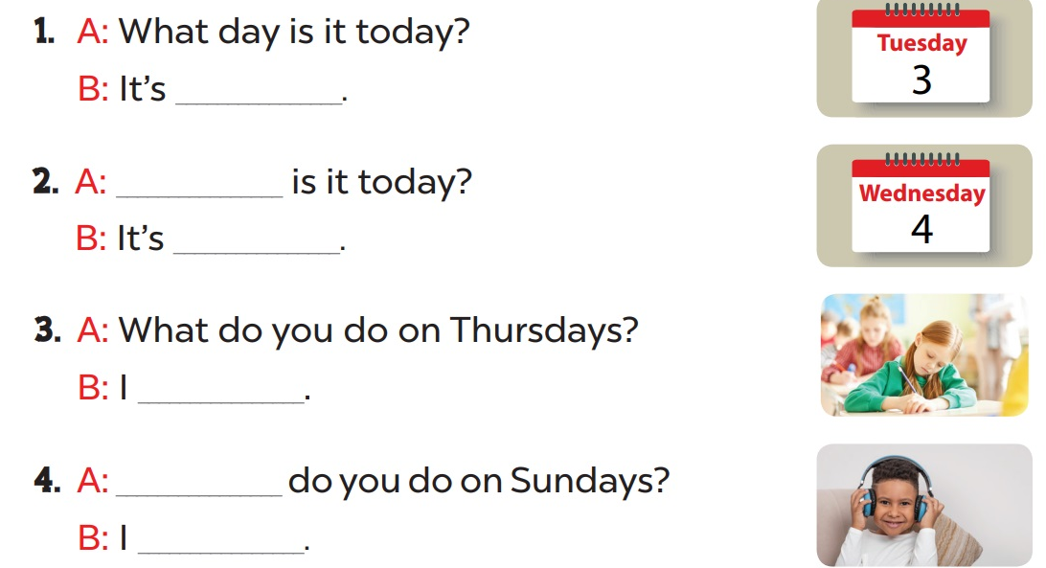
Complete and read aloud.
Tuesday
What day
Wednesday
study at school
What
listen to music

Slide 7
04
Activity 6 Let’s sing.

Slide 8
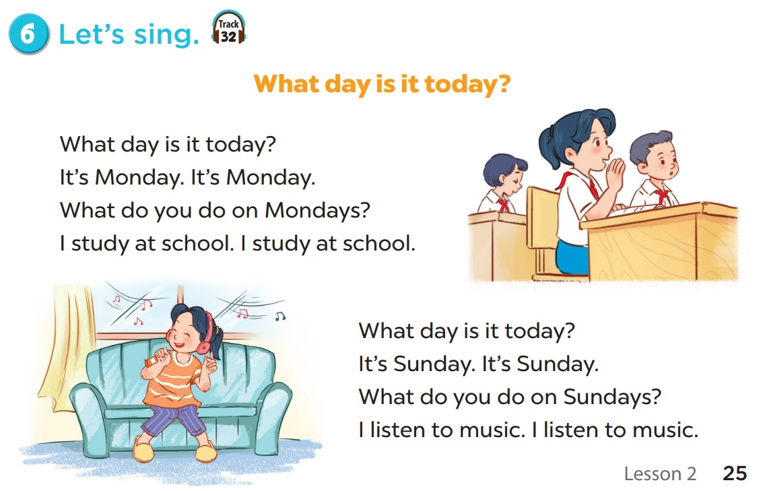
Notes:
Video hoạt hình: https://www.youtube.com/watch?v=YvH0KYru6h0&list=PL8_ETpRL2xNay3h-a-vBjWhplE1wXFpSJ&index=1

Slide 9
05
Fun corner & wrap-up

