Slide 1



My week
3
LESSON 3 - PERIOD 5
SUNDAY
SUNDAY
MONDAY
TUESDAY
WEDNESDAY
THURSDAY
FRIDAY
SATURDAY

Slide 2
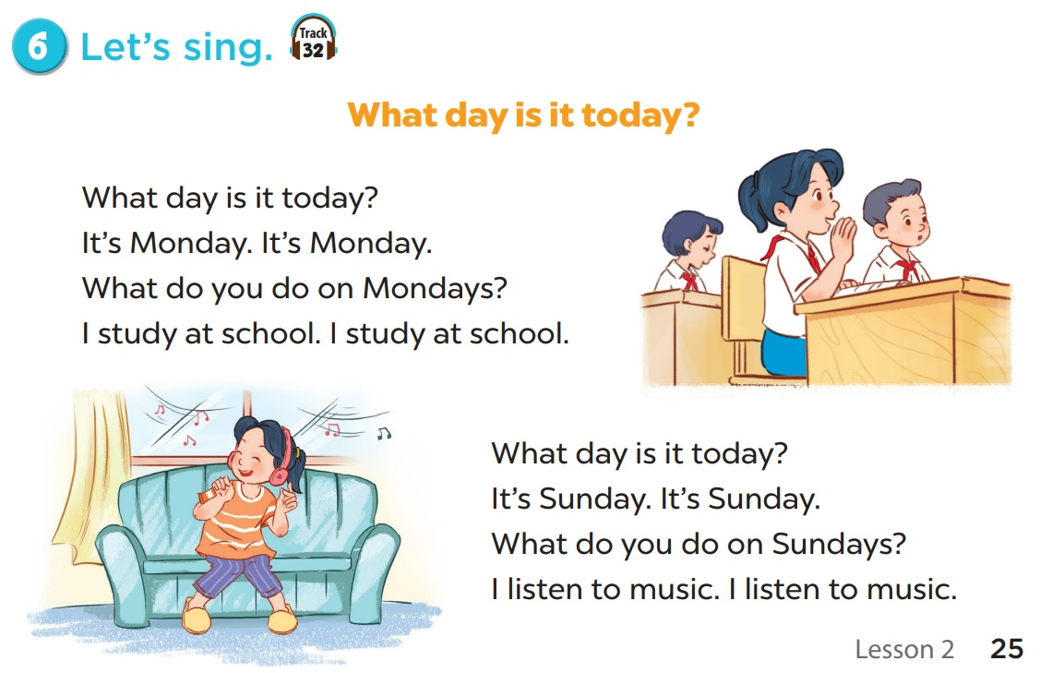
Let’s sing together!

Slide 3
02
Activity 1
Listen and repeat.

Slide 4
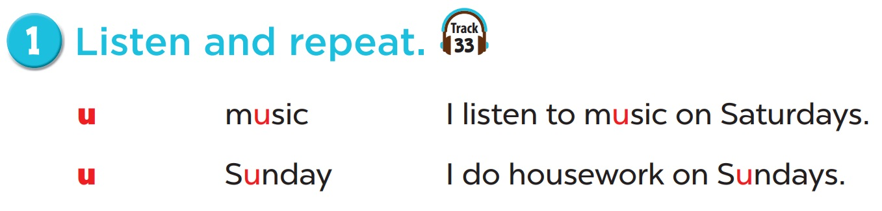

Slide 5
03
Activity 2
Listen and circle.

Slide 6
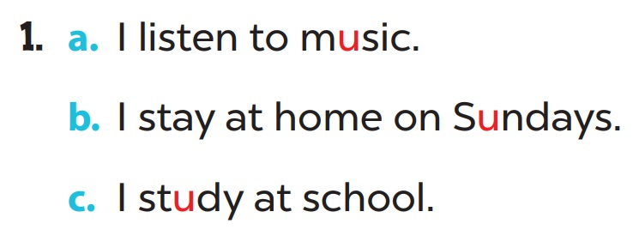

Slide 7
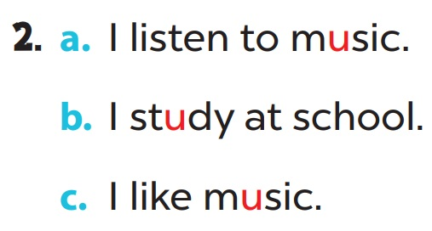

Slide 8
04
Activity 3
Let’s chant.

Slide 9
05
Fun corner & wrap-up

