Slide 1



My week
3
LESSON 3 PERIOD 6
SUNDAY
SUNDAY
MONDAY
TUESDAY
WEDNESDAY
THURSDAY
FRIDAY
SATURDAY

Slide 2
01
Warm-up

Slide 3
02
Activity 4 Read and complete.

Slide 4
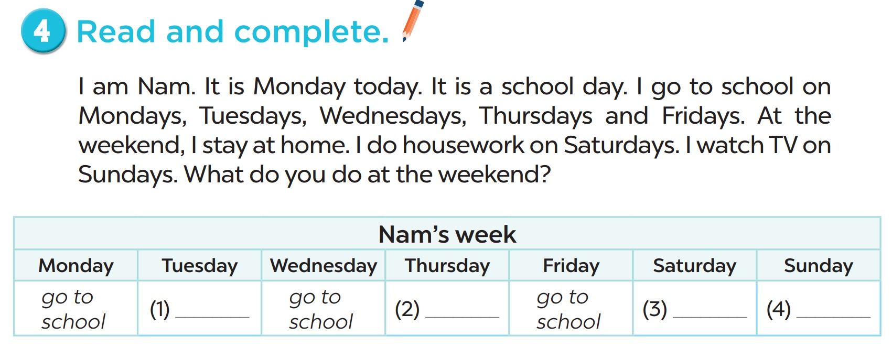

Slide 5
03
Activity 5 Let’s write.

Slide 6
