Slide 2

02
Activity 1
Listen and repeat.

Slide 3

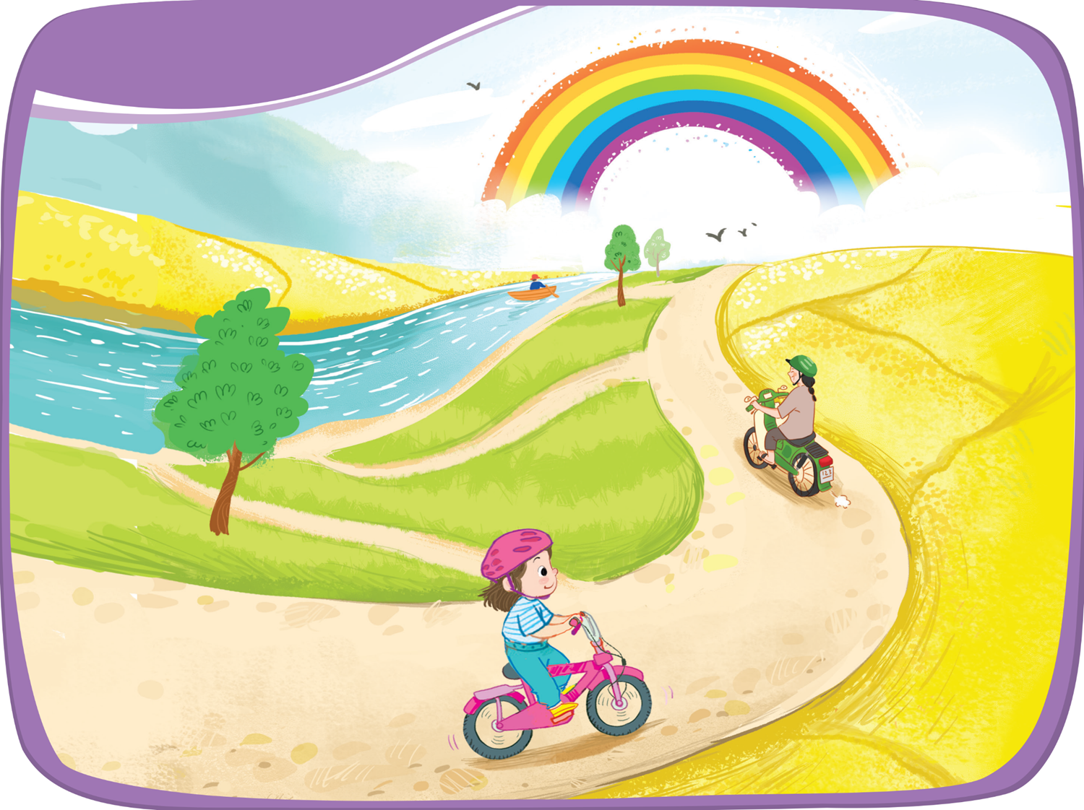
1. Listen and repeat.

Slide 4

Pairwork

Slide 5

Pairwork
Play “Rock, Paper, Scissors” game.
The winner will say the sound “r”.
The loser will say aloud the words
with that sound.

Slide 6
04
Fun corner
and Wrap-up

Slide 7


Game: BOARD RACE
Team 1
Winner
Team 2
Task 1
Task 2
Task 3
Task 4
Task 5
Task 6
Notes:
Click the task to move to other slides
Click the Team 1/ 2 to get flags
Click winner to congratulation

Slide 8



Slide 9
