Slide 2





Slide 3
Unit 4: In the countryside
Lesson 2 – Period 2

Slide 4

TABLE OF CONTENTS
Warm-up and Review
2.Activity 3: Listen and chant.
3.Activity 4: Listen and circle.
4.Activity 5: Look and write.
5.Fun corner & Wrap-up

Slide 5

01
Warm up and Review

Slide 6
02
Activity 3
Listen and chant.

Slide 7
03
Activity 4
Listen and tick.

Slide 8


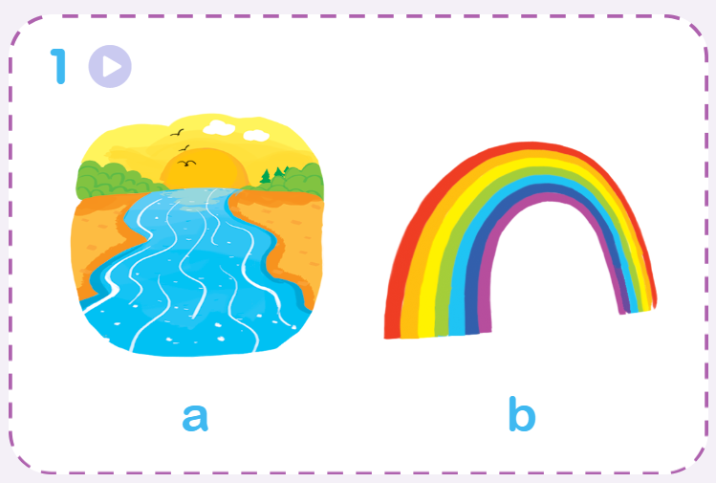
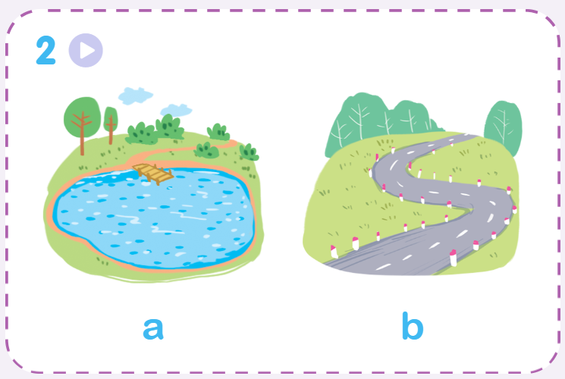
Listen and circle.

Slide 9
04
Activity 5
Look and write.

Slide 10







Look and write.

Slide 11
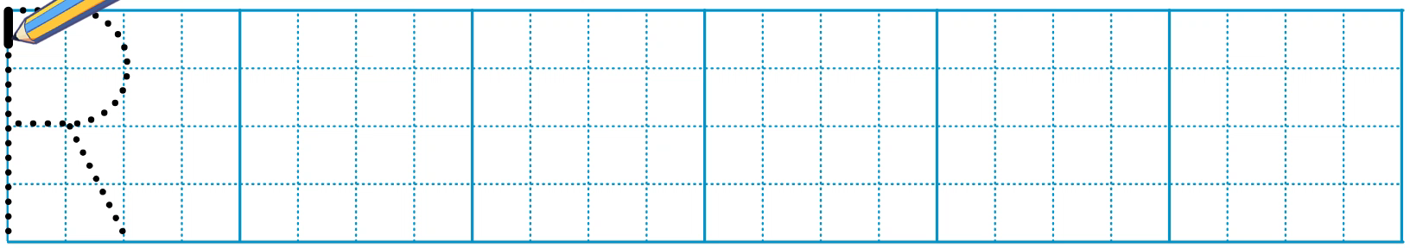
Look and write.

Slide 12
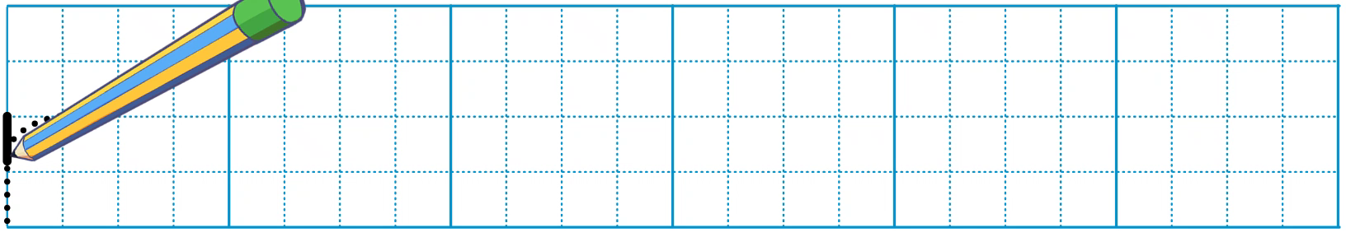
Look and write.

Slide 13
05
Fun corner and Wrap-up

Slide 14



Game: PELMANISM
river
ruler
road
Notes:
Click the penguins and hot-air balloons to see the pictures and words
Click the pictures or words to remove them

Slide 15


rainbow
river
road
Notes:
Click the penguins and hot-air balloons to see the pictures and words
Click the pictures or words to remove them

Slide 16


