Slide 2

L
M
E
E
C
O
W

Slide 3
Unit 4: In the countryside
Lesson 3 – Period 3

Slide 4

TABLE OF CONTENTS
1. Warm-up and Review
2. Activity 6. Listen and repeat.
3. Activity 7. Let’s talk.
4. Activity 8. Let’s sing!
5. Fun corner and Wrap-up

Slide 5
01
Warm-up
and Review

Slide 6
Game:
TICK THE
R/r LETTER PICTURES

Slide 7
02
Activity 6
Listen and repeat.

Slide 8
03
Activity 7
Let’s talk.

Slide 9






Let’s talk.
What can you see?
I .
a
b
c

Slide 10

Let’s talk.
What can you see?
I _______.
a
Notes:
Click the bubble to see the answer

Slide 11


Let’s talk.
What can you see?
I _______.
b

Slide 12

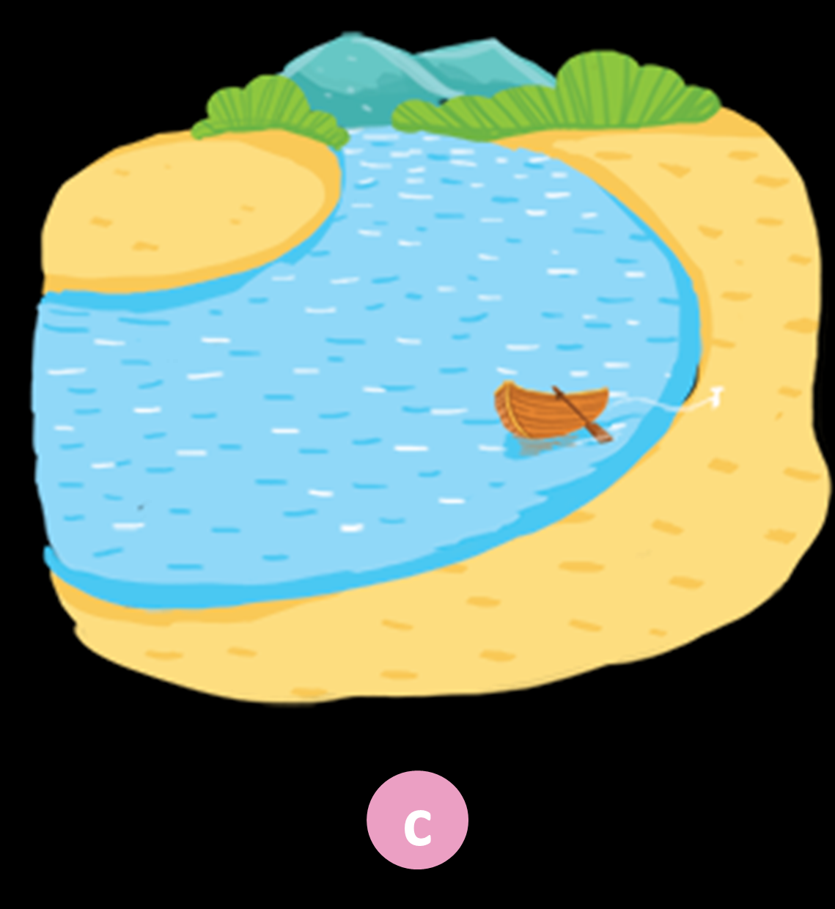
Let’s talk.
What can you see?
I _______.
c

Slide 13
04
Activity 8
Let’s sing.

Slide 14


What can you see?
I can see a ____.
road

Slide 15

What can you see?
I can see a ___.
sail

Slide 16

What can you see?
I can see a ___.
kite

Slide 17

What can you see?
I can see a _____.
kitten

