Slide 1


My birthday party
4
Lesson 1 – Period 1

Slide 2
01
Warm-up
Guessing game

Slide 3
02
Activity 1
Look, listen and repeat.

Slide 4
03
Activity 2
Listen, point and say.

Slide 5
New words

Slide 6
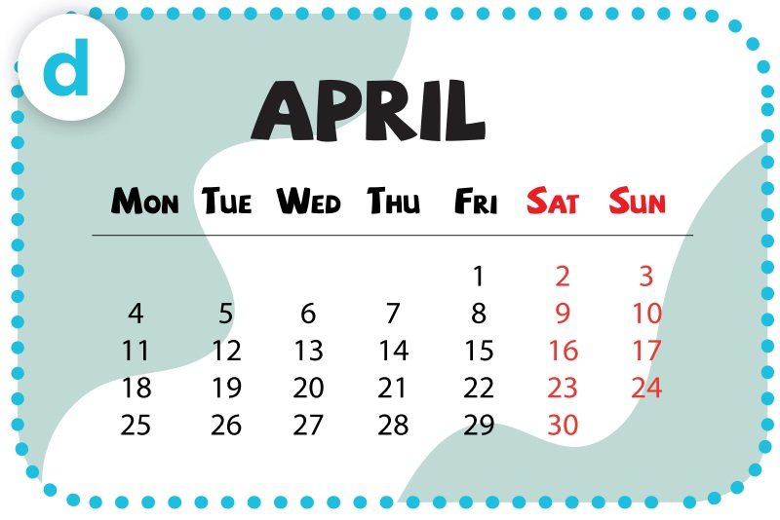
- When’s your birthday?
- It’s in April.

Slide 7
04
Activity 3
Let’s talk.

Slide 8
