Slide 1


My birthday party
4
Lesson 1 – Period 2

Slide 2
01
Warm-up
Yes or No

Slide 3
02
Activity 4
Listen and number.

Slide 4
03
Activity 5
Look, complete and read.

Slide 5
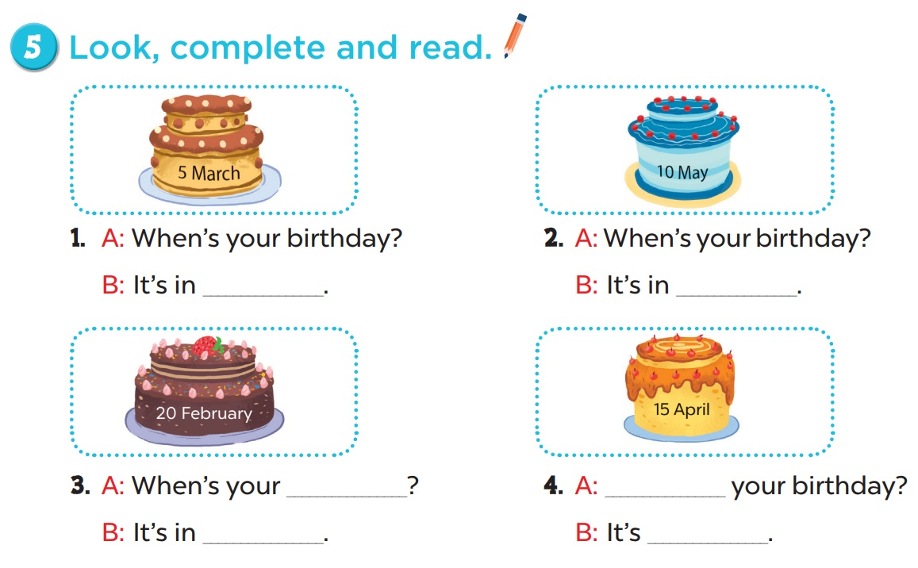

Slide 6
04
Activity 6
Let’s sing.

Slide 7
05
Game

