Slide 1


My birthday party
4
Lesson 2 – Period 3

Slide 2
01
Warm-up
Let’s sing.

Slide 3
02
Activity 1
Look, listen and repeat.

Slide 4
03
Activity 2
Listen, point and say.

Slide 5
What is missing?

Slide 6
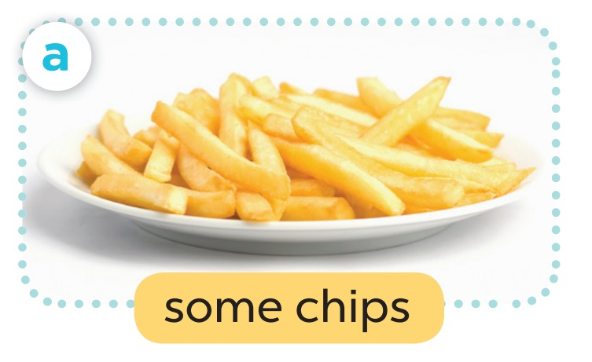
- What do you want to eat?
- I want some chips.

Slide 7
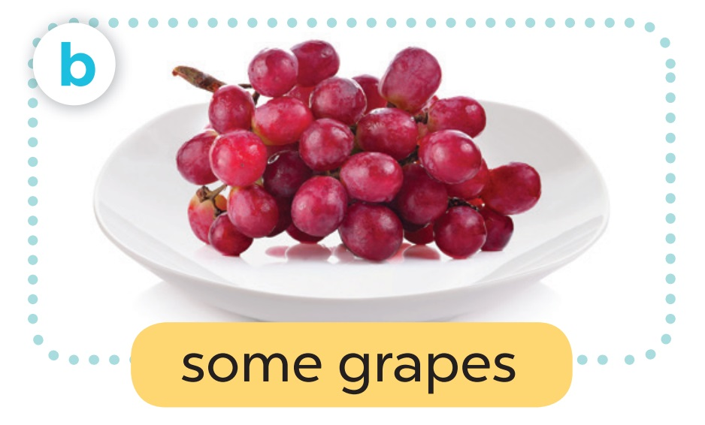
- What do you want to eat?
- I want some grapes.

Slide 8
04
Activity 3
Let’s talk.

Slide 9
