Slide 2
Unit 5: In the classroom
Lesson 1 – Period 1

Slide 3
Table of contents
1. Warm-up and Review
2. Activity 1: Listen and repeat.
3. Activity 2: Point and say.
4. Fun corner and Wrap-up

Slide 4



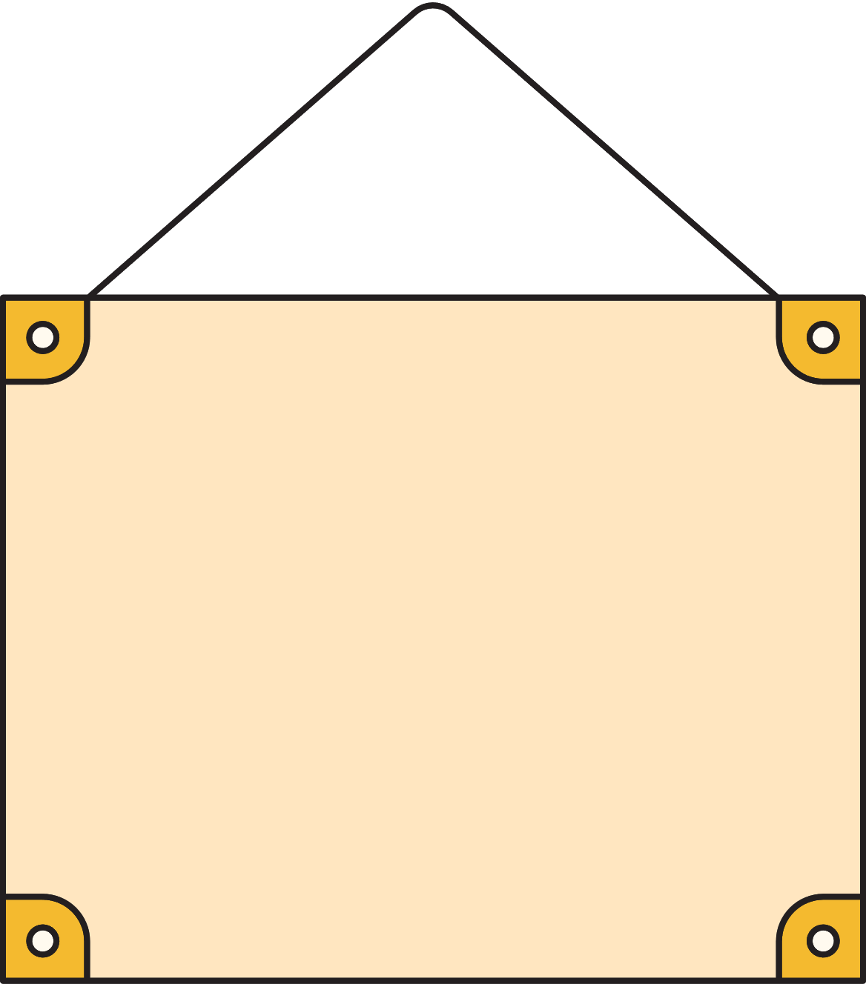
03
Activity 2
Point and say.

Slide 5







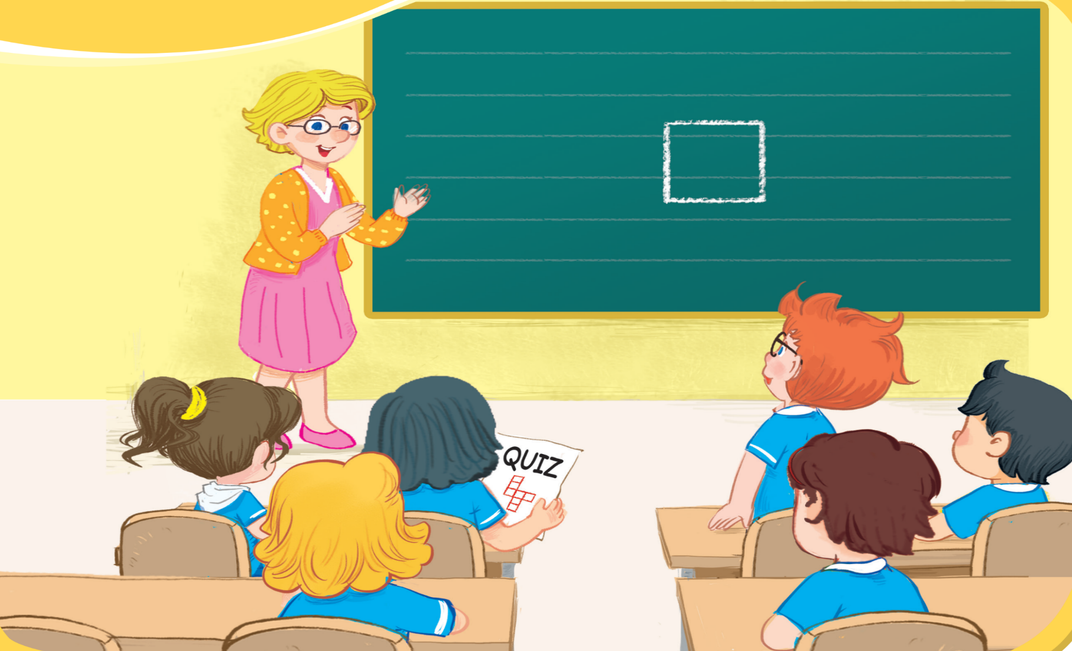




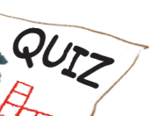


Unit
2. Point and say.
question
square
quiz

Slide 6
04
Fun corner and Wrap-up

Slide 7
Game: Whispers

