Slide 2
Unit 5: In the classroom
Lesson 2 - Period 2

Slide 3






Table of contents
1. Warm-up and Review
2. Activity 3: Listen and chant.
3. Activity 4: Listen and tick.
4. Activity 5: Look and write.
5. Fun corner and Wrap-up

Slide 4

01
Warm-up
and Review

Slide 5

CONGRATULATIONS!

Slide 6
02
Activity 3
Listen and chant.

Slide 7
03
Activity 4
Listen and tick.

Slide 8


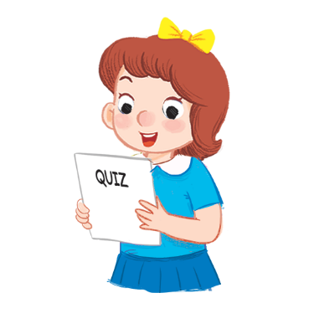




4.Listen and tick.
1
2

Slide 9

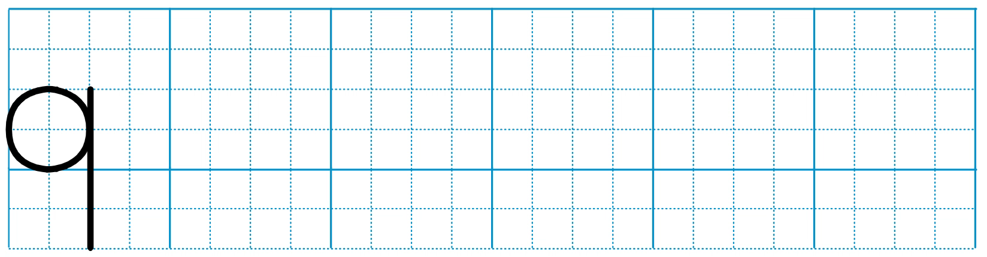
5. Look and write.

Slide 10
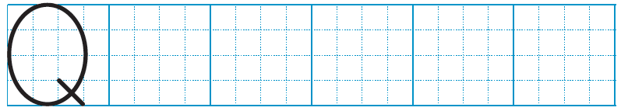
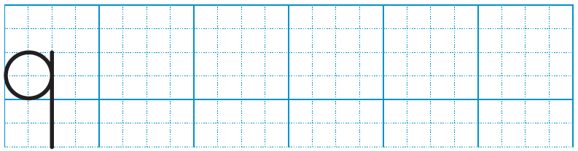
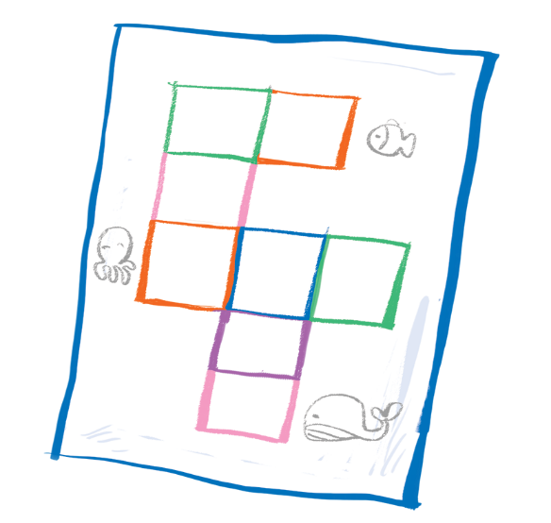


5. Look and write.
q
q
uiz
q
uestion
s uare

Slide 11
05
Fun corner
and Wrap-up

