Slide 2
Unit 5: In the classroom
Lesson 3 – Period 3

Slide 3
TABLE OF CONTENTS
Warm-up & Review
Activity 6: Listen and repeat.
Activity 7: Let’s talk.
Activity 8: Let’s sing.
Fun corner & Wrap-up

Slide 4

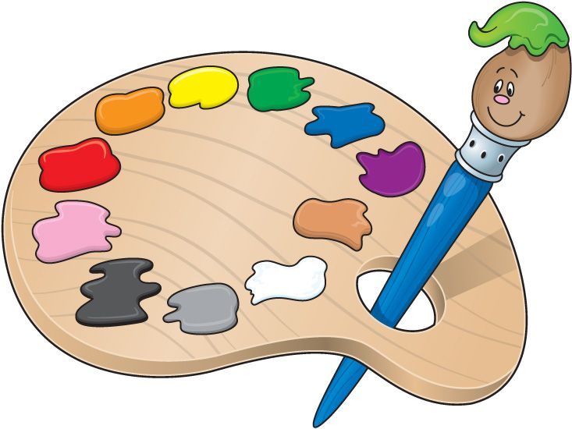
+ 1 point
He’s riding a bike.
Notes:
Click the palette to come back slide 4

Slide 5
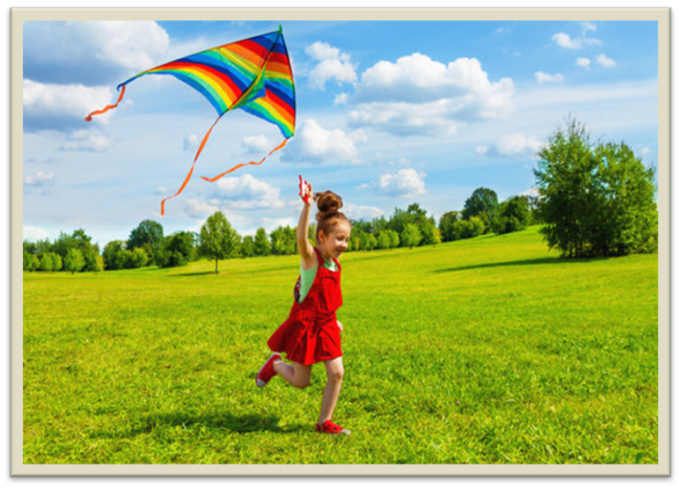
+ 1 point
She’s flying a kite.
Notes:
Click the palette to come back slide 4

Slide 6
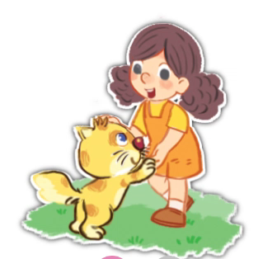
+ 2 point
She’s playing with a kitten.
Notes:
Click the palette to come back slide 4

Slide 7
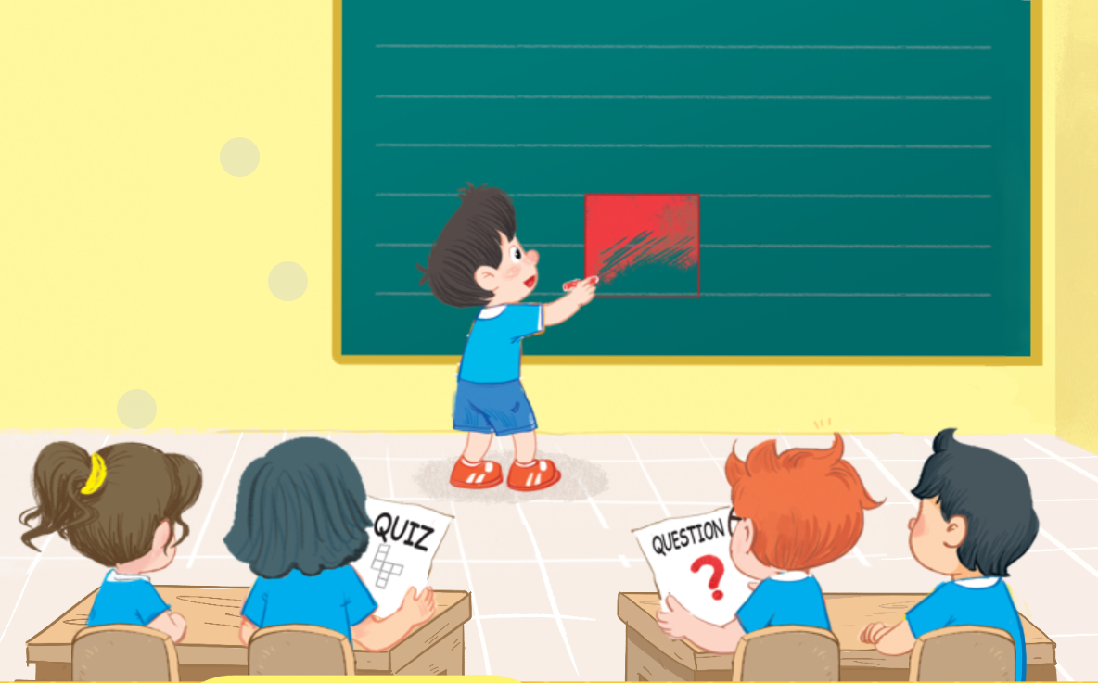
+ 2 point
He’s colouring a square.
Notes:
Click the palette to come back slide 4

Slide 8

+ 1 point
She’s doing a quiz.
Notes:
Click the palette to come back slide 4

Slide 9

+ 3 point
He’s answering a question.
Notes:
Click the palette to come back slide 4

Slide 10
CONGRATULATION!

Slide 11
02
Activity 6
Listen and repeat.

Slide 12

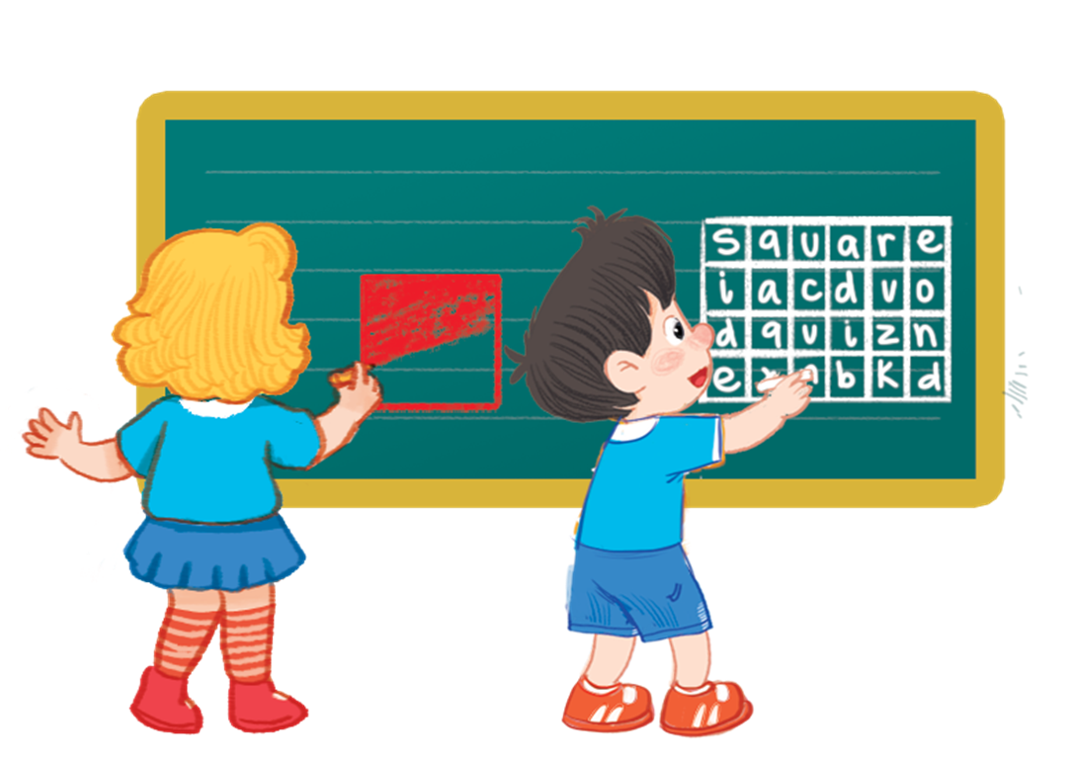
6. Listen and repeat.

Slide 13




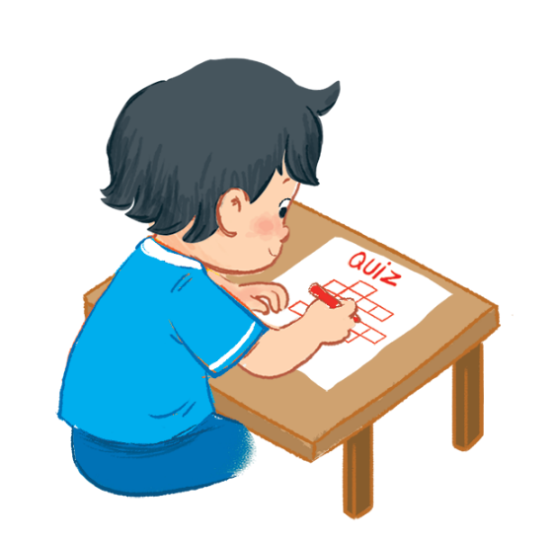
Let’s talk.
.
What ____?
b

Slide 14

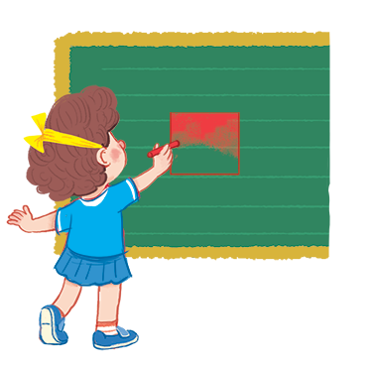
Let’s talk.
.
What ____?
c

Slide 15
04
Activity 8
Let’s sing!

Slide 16

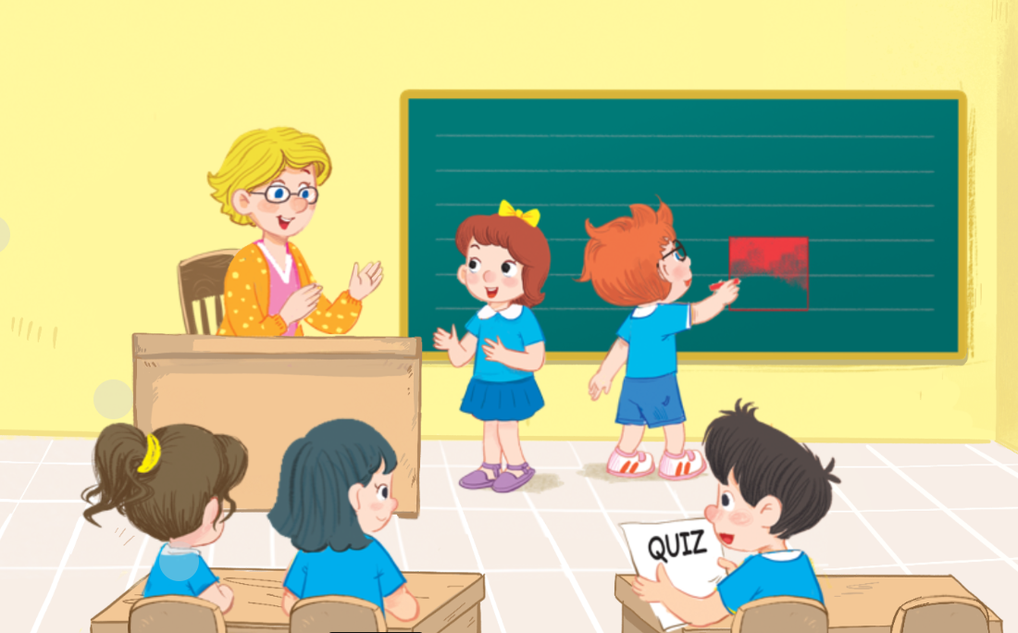
8. Let’s sing.

Slide 17

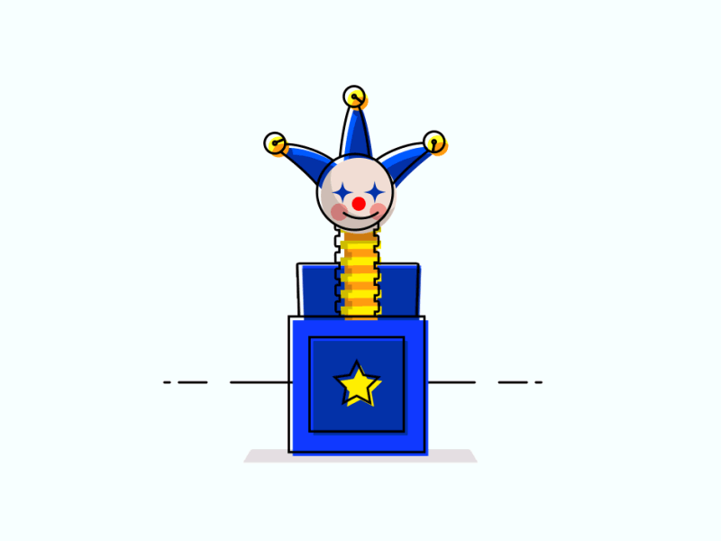

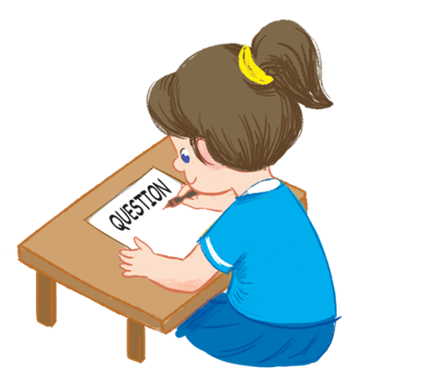


Game: Lucky box
1
2
3
4
5
Notes:
Click the numbers to open the box and see the pictures
Click the pictures to clear them

Slide 18
GOODBYE!

