Slide 2

Unit 5 – Lesson 1
At the fish and chip shop
Notes:
By the end of the unit, pupils will be able to:
- pronounce the sound of the letter I/i in isolation and in the words chicken, chips, fish and milk correctly.
- say the sound of the letter I/i and the words chicken, chips, fish and milk in a chant.
- recognize the words in different situations when listening.
- use I like _____ to talk about someone’s favourite food/drinks.
- trace the letter I/i.
sing a song with the structure “I like _____.”
Lesson 1
By the end of lesson 1, pupils will be able to:
pronounce the sound of the letter I/i in isolation and in the words chicken, chips, fish and milk correctly.
point to the letter I/i and food/drinks (chicken, chips, fish and milk) in the picture and say the sound of the letter I/i , the words chicken, chips, fish, milk.

Slide 3

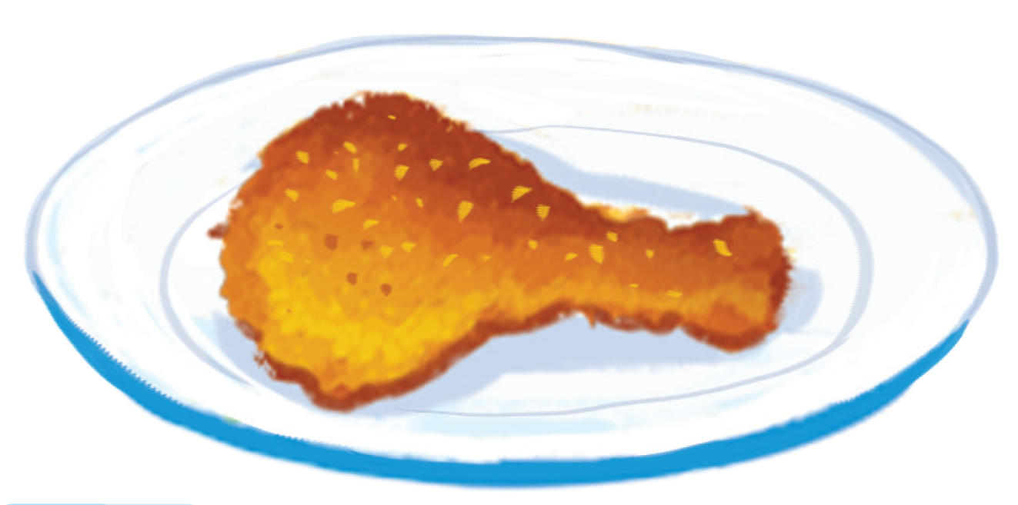
chicken
Notes:
Step 2: Listen and repeat vocabulary
Time limit: 5 mins
Goal: Pupils are able to identify and pronounce 4 words: fish, chips, milk, chicken correctly.
Teacher shows pictures on slide and says the words. (Teacher may pronounce each sound of the word separately, for example f-i-sh).
Pupils listen to teacher and repeat.
Step 3: Quick check
Time limit: 4 mins
Teacher checks pronunciation (as teams).
Teacher sticks flashcards and word cards on the board randomly. Teacher has pupils go to the board and put word cards under the matching flashcards.
Teacher checks pronunciation individually. Teacher points to a picture and has a pupil say the word.

Slide 4
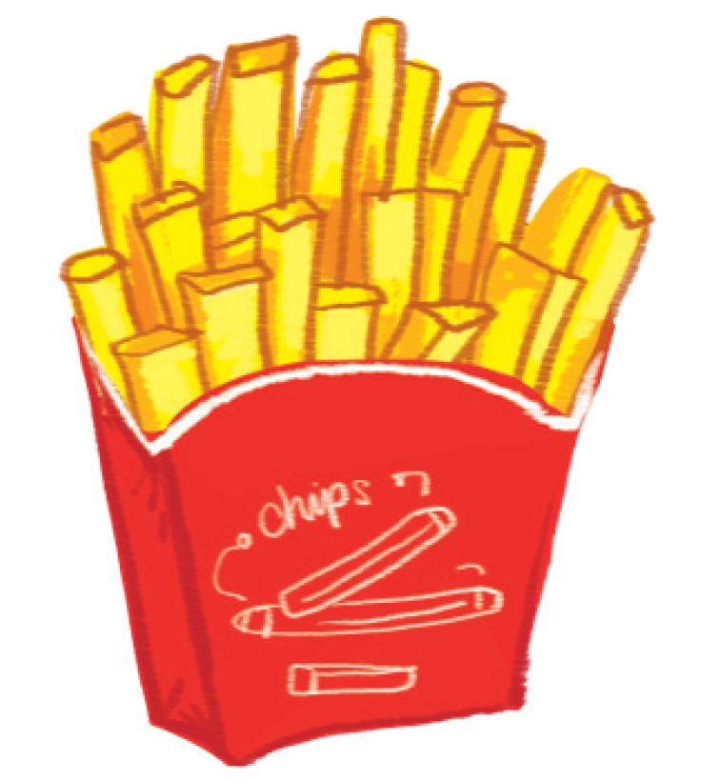
chips

Slide 5
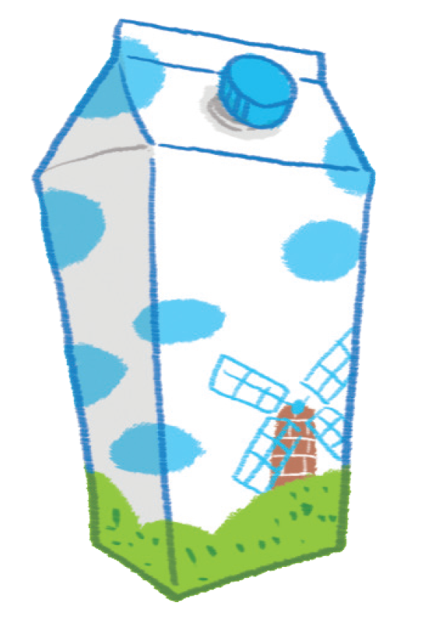
milk

Slide 6



Notes:
Goal:
Pupils will be able to point to the letter I/i and food/drinks (chicken, chips, fish and milk) in the picture and say the sound of the letter I/i , the words chicken, chips, fish, milk.
Step 1: Listen, point and repeat
Goals: Pupils are able to point to the correct picture and pronounce the words.
Time limit: 3 mins
Teacher plays the audio.
1st time: Pupils listen and point only.
2nd time: Pupils listen, point and repeat.
Pupils repeat the words as a class and teams.
Step 2: Listen, point and repeat (in pairs)
Time limit: 3 mins
Pupils work in pairs: 1 pupil points, 1 pupil says the words.
Teacher goes around the class and gives feedback on pupils’ pronunciation.

Slide 7
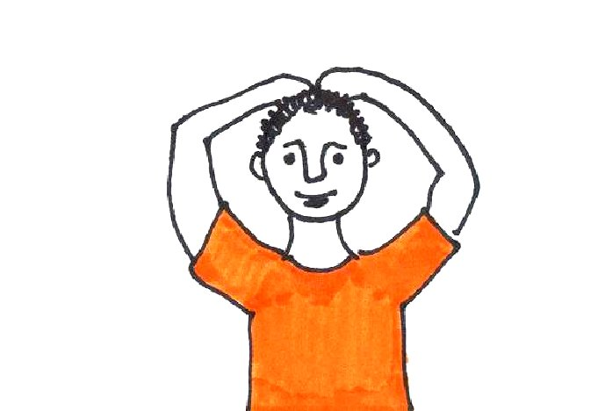
Hands on your head!
Notes:
Step 3: Quick check
Time limit: 5 mins
Game: Hands on your head
- Teacher says Hands on your head, pupils put a hand on their head.
- Teacher says a word, pupils quickly slap on the corresponding picture, then put their hand back to the head.
- Teacher may have some pupils say the words.

Slide 8

GAME
Notes:
Game: What’ s missing?
Time limit: 6 mins
Teacher shows on slide 4 pictures. Teacher may have pupils read all the words. After that, a picture will disappear. Pupils guess the word.
Teacher gives star if pupils are correct.
Note: In some slides there are only words, in other there are both words and pictures.

Slide 9



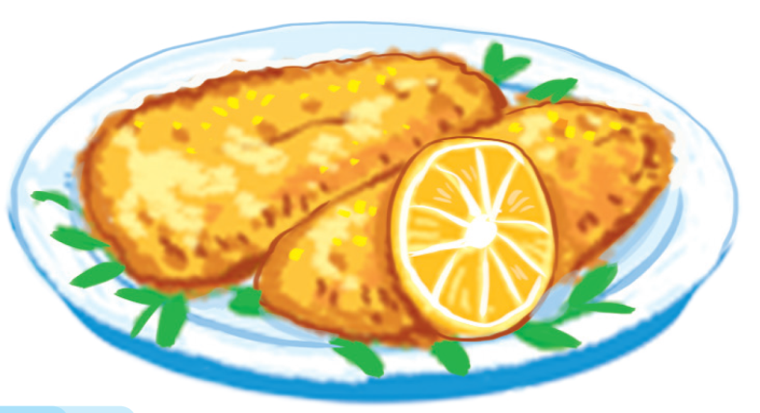
chicken
chips
milk
fish

Slide 10
chicken
chips
milk
fish

Slide 11
chicken
chips
milk
fish

Slide 12
chicken
chips
milk
fish

Slide 13
chicken
chips
milk
fish

Slide 14
chicken
chips
milk
fish

Slide 15
chicken
chips
milk
fish

Slide 16
chicken
milk
chips
fish

Slide 17
chicken
milk
chips
fish

Slide 18
chicken
milk
chips
fish

Slide 19

Goodbye
Notes:
Teacher shows the vocabulary of the lesson on slide.
Pupils say goodbye.

Slide 20

Goodbye

Slide 21
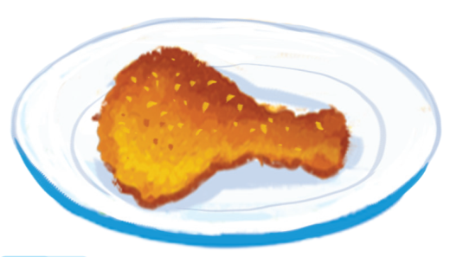
Goodbye

