Slide 1
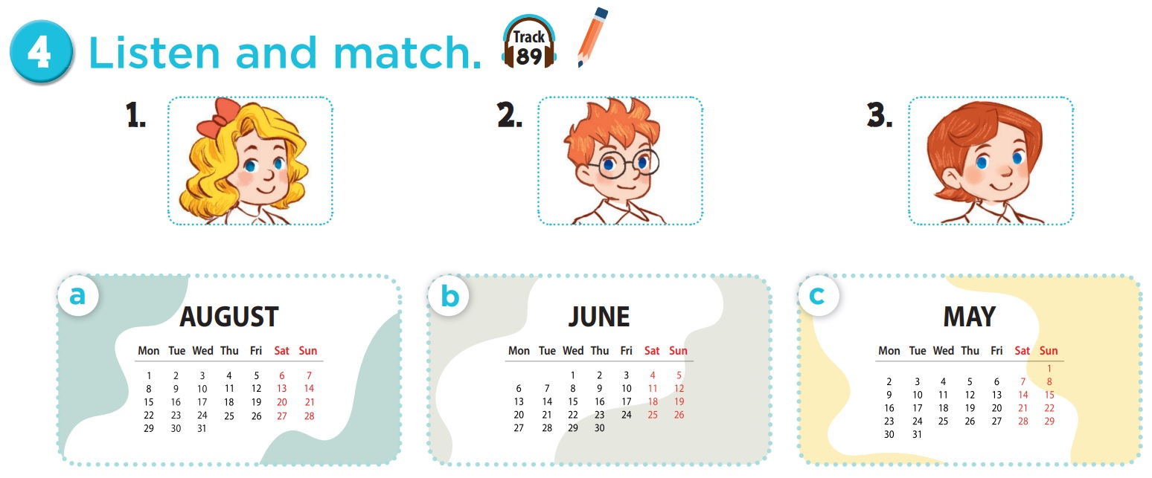

Who is she? Who is he?

Slide 2
Which month do you see?

Slide 3


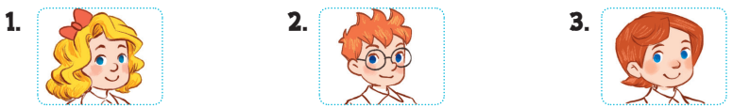
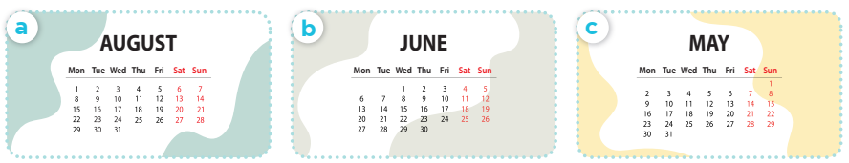

Slide 4
03
Look, complete and read.

Slide 5



1.
A: Is your sports day in June?
B: Yes, ______.
2.
A: Is your sports day in ________?
B: Yes, it is.
it is
August

Slide 6
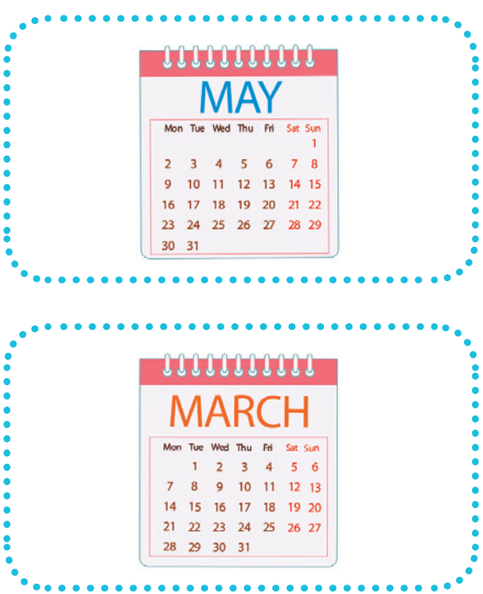
3.
A: _____ your sports day in February?
B: No, it isn’t. It’s in _____.
4.
A: Is your sports day ____ July?
B: _________. It’s in March.
Is
May
in
No, it isn’t

Slide 7
04
Let's sing.

Slide 8



Our sports day
Sports day, sports day.
Is your sports day in May?
Yes, it is. Yes, it is.
It’s in May.
Sports day, sports day.
Is your sports day in June?
No, it isn’t. No, it isn’t.
It’s in July.

Slide 9
05
Game

Slide 10



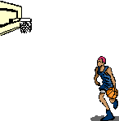

All-Star

Slide 11

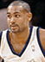
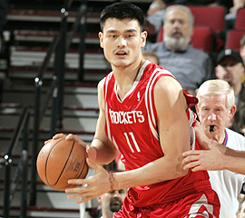

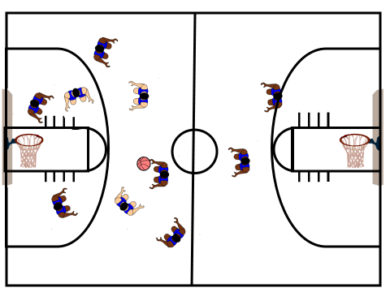
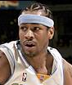
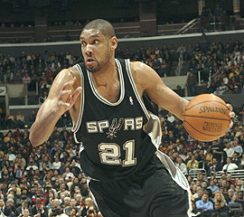


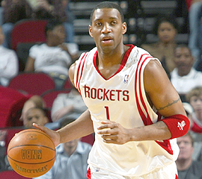

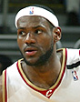

Scoreboard
Grant Hill
Yao Ming
Pippin
Tim Duncan
Allen
Michael Jordan
Grady
Nick
James

Slide 12
Is your sports day _____ June?
in
B
A. on
B. in
C. at
D. for

Slide 13


Slam Dunk
Slam Dunk

Slide 14
___ your sports day in May?
A
A. Is
B. It

Slide 15
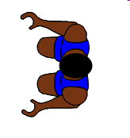
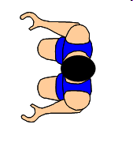

No point!

Slide 16

Is your sports day
in April?
B
A. Yes, it is.
B. No, it isn't.
Notes:
Encourage students to say "It's in March."

Slide 17

Slam Dunk
Slam Dunk

Slide 18

Is your sports day in July?
C
A. Yes, it isn't.
B. No, it isn't.
C. Yes, it is.
D. No, it is.

Slide 19

Slam Dunk
Slam Dunk

Slide 20

A: Is your sports day
in ___?
B: Yes, it is.
A
A. March
B. May

Slide 21
Slam Dunk
Slam Dunk

Slide 22
A: Is your sports day
in ___?
B: No, it isn't.
B
A. March
B. May

Slide 23
No point!

Slide 24
A: Is your sports day
in February?
B: Yes, _____.
A
A. it is
B. it isn't

Slide 25

Slam Dunk
Slam Dunk

Slide 26
A: Is your sports day in September?
B: No, _____.
B
A. it is
B. it isn't

Slide 27

Slam Dunk
Slam Dunk

Slide 28
A: Is your sports day
in January?
B: _____. It's in March.
C
A. Yes, it isn't.
B. Yes, it is.
C.No, it isn't.
D. No, it is.

Slide 29
Slam Dunk
Slam Dunk

Slide 30

Website: hoclieu.vn
Fanpage: facebook.com/www.tienganhglobalsuccess.vn
Website: sachmem.vn; hoclieu.vn
Fanpage: www.facebook.com/sachmem.vn

