Slide 1





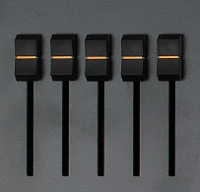




C R A H M
MARCH
Notes:
Click on the red button to reveal the answer.

Slide 2
YLUJ
JULY
Notes:
Click on the red button to reveal the answer.

Slide 3
03
Look, listen and repeat.

Slide 4
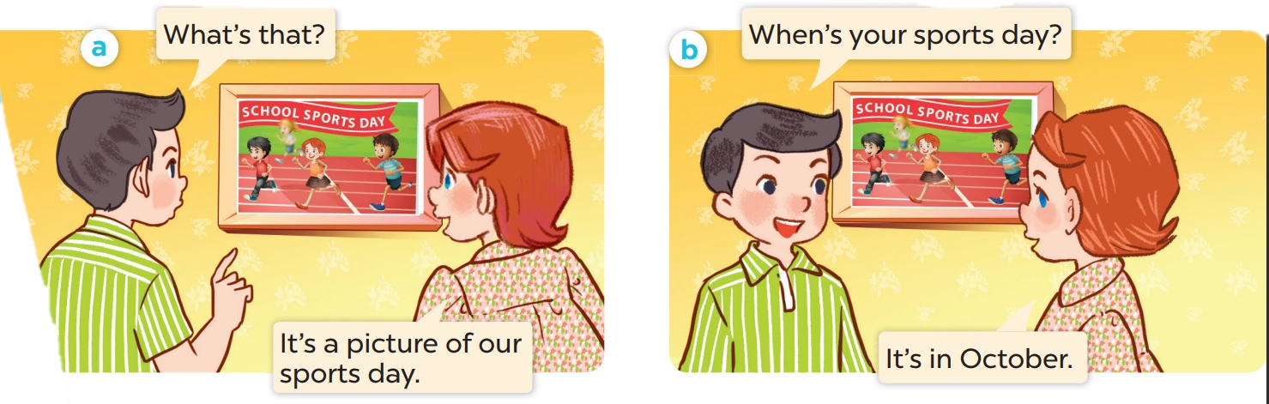
Who is the girl? Who is the boy?

Slide 5

Look, listen and repeat.

Slide 6
Work in pairs. Practise.

Slide 7
03
Listen, point and say.

Slide 8
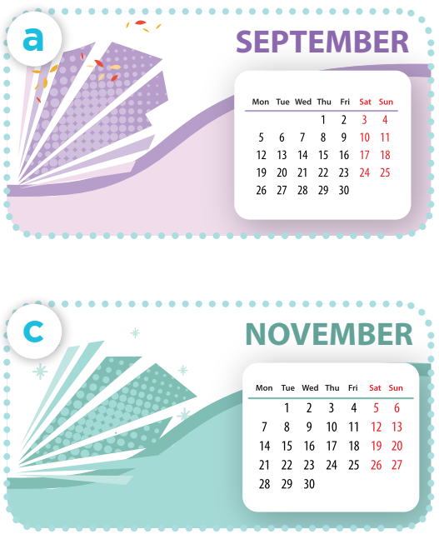
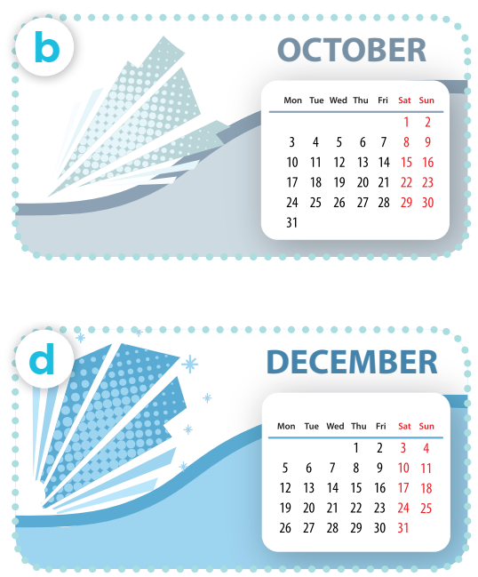
Listen, point and say.
Work in pairs. Practise.
When’s your sports day?
It’s in ___.
Notes:
Click on the Speaker Icon to play the audio.

Slide 9
04
Let's talk.

Slide 10


When's your sports day?
It's in December.

Slide 11


When's your sports day?
NOVEMBER
It's in November.

Slide 12
When's your sports day?
It's in _____.

Slide 13
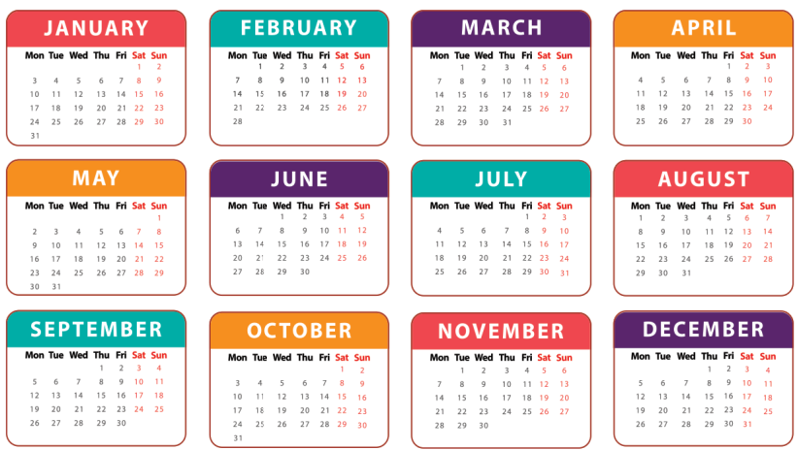
3
Let’s talk.
When’s your sports day?
It’s in ___.

Slide 14
06
Game

Slide 15

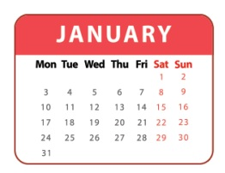


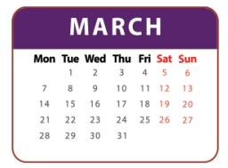

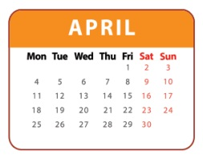
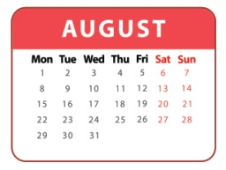
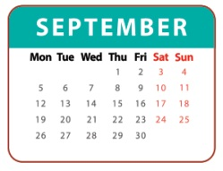
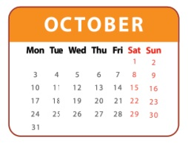
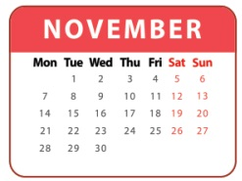
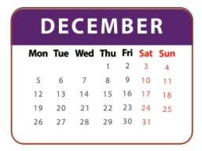
1
2
3
= +1 point
4
5
6
= lose 2 points
= rock, paper, scissors
(winner takes 2)
7
8
9
Notes:
- Divide the class into 3 teams.
- Pupils from each team choose a number (or throw sticky ball on the grid to choose the number), then have 2 pupils from each team ask and answer with the picture in that number.
- Pupils or teacher clicks on the month to reveal the icons indicating the points for that team.
- After 9 numbers, the team with the most points is the winner.

Slide 16

Website: hoclieu.vn
Fanpage: facebook.com/www.tienganhglobalsuccess.vn
Website: sachmem.vn; hoclieu.vn
Fanpage: www.facebook.com/sachmem.vn

