Slide 1
letter y
/i/
/aɪ/
February
July

Slide 2

1
Listen and repeat.
y February
Our sports day is in February.
y July
My birthday is in July.

Slide 3
03
Listen and circle.

Slide 4
2
Listen and circle.
1. Is your sports day in ___?
a. July b. February c. January
2. I like ___.
a. July b. January c. cycling

Slide 5
04
Let’s chant.

Slide 6


3
Let’s chant.
When’s your sports day?
In January, February or May?
In January, in January.
It’s in January.
When’s your sports day?
In May, June or July?
In July, in July.
It’s in July.

Slide 7
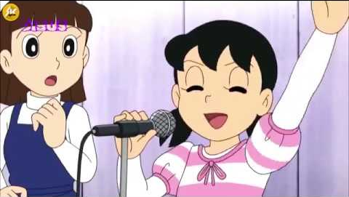
Chant like Shizuka does!

Slide 8
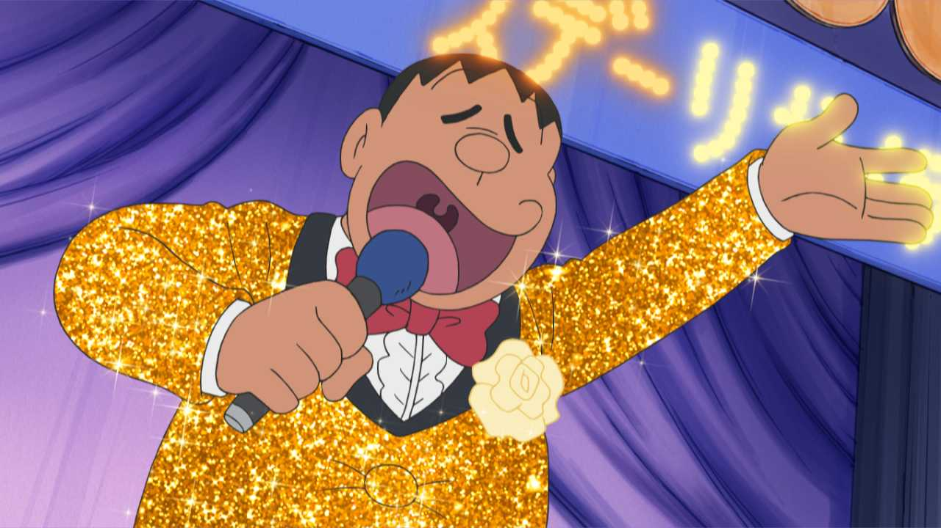
Chant like Jaian does!

Slide 9
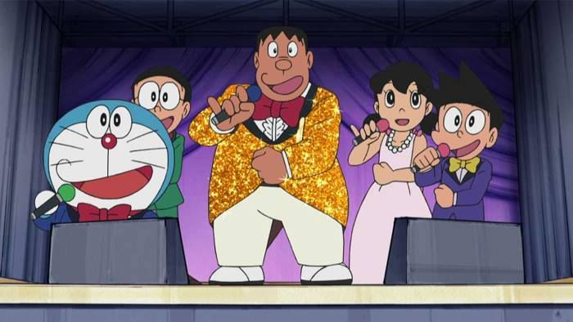
Let’s chant together!

Slide 10

Website: hoclieu.vn
Fanpage: facebook.com/www.tienganhglobalsuccess.vn
Website: sachmem.vn; hoclieu.vn
Fanpage: www.facebook.com/sachmem.vn

