Slide 2





01
Warm-up and Review

Slide 3


02
Activity 3
Read and match.

Slide 4
04
Activity 5
Let’s write.

Slide 5



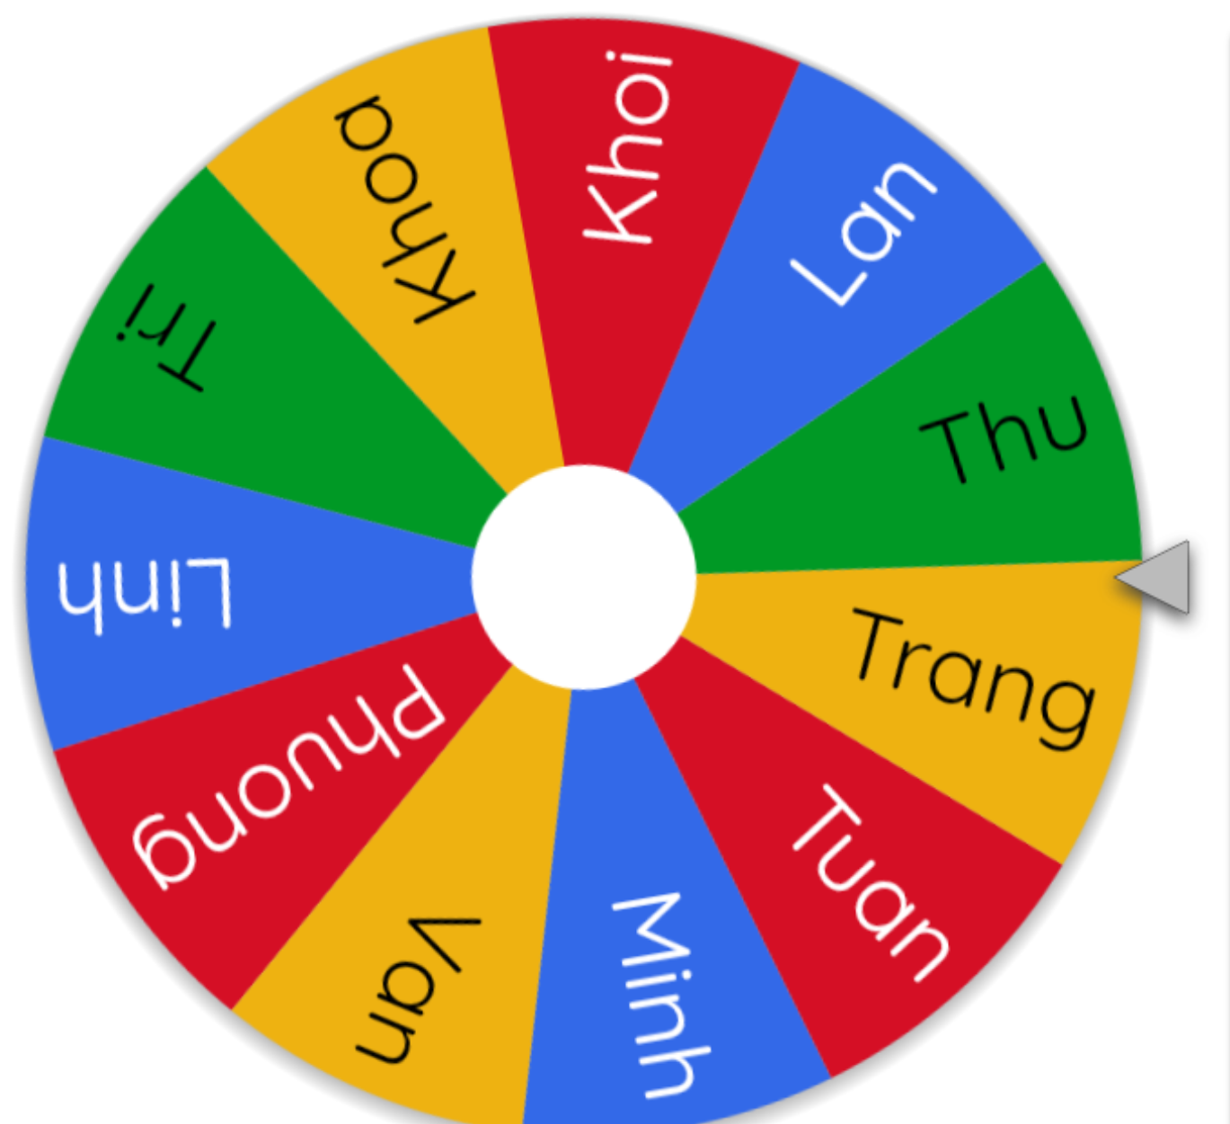
Let’s spin.
Notes:
If time allows, invite a few pupils to read the sentences they have completed / written aloud in front of the class. The class observes and praises their work.
Use this link to play game online: https://wheelofnames.com/

Slide 6
05
Fun corner and Wrap-up

Slide 7









Number Race!
Play

Slide 8










1
BACK TO GAME BOARD
When’s your birthday?
ANSWER
10

Slide 9





4
BACK TO GAME BOARD
I like (surfing the Internet).
30

Slide 10




5
BACK TO GAME BOARD
He/She likes to be (a dentist).
10

Slide 11
5
BACK TO GAME BOARD
Because he/she’d like to …….
20

Slide 12
Category 5
BACK TO GAME BOARD
She/He’d like to be (…………….).
Because she/he’d like to …………
30

Slide 13





6
BACK TO GAME BOARD
He’s (………………….).
10

Slide 14



6
BACK TO GAME BOARD
What’s your mother’s job?
ANSWER
20

Slide 15
6
BACK TO GAME BOARD
She’s (…………………….).
20

Slide 16
6
BACK TO GAME BOARD
What do they like doing
in their free time?
ANSWER
30

Slide 17
6
BACK TO GAME BOARD
My father likes …………………… and my mother likes …………………..
30

Slide 18
Website: hoclieu.vn
Fanpage: https://www.facebook.com/tienganhglobalsuccess.vn/

