Slide 1


My birthday party
4
Lesson 2 – Period 4

Slide 2
03
Activity 5
Look, complete and read.

Slide 3
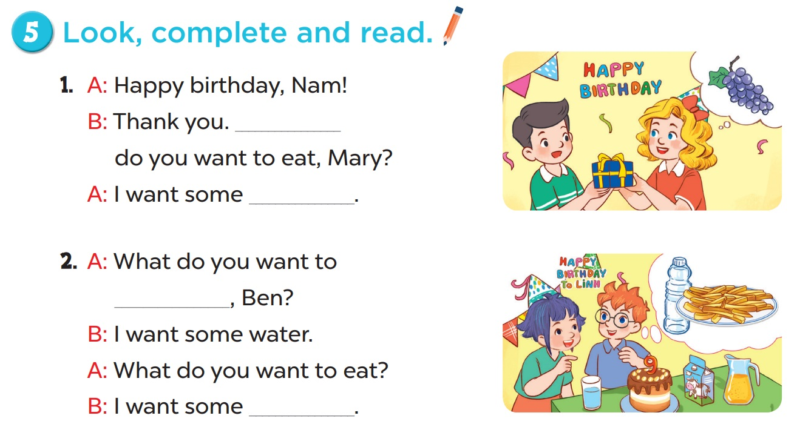

Slide 4
04
Activity 6
Let’s play.

Slide 5
