Slide 1


My birthday party
4
Lesson 3 – Period 5

Slide 2
02
Activity 1
Listen and repeat.

Slide 3
03
Activity 2
Listen and circle.

Slide 4
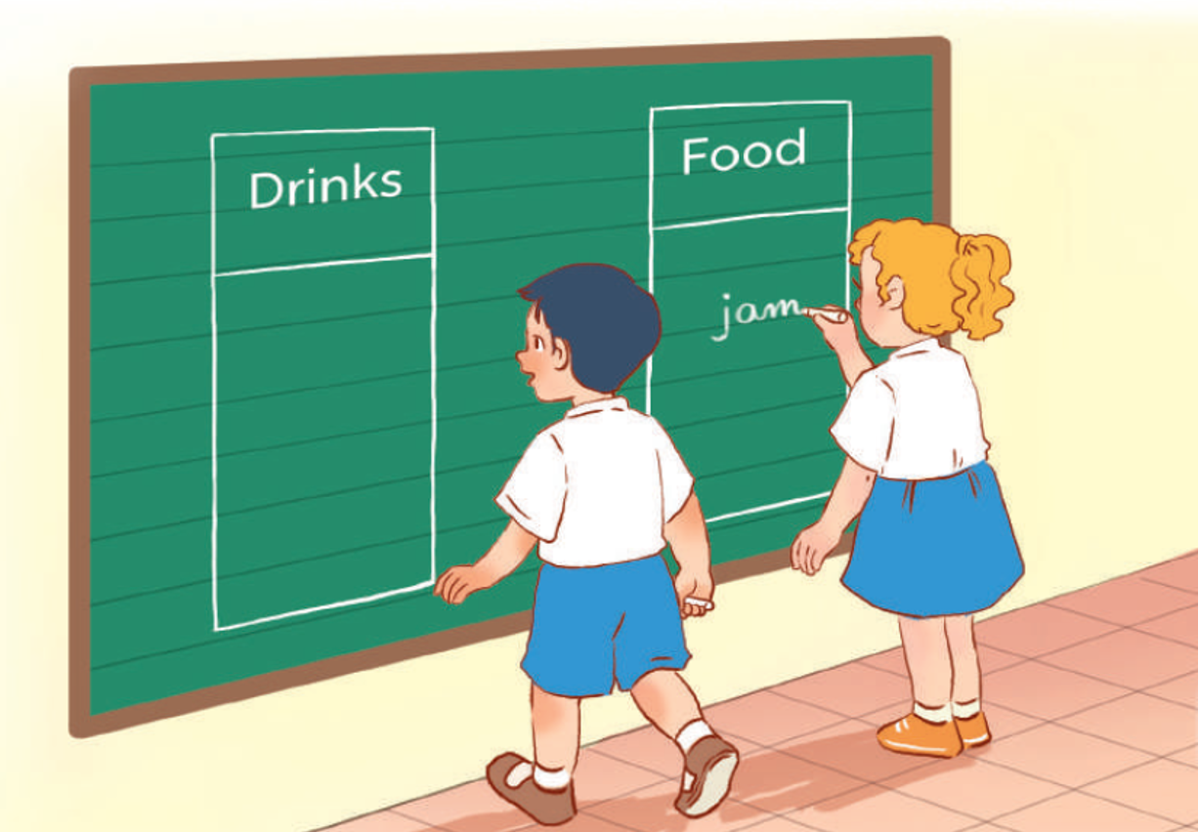
Board Race
w
j

Slide 5
04
Activity 3
Let’s chant.

