Slide 1
01
Warm-up
Let’s chant!

Slide 2
02
Activity 4
Read and circle.

Slide 3
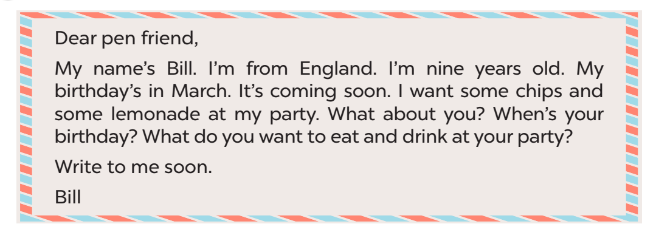
Read.

Slide 4
03
Activity 5
Let’s write.

Slide 5
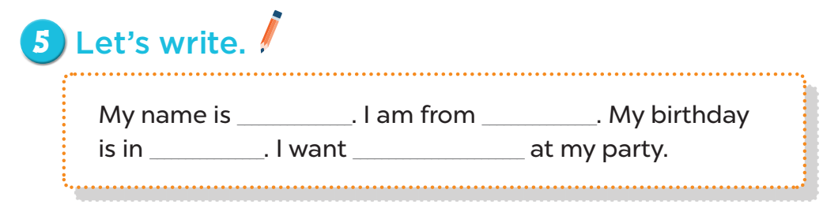

Slide 6
05
Activity 3
Project

Slide 7
