Slide 2









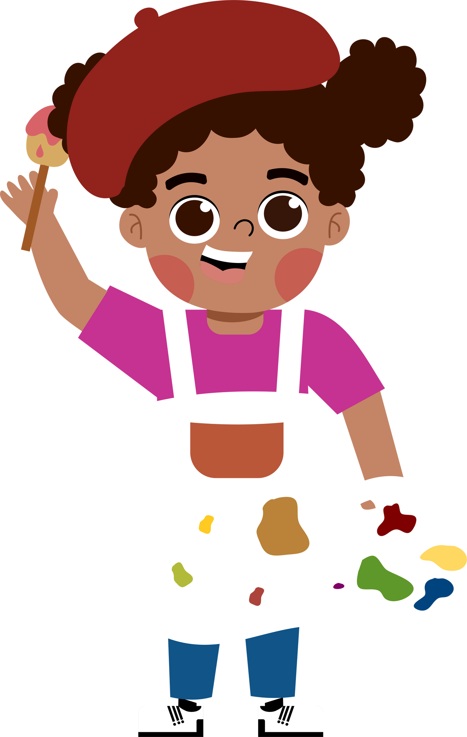








5
My future job

Slide 3







She’s young, she studies at school. Who is she?
pupil
teacher

Slide 4
She works on a farm. Who is she?
policeman
farmer

Slide 5

He can sing very well. Who is he?
actor
singer

Slide 6




02.
Look, listen and repeat.

Slide 7
03.
Listen, point and say.

Slide 8






reporter

Slide 9
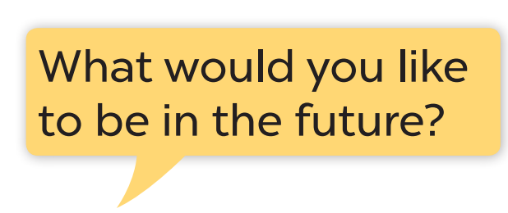



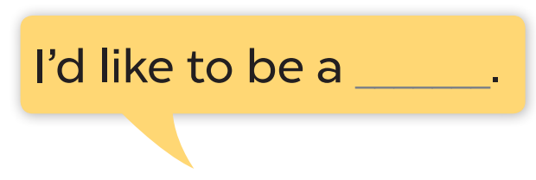

Slide 10
03.
Let’s talk.

Slide 11

QUESTION: Question here
ANSWER: here
writer

Slide 12
Website: hoclieu.vn
Fanpage: https://www.facebook.com/tienganhglobalsuccess.vn/

