Slide 1


















5
My future job
  Lesson 1 - Period 2

Slide 2





TABLE OF CONTENTs
  01. Warm-up and Review
  02. Listen and number.
  03. Read and complete.
  04. Listen, complete and sing.
  05. Fun corner and Wrap-up

Slide 3




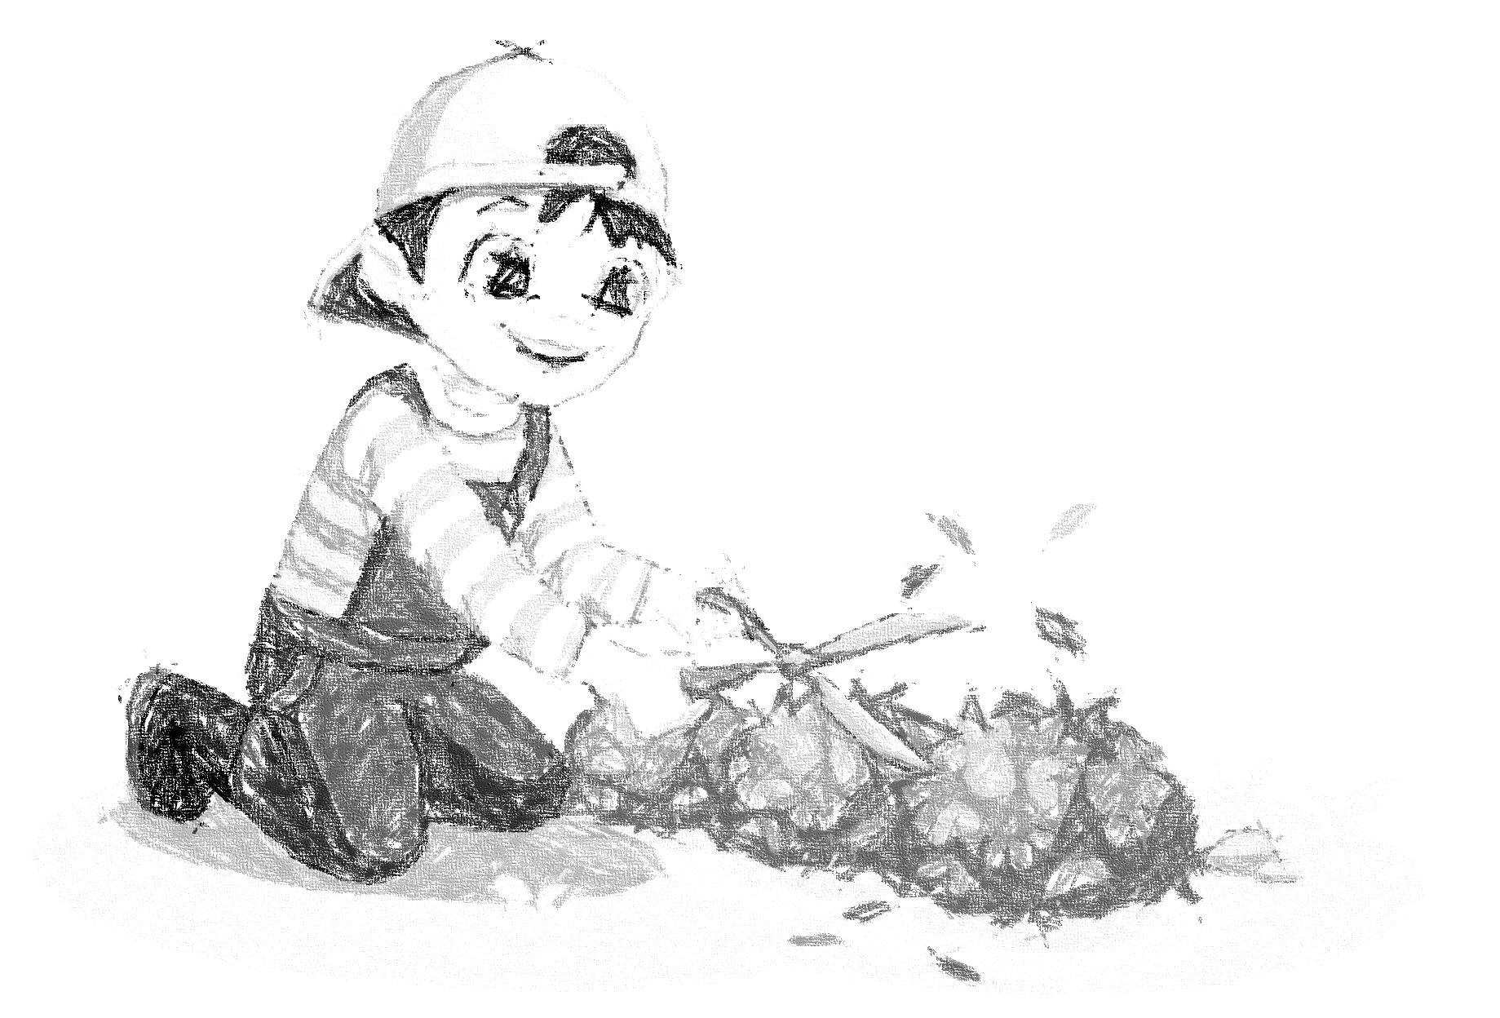

I would like to be a ______.
gardener

Slide 4


I would like to be a ______.
teacher

Slide 5


I would like to be a ______.
reporter

Slide 6


I would like to be a ______.
driver

Slide 7




02.
Listen and number.

Slide 8
04.
Listen, complete and sing.

Slide 9
05.
Fun corner and Wrap-up

Slide 10
Website: hoclieu.vn
Fanpage: https://www.facebook.com/tienganhglobalsuccess.vn/

