Slide 2









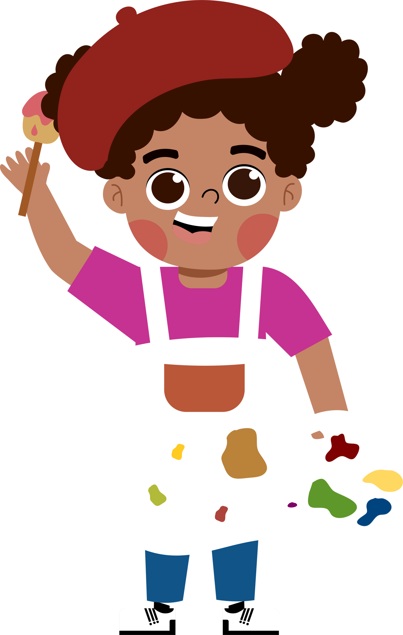
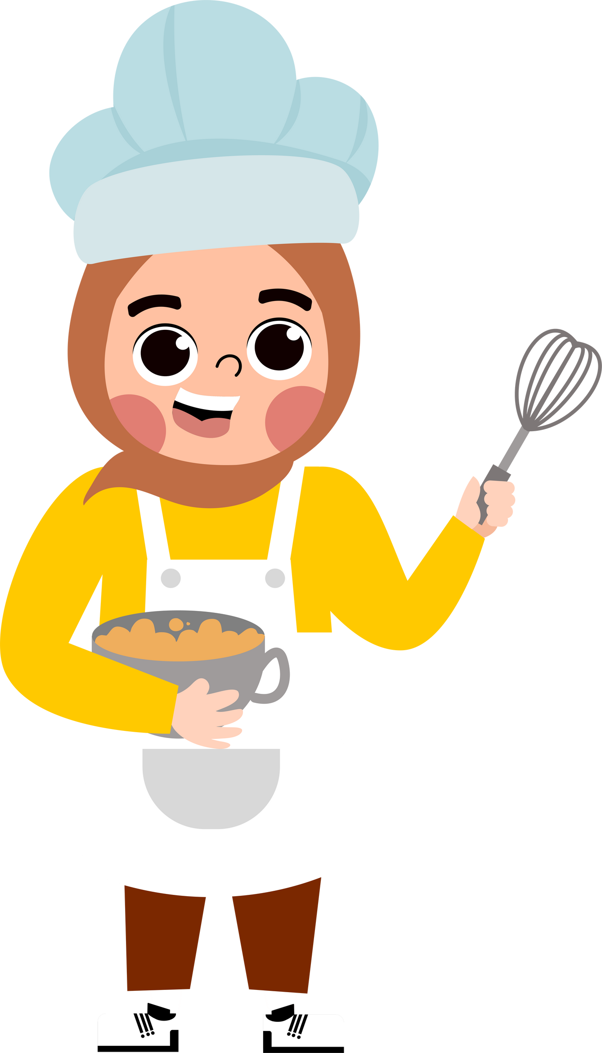


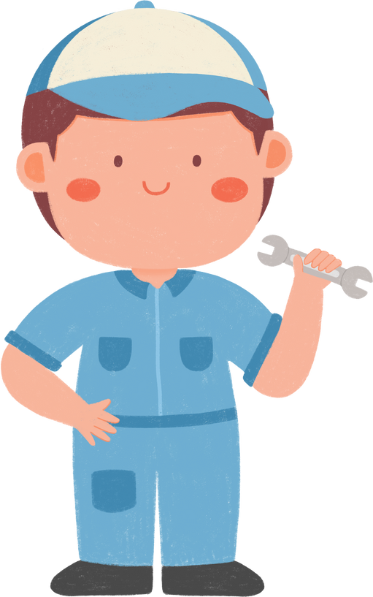




5
My future job
Lesson 2 - Period 3
Lesson 2 - Period 3

Slide 3




01.
Warm-up
and Review

Slide 4




Guessing game

Slide 5


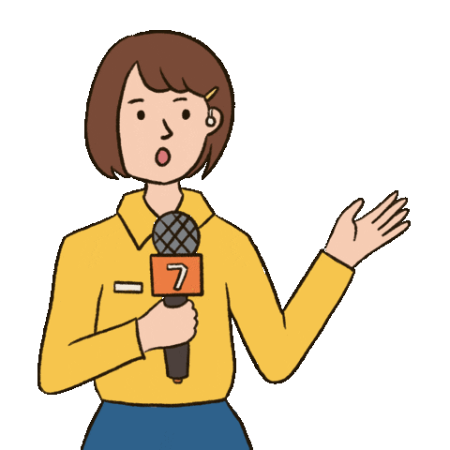

You can see her on TV or on the radio. She reports the news.
e
_ e p _ _ t _ r
r
o
r

Slide 6
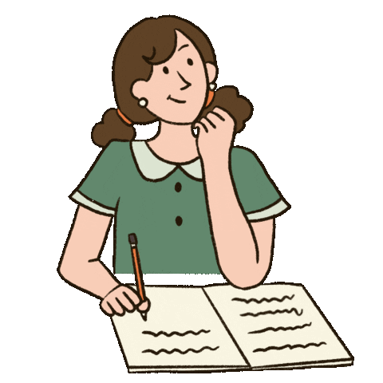
She loves reading stories and
writing new stories.
w
_ r _ _ e r
i
t

Slide 7

He helps sick people.
He works in the hospital.
d
c
_ o _ t o _
r

Slide 8

He works in the restaurant.
He loves cooking.
c
o
k
_ _ o _

Slide 9
02.
Look, listen and repeat.

Slide 10
03.
Listen, point and say.

Slide 11
New words

Slide 12
04.
Let’s talk.

Slide 13



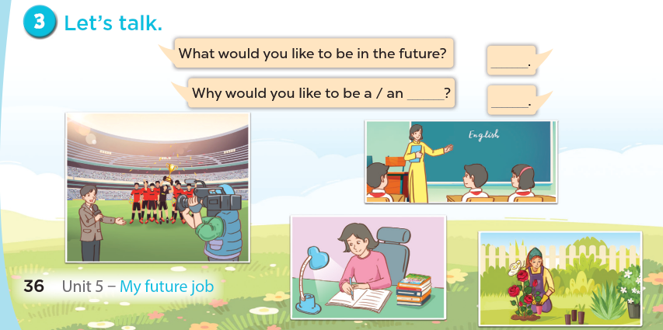


Slide 14
05.
Fun corner and Wrap-up

Slide 15
Look and say.

Slide 16

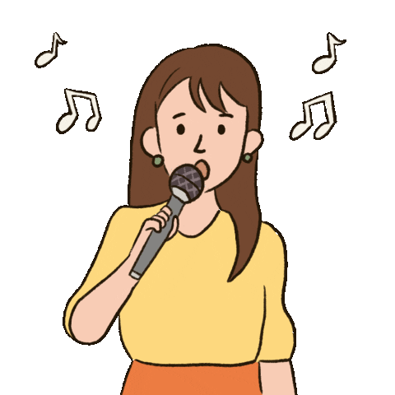

Why would you like to be a singer?
- Because I like to ....................
sing
A. help people
B. write stories
C. sing

Slide 17
Website: hoclieu.vn
Fanpage: https://www.facebook.com/tienganhglobalsuccess.vn/

