Slide 2









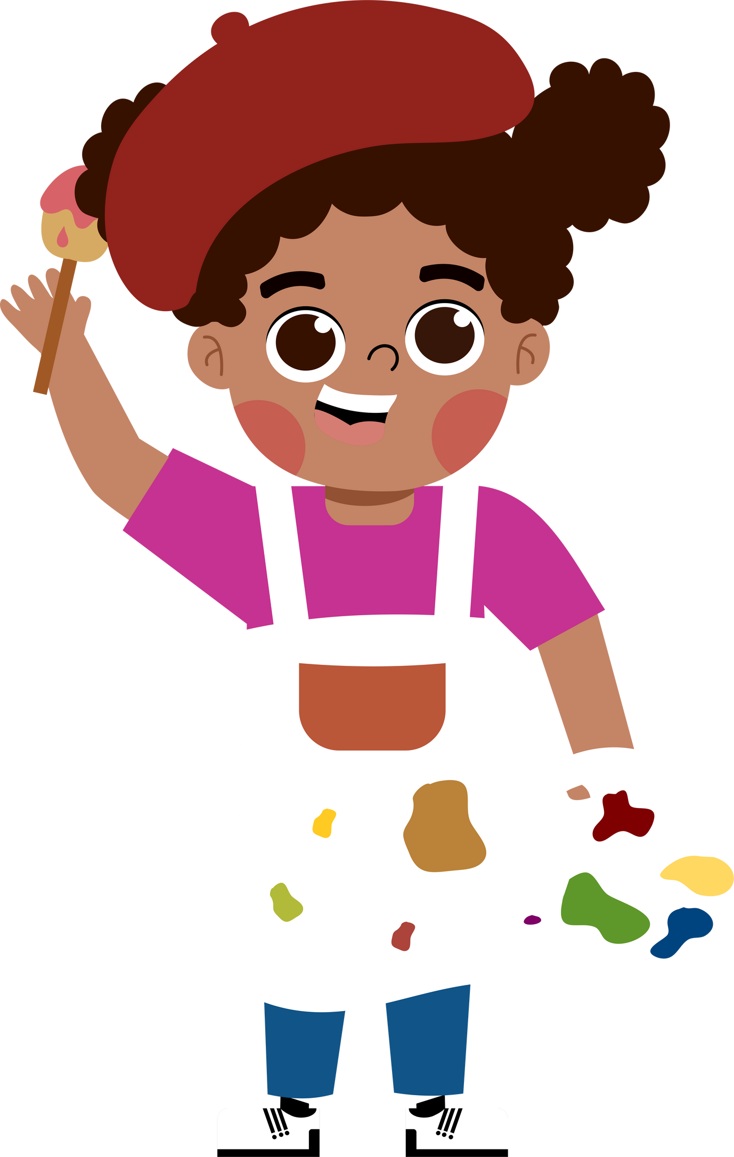
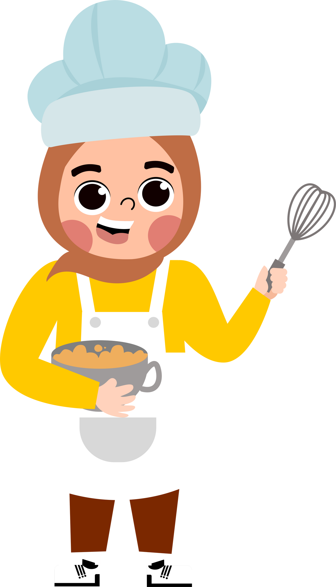


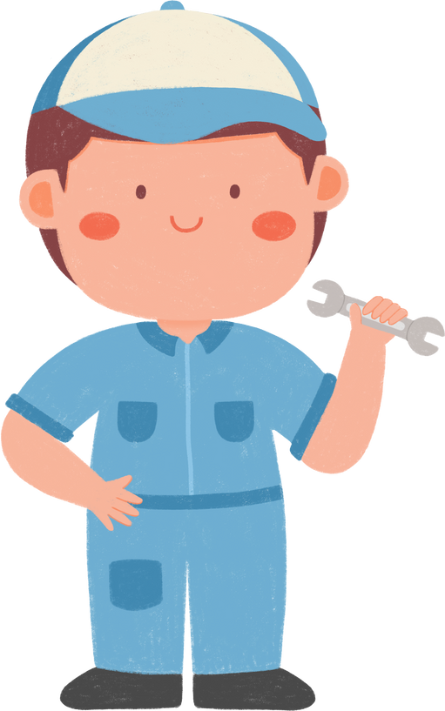




5
My future job
  Lesson 2 - Period 4

Slide 3





TABLE OF CONTENTs
  01. Warm-up and Review
  02. Listen and tick.
  03. Read and complete.
  04. Let’s play.
  05. Fun corner and Wrap-up

Slide 4




01.
Warm-up
and Review

Slide 5











Slide 6






Why would you like to be a teacher?
Because I’d like to …………………………………….
teach children
report the news

Slide 7

Why would you like to be a writer?
Because I’d like to …………………………………….
help sick people
write stories

Slide 8

Why would you like to be a gardener?
Because I’d like to …………………………………….
grow flowers
put out fire

Slide 9

Why would you like to be a doctor?
Because I’d like to …………………………………….
help sick people
grow flowers

Slide 10
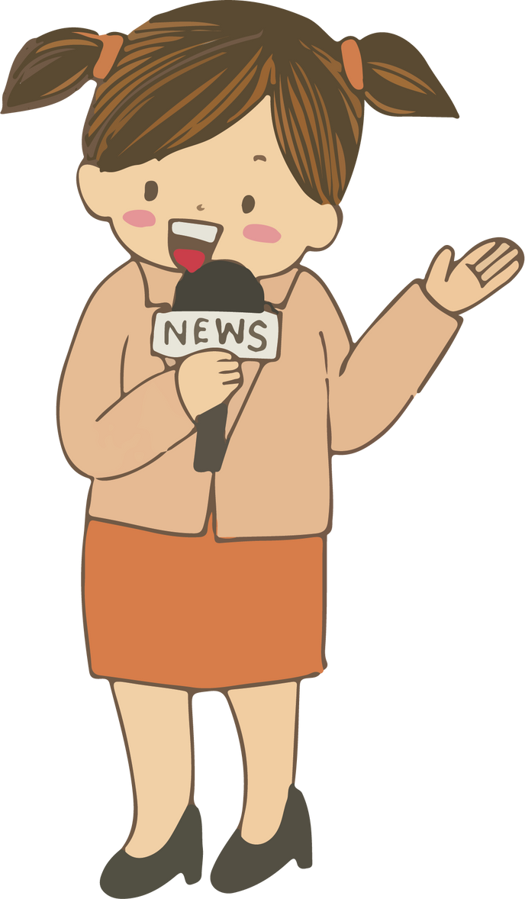
Why would you like to be a reporter?
Because I’d like to …………………………………….
write stories
report the news

Slide 11
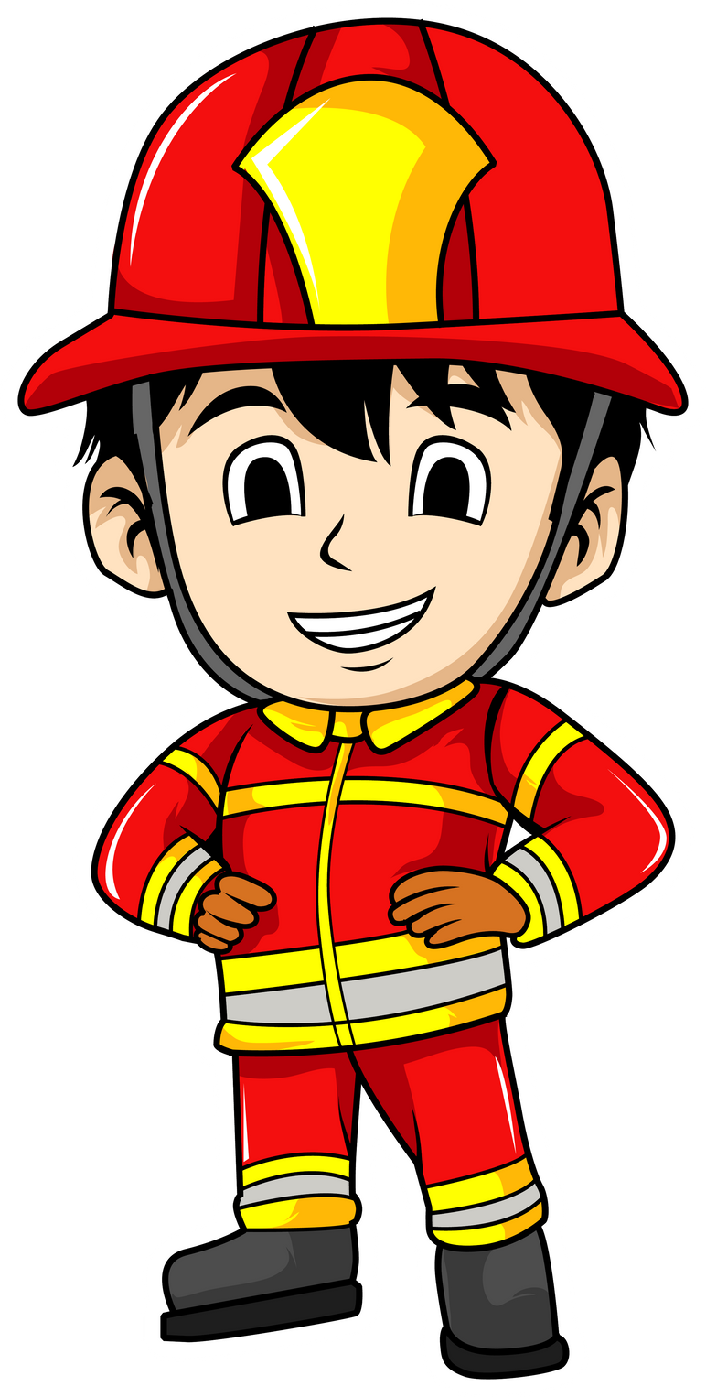
Why would you like to be a firefighter?
Because I’d like to …………………………………….
teach children
put out fire

Slide 12
02.
Listen and tick.

Slide 13
03.
Read and complete.

Slide 14
04.
Let’s play.

Slide 15
05.
Fun corner and Wrap-up

Slide 16
I’d like to put out the fire.
doctor
firefighter
reporter
writer
teacher
gardener

Slide 17
Website: hoclieu.vn
Fanpage: https://www.facebook.com/tienganhglobalsuccess.vn/

