Slide 2









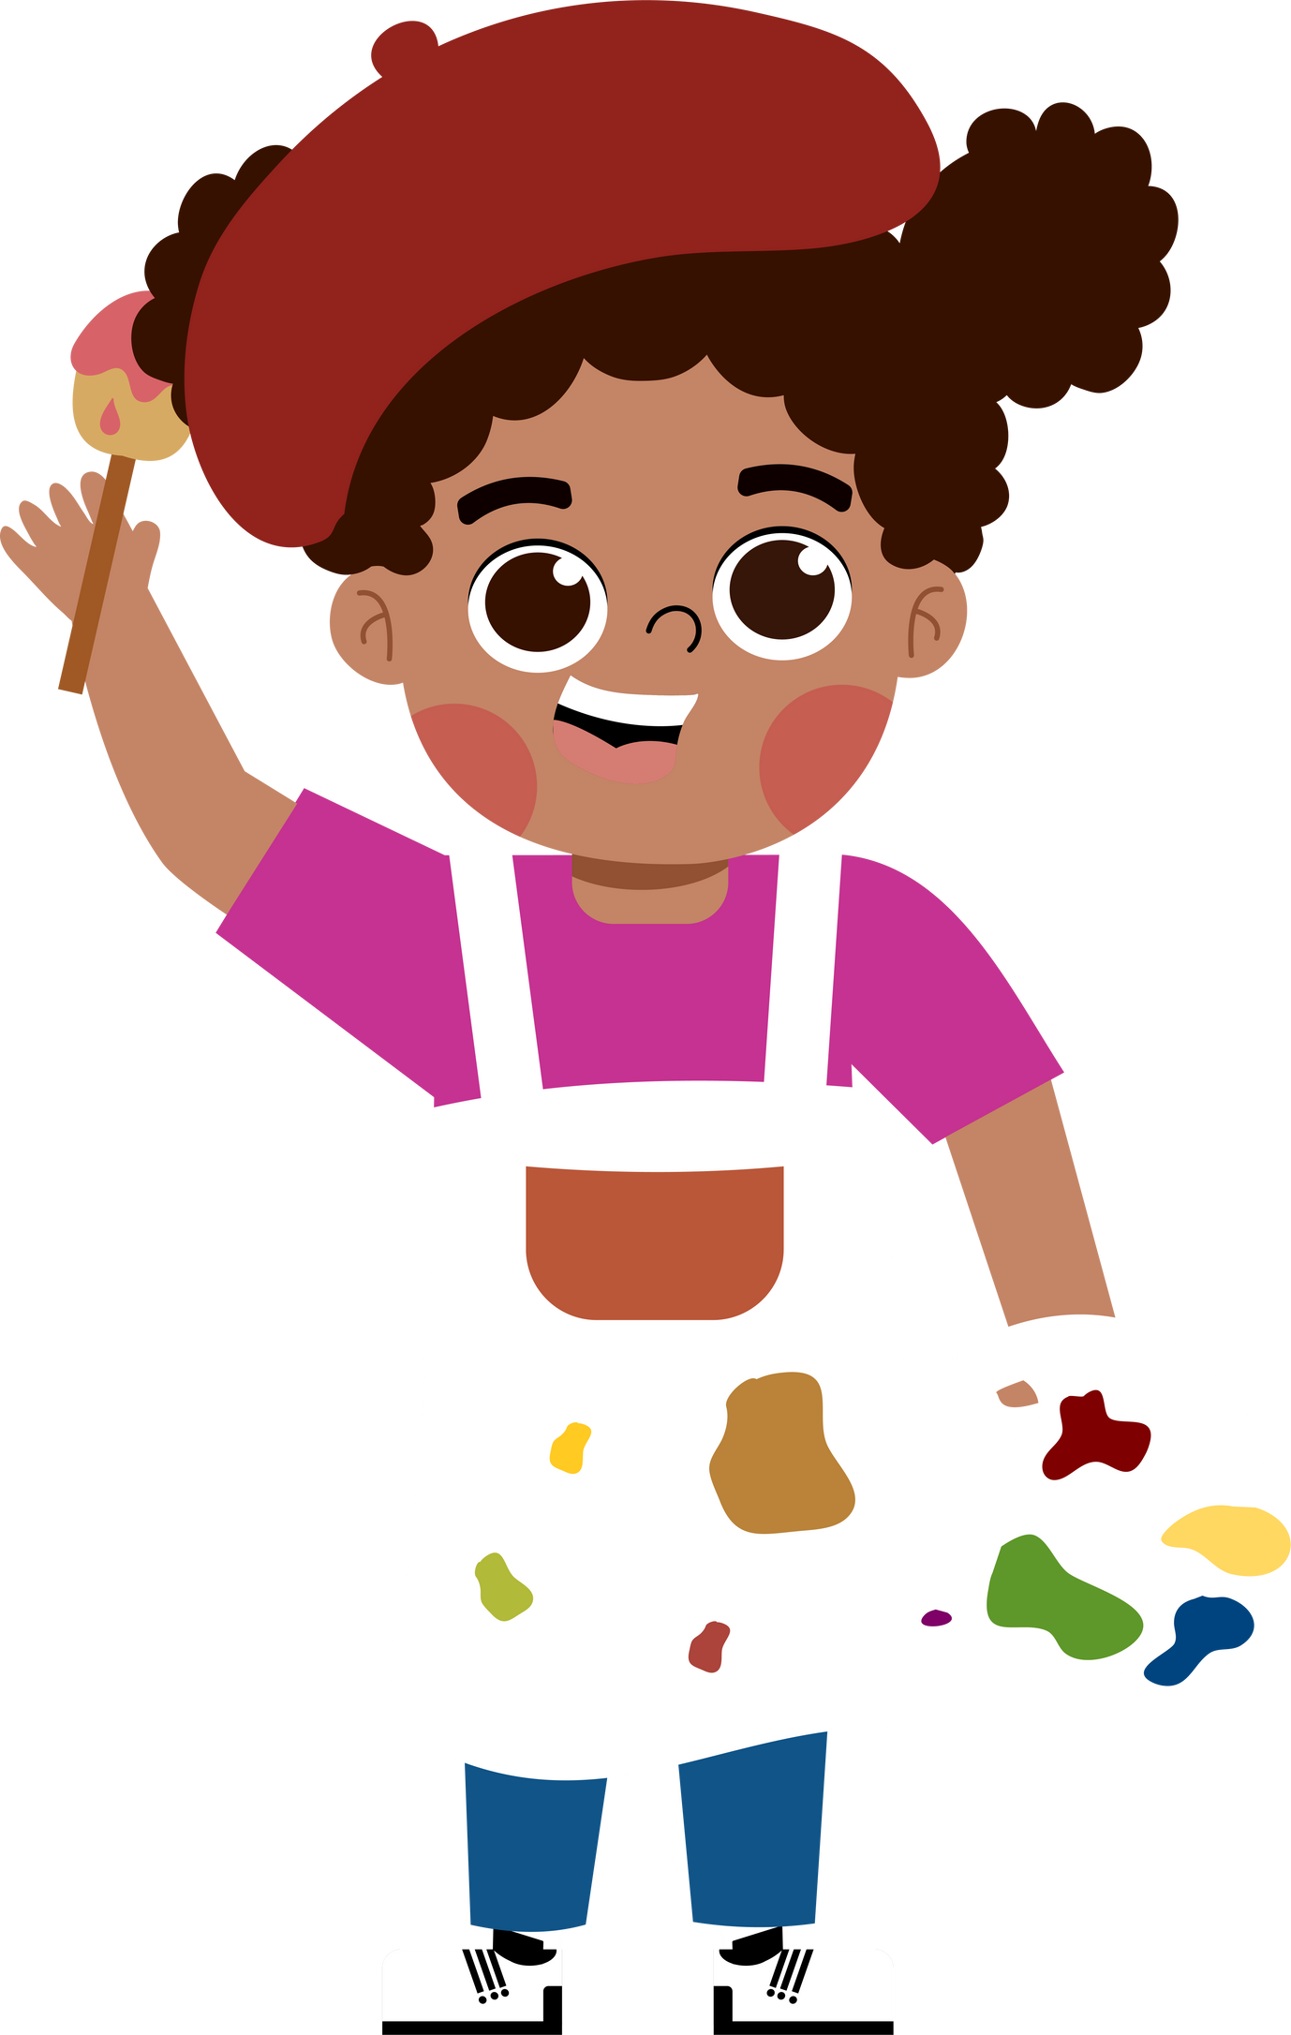








5
My future job
Lesson 3 - Period 5

Slide 3





TABLE OF CONTENTs
01. Warm-up and Review
02. Listen and repeat.
03. Circle, listen and check.
04. Let's chant.
05. Fun corner and Wrap-up

Slide 4




01.
Warm-up and Review
Unscramble the letters.

Slide 5




More jobs
Guess the job.

Slide 6

artist

Slide 7

farmer

Slide 8

dentist

Slide 9

actor

Slide 10

pilot

Slide 11
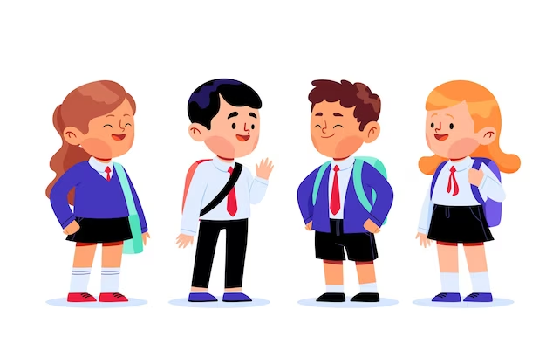
student

Slide 12




NOUNS
How many syllables?
artist
teacher
writer
gardener
pilot
dentist
actor
firefighter
doctor
student
farmer
reporter

Slide 13
02.
Listen and repeat.

Slide 14
03.
Circle, listen and check.

Slide 15
04.
Let's chant!

Slide 16
05.
Fun corner and Wrap-up

Slide 17


Let's chant like a robot!

Slide 18
Website: hoclieu.vn
Fanpage: https://www.facebook.com/tienganhglobalsuccess.vn/

