Slide 1



Things we can do
5
LESSON 1 PERIOD 1

Slide 2
01
Warm-up

Slide 3

New words

Slide 4
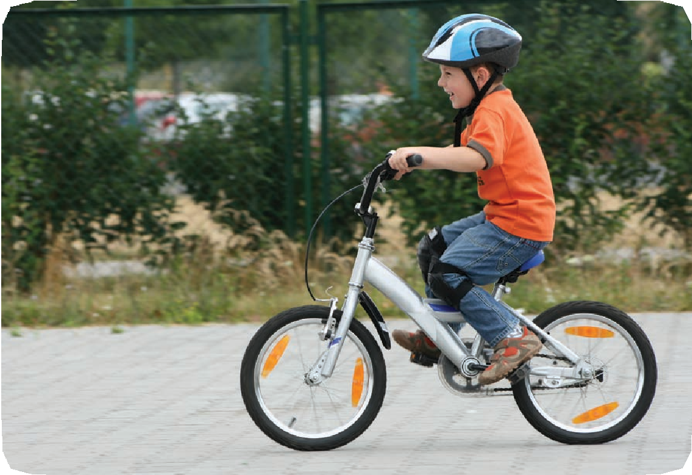
ride a bike

Slide 5
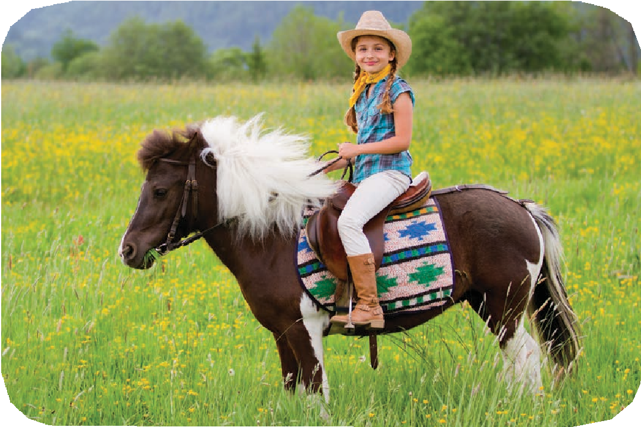
ride a horse

Slide 6
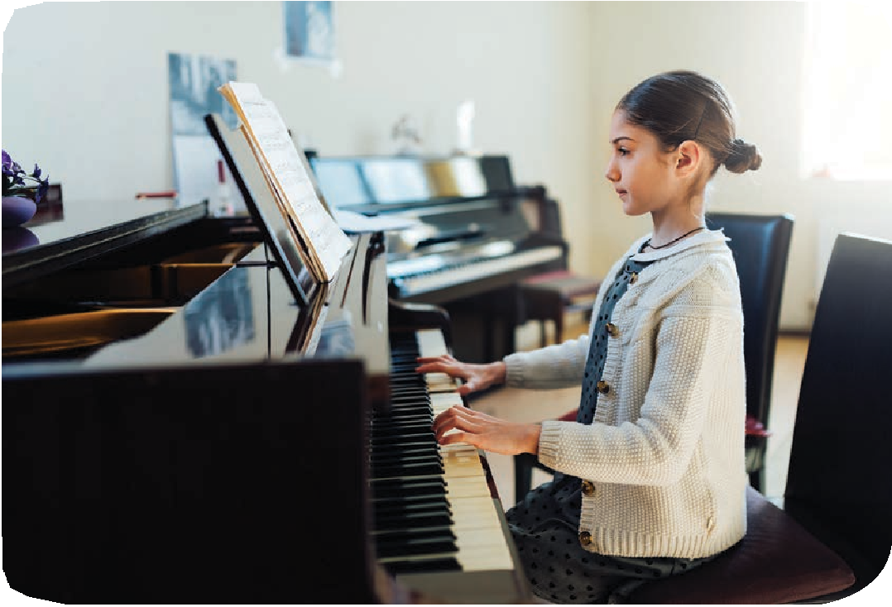
play the piano

Slide 7
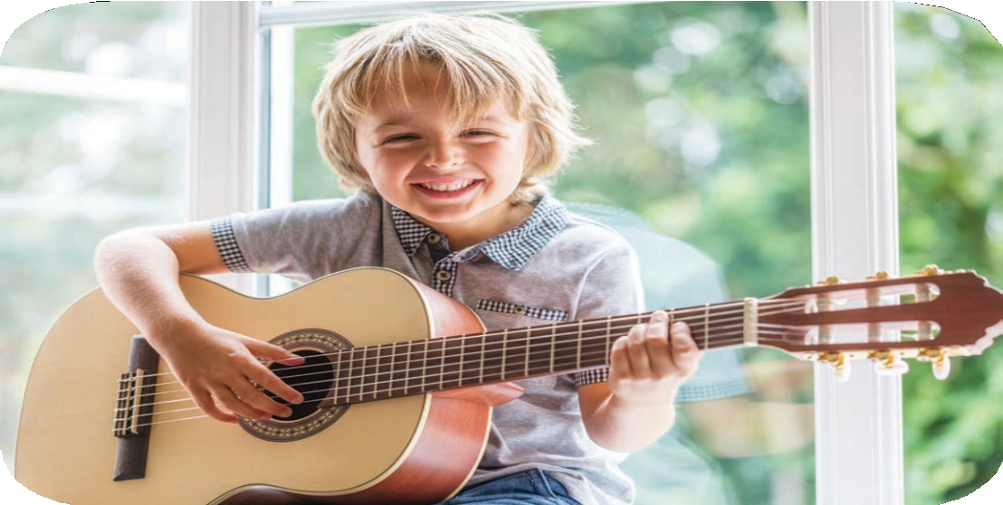
play the guitar

Slide 8
03
Activity 1
Look, listen and repeat.

Slide 9
04
Activity 2
Listen, point and say.

Slide 10
05
Activity 3
Let’s talk.

Slide 11
