Slide 1



Things we can do
5
LESSON 2 PERIOD 4

Slide 2


03
Activity 4
Listen and tick or cross.

Slide 3
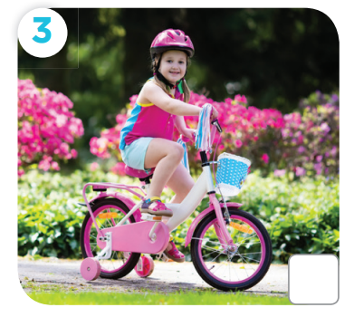
Can she ride a bike?

Slide 4
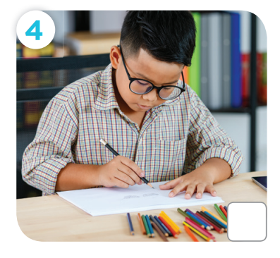
Can he draw a picture?

Slide 5
05
Activity 6
Let’s sing.

Slide 6
06
Fun corner

