Slide 2

Our school Rooms
Lesson 1 - Period 2

Slide 3



02
Listen and tick or cross.

Slide 4

03
Read and complete.

Slide 5



04
Let’s sing.

Slide 6
05
Fun corner & Wrap-up

Slide 7
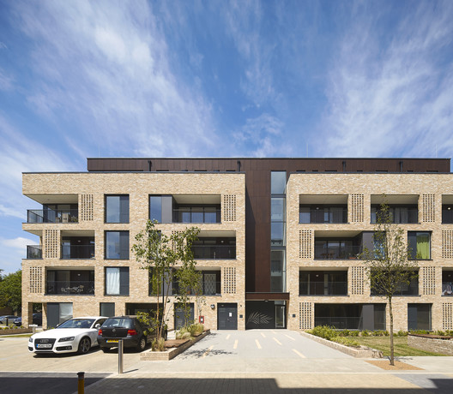


Where’s the music room?
It’s on the ____________
third floor.
It’s on the
third floor.
MUSIC ROOM

Slide 8
Website: hoclieu.vn
Fanpage: https://www.facebook.com/tienganhglobalsuccess.vn/

