Slide 2

Our school rooms
Lesson 2 - Period 3

Slide 3


01
Warm-up & Review

Slide 4



02
Look, listen and repeat.

Slide 5
03
Listen, point and say.

Slide 6

Listen and repeat.

Slide 7
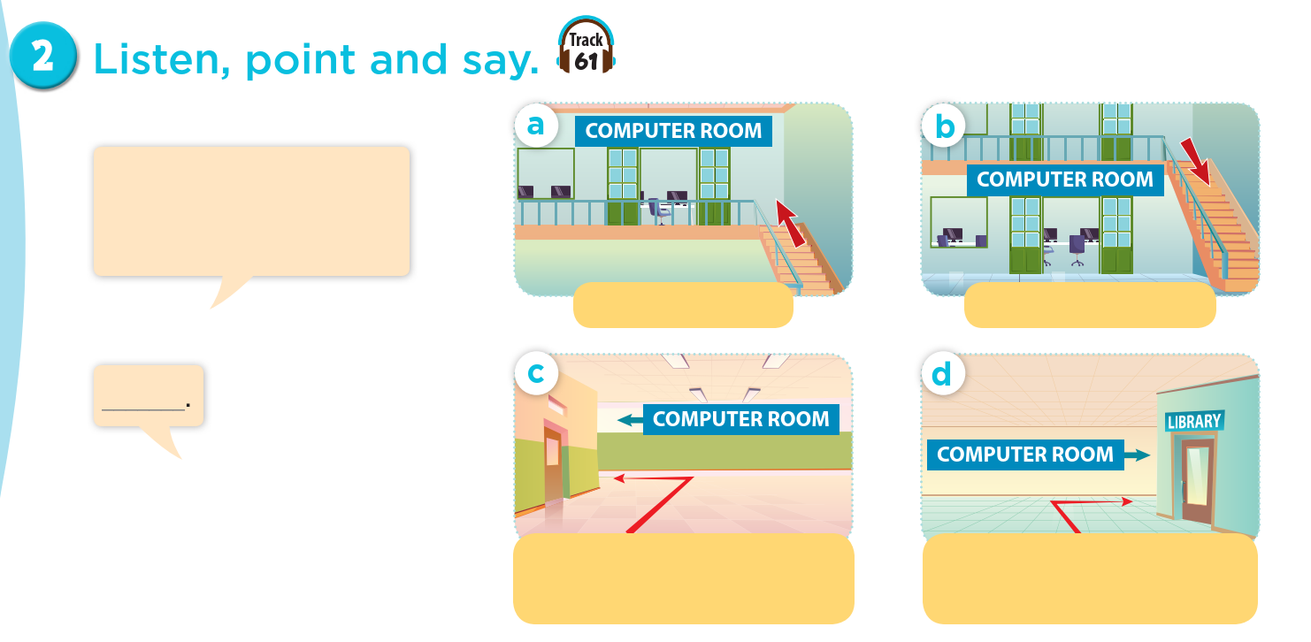
Act it out.
Could you tell me the way to the computer room, please?
go upstairs
go downstairs
go along the corridor and turn left
go past the library and turn right

Slide 8
04
Let’s talk.

Slide 9
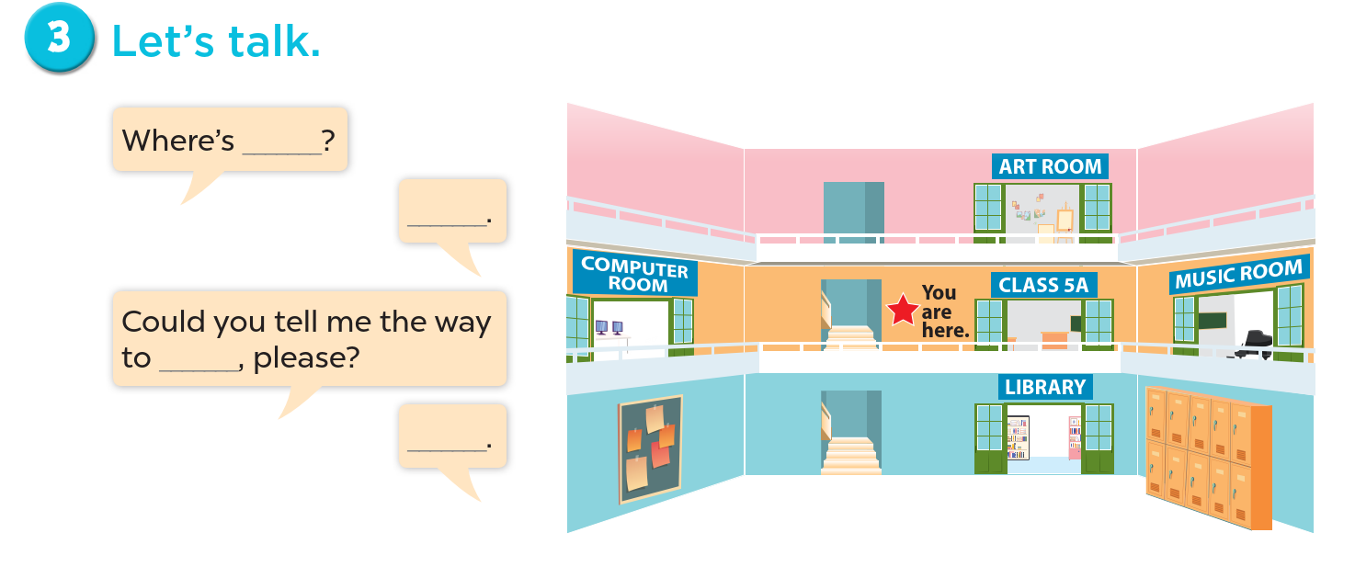

Slide 10
05
Fun corner & Wrap-up

Slide 11
Madagasca Game

Slide 12



Pick a crate!

Slide 13



Steal 3 points.

Slide 14






4 points

Slide 15
Website: hoclieu.vn
Fanpage: https://www.facebook.com/tienganhglobalsuccess.vn/

