Slide 2

Our school rooms
Lesson 3 - Period 6

Slide 3
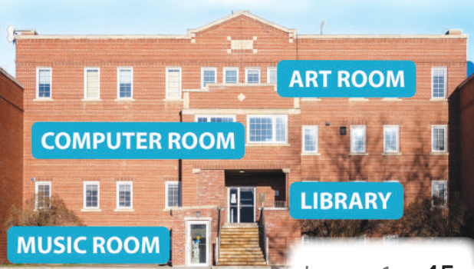




Where's the library?
It's on the first floor.

Slide 4
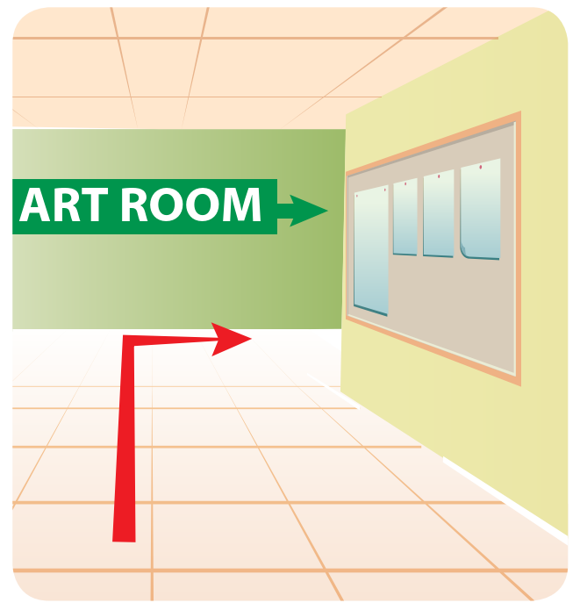
Could you tell me the way to the art room, please?
Go along the corridor and turn right.

Slide 5
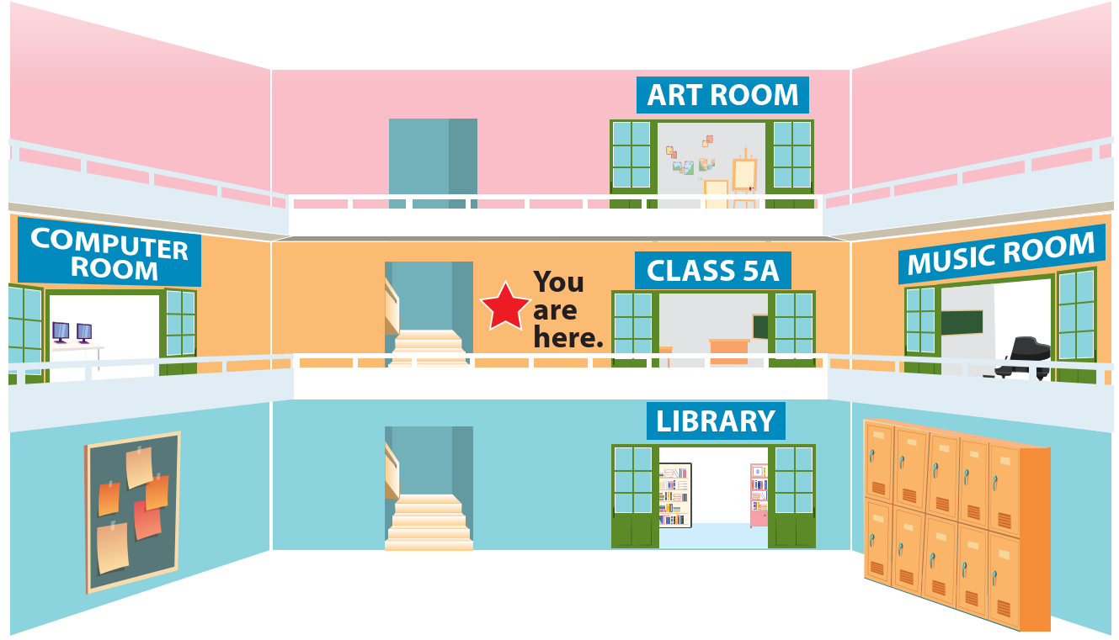
I'm going ________ to the art room.
upstairs

Slide 6


02
Read and tick True or False.

Slide 7
03
Let's write.

Slide 8
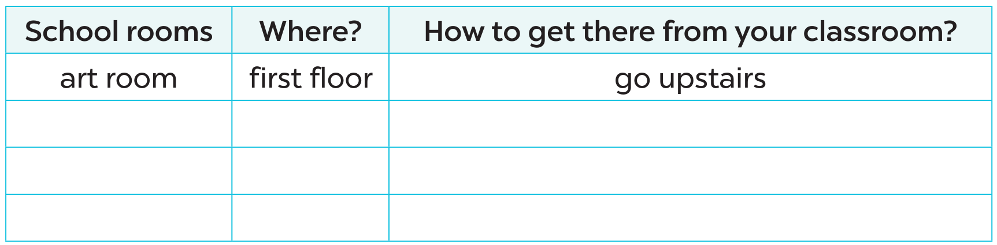
Let's write.

Slide 9
04
Project

Slide 10

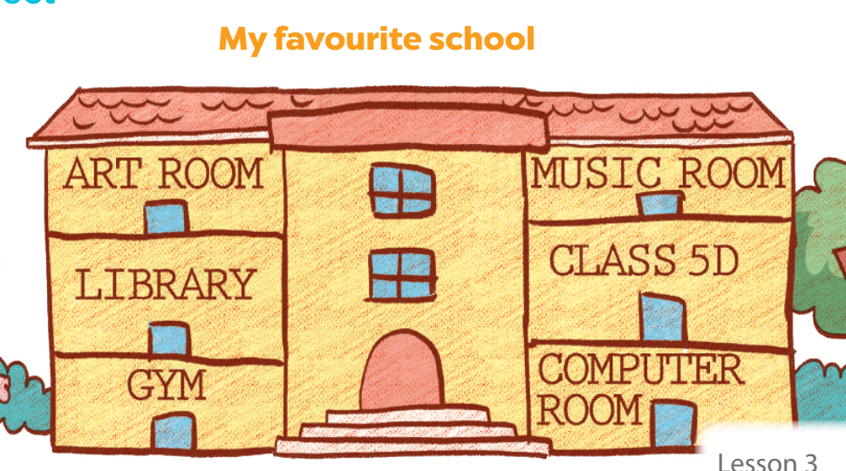
05
Fun corner & Wrap-up

Slide 11
Website: hoclieu.vn
Fanpage: https://www.facebook.com/tienganhglobalsuccess.vn/

