Slide 2


Our favourite
school activities
Lesson 1 - Period 2

Slide 3


01
Warm-up
& Review

Slide 4
Lucky
number

Slide 5
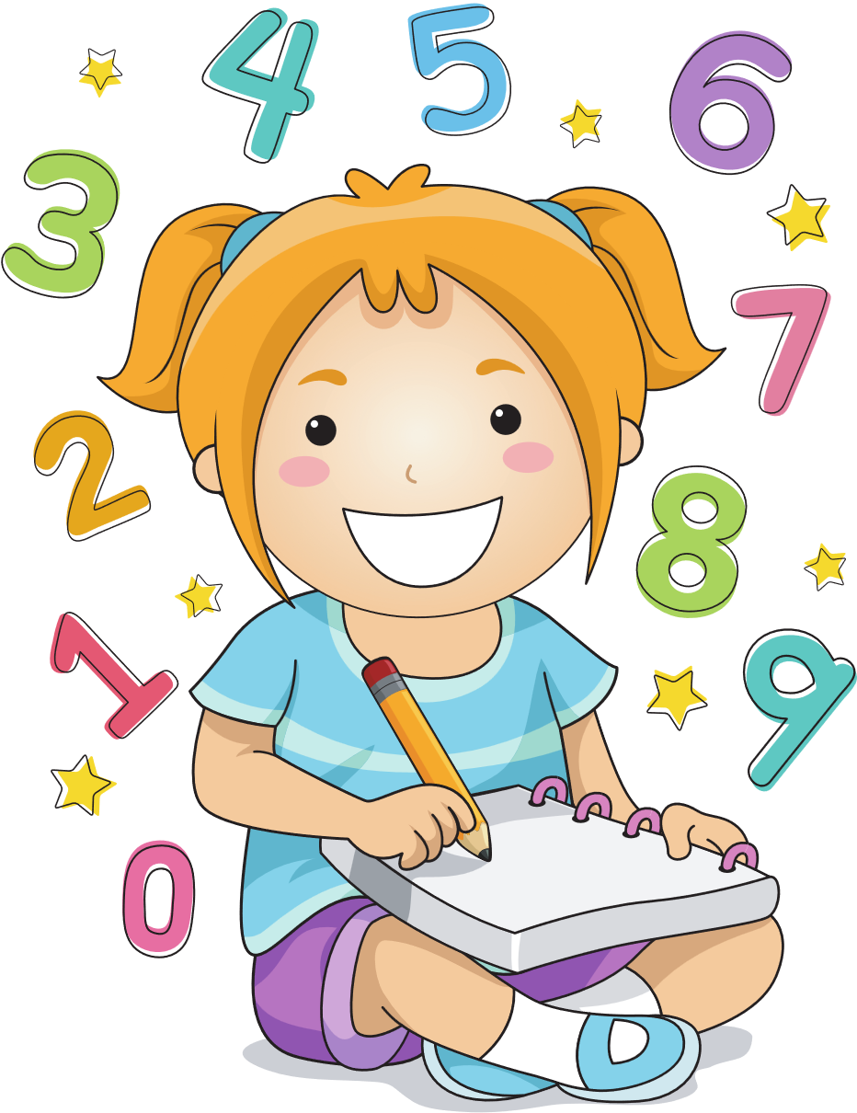

What school activities does she like?
5
She likes solving maths problems.

Slide 6
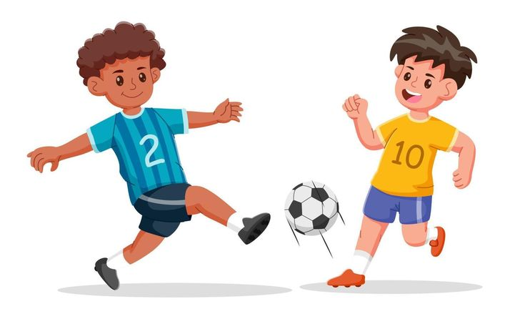
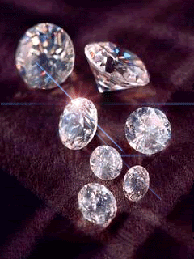
What school activities do they like?
6
They like playing football.

Slide 7
02
Listen
and number.

Slide 8
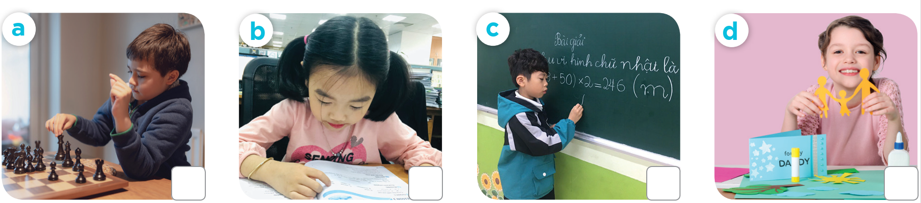
What school activities does he / she like?
“
”

Slide 9
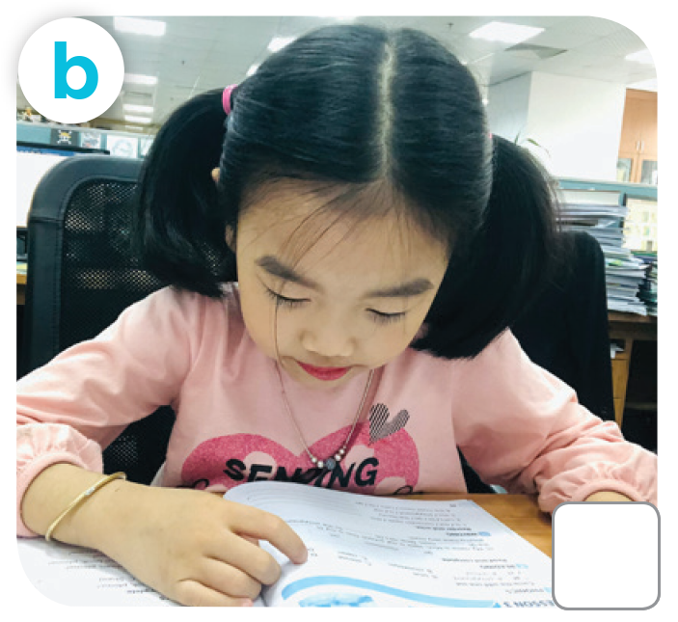
What school activities does she like?
“
”

Slide 10
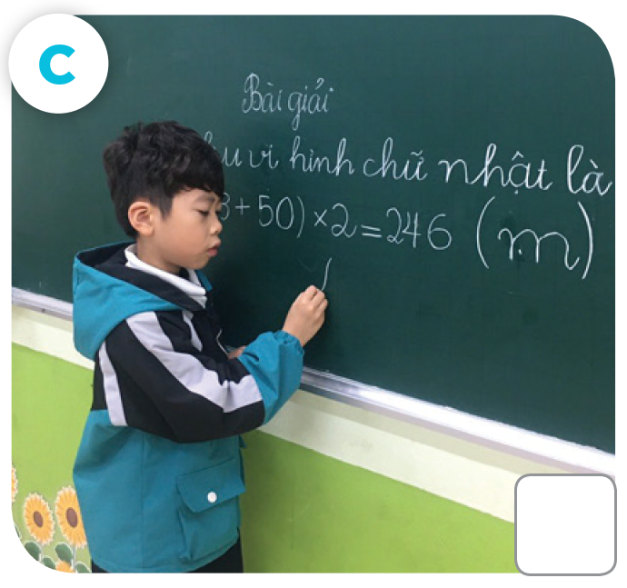
What school activities does he like?
”

Slide 11
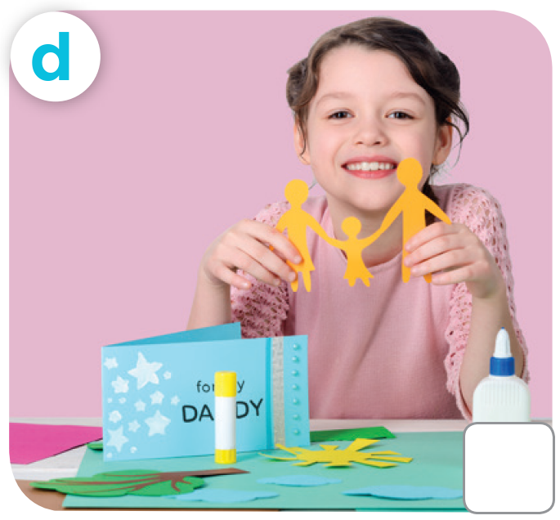
What school activities does she like?
”

Slide 12
03
Read and
complete.

Slide 13

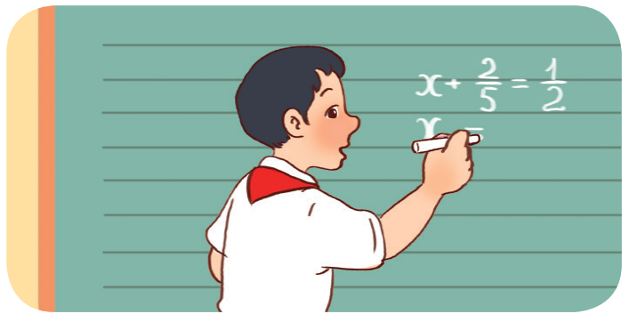
3. A: What’s he doing?
B: He’s _______________________. It’s his favourite school activity.
solving a maths problem

Slide 14
Listen,
complete
and sing.
04

Slide 15
05
Fun corner & Wrap-up

Slide 16
Website: hoclieu.vn
Fanpage: https://www.facebook.com/tienganhglobalsuccess.vn/

