Slide 2


Our favourite
school activities
Lesson 2 - Period 3

Slide 3

Table of contents
01
Warm-up & Review
02
Look, listen and repeat.
Listen, point and say.
03
04
Let’s talk.
05
Fun corner & Wrap-up

Slide 4


01
Warm-up
& Review

Slide 5

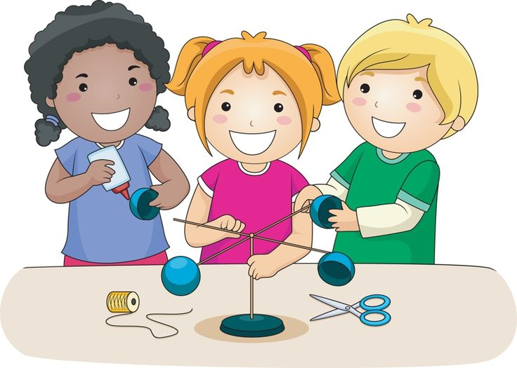
do projects

Slide 6
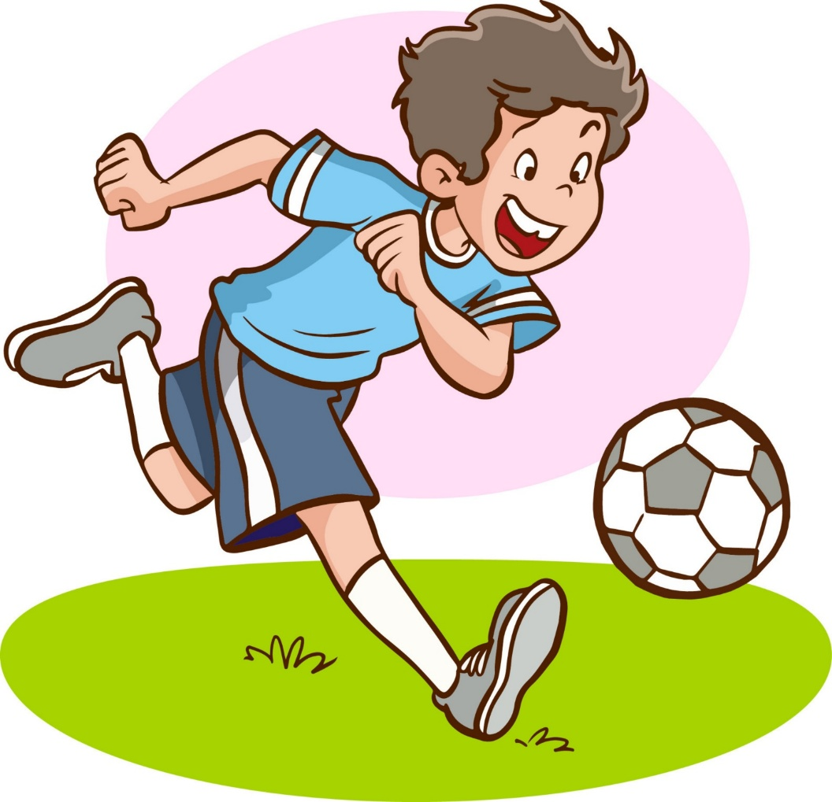
play football

Slide 7

read books

Slide 8
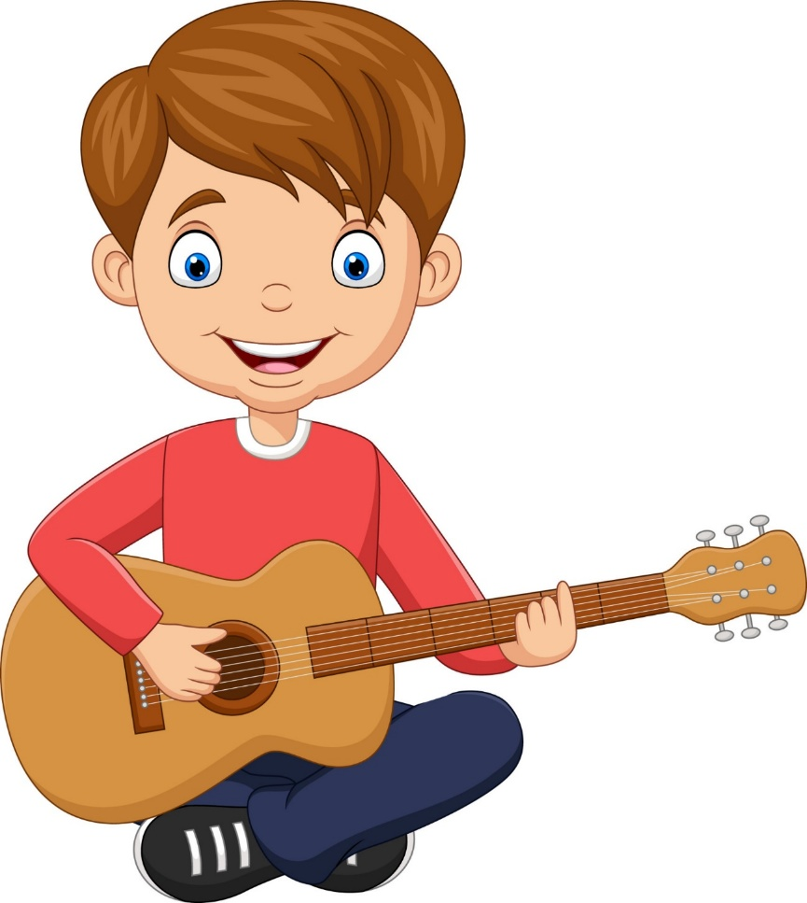
play the guitar

Slide 9
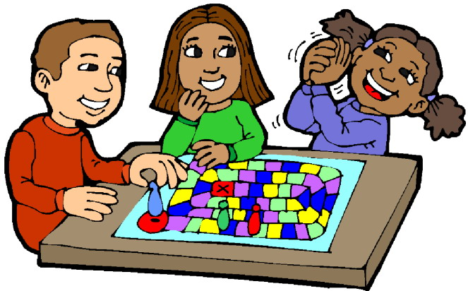
play games

Slide 10
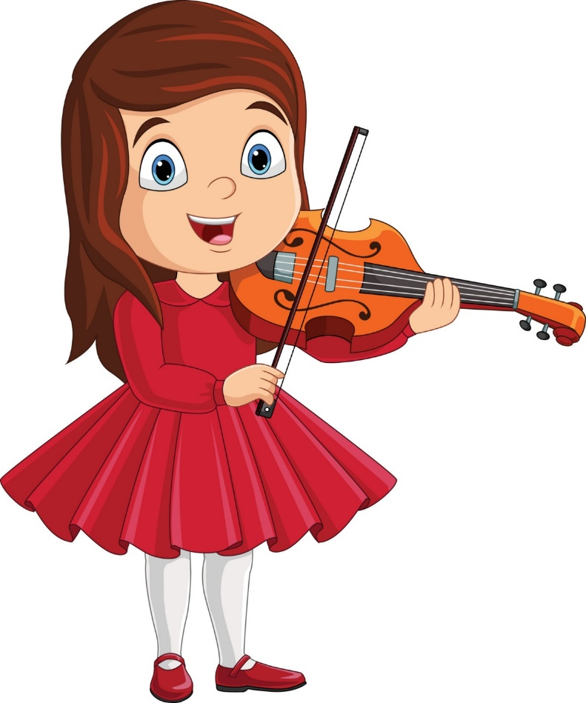
play the violin

Slide 11
02
Look, listen
and repeat.

Slide 12
Why does he like
solving maths problems?
Because he thinks it’s useful.

Slide 13
03
Listen, point
and say.

Slide 14
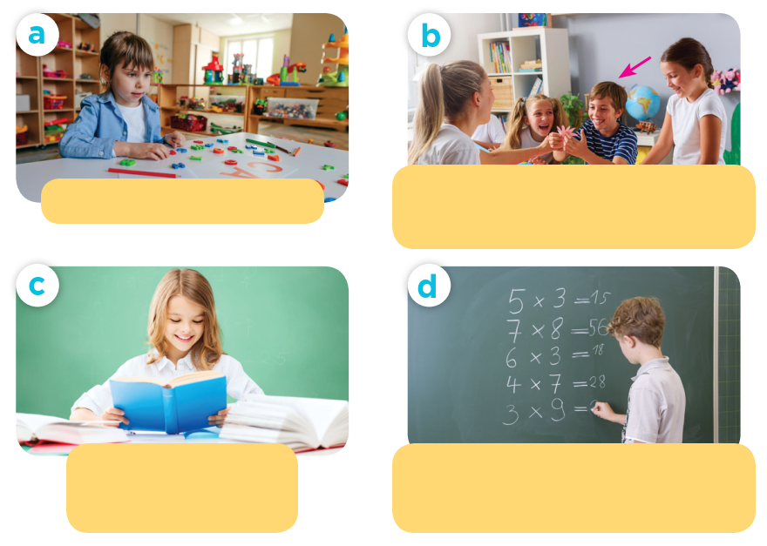
Look and guess.

Slide 15

useful
This tools are useful.

Slide 16

interesting
This book is interesting.

Slide 17
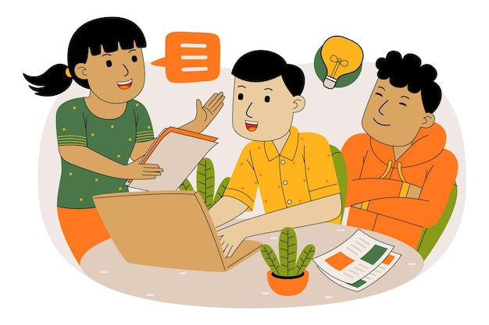
good for group work
Doing projects is good for group work.

Slide 18
04
Let’s talk.

Slide 19

Why does he / she like _______?
Because he / she thinks ______.

Slide 20
05
Fun corner & Wrap-up

Slide 21
Website: hoclieu.vn
Fanpage: https://www.facebook.com/tienganhglobalsuccess.vn/

