Slide 2
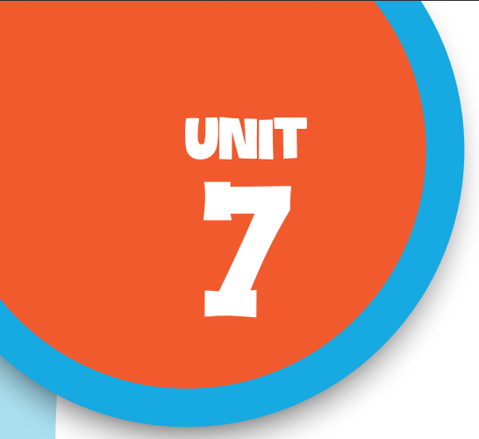

Our favourite school activities
Lesson 2 - Period 4

Slide 3

Table of contents
01
Warm-up and Review
02
Listen and tick.
03
Read and complete.
04
Let’s play.
05
Fun corner & Wrap-up

Slide 4


01
Warm-up and Review

Slide 5

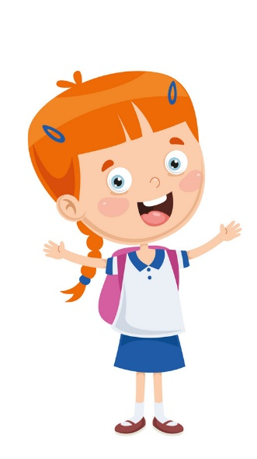


Why does she like reading books?
Because she thinks …

Slide 6
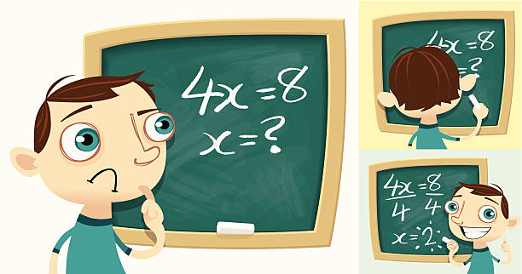
Why does he like solving maths problems?
Because he thinks …

Slide 7
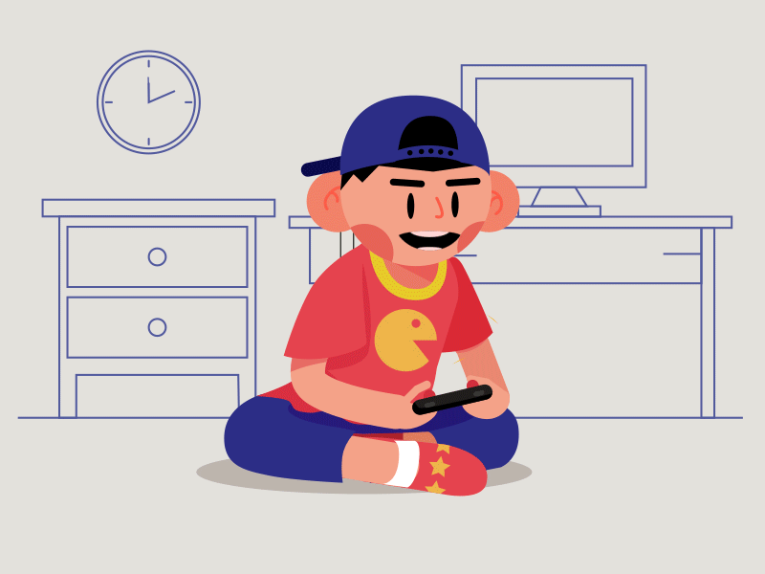
Why does he like playing games?
Because he thinks …

Slide 8
02
Listen
and tick.

Slide 9
03
Read and
complete.

Slide 10
04
Let’s play.

Slide 11
05
Fun corner & Wrap-up
Lucky number

Slide 12
Website: hoclieu.vn
Fanpage: https://www.facebook.com/tienganhglobalsuccess.vn/

